Slide 1



COST ACTION:EU-MACE
EU Materials Acceleration Center for Energy
&
EERA JP-AMPEA
Sawako Nakamae (Action Chair, JP-coordinator)
SPEC/IRAMIS/CEA-Saclay
CA22123 (Nov 1, 2023 – Oct. 31, 2027)

Slide 2
COST Action is …
EU funding instrument for networking activities to develop new initiatives to strengthen EU’s capacity to address STS challenges: Spread excellence,
Foster interdisciplinary research, Empower and retain young researchers
4 yrs& 500 K€
Actions funded:
Meetings/Workshops/Conferences
Short term scientific missions (not research)
Training (schools & similar actions)
Communication (include OA publication)
Conference attendances
Virtual tools
No research. No salary
Funding period & average fund
37%
50K
Success-rate on followup proposals
energy experts
Notes:
Our strength comes from our Europe-wide network of public research centres and universities. Together they represent the most outstanding research and innovation (R&I) players in the continent.
Thanks to them, we are the largest and most influential low carbon energy research community.
Catalysing European energy research for a climate-neutral society by 2050".

Slide 3

Research Coordination and Networking for Innovation
EERA is …
The largest low-carbon energy research community in Europe bringing together leading research institutes to expand and optimise EU energy research capabilities.
A membership-based, non-profit association.
Advisor to the European Union's Strategic Energy Technology (SET) Plan.
250+
30+
50K
public research centres and universities
countries
energy experts
50K
energy experts
Notes:
Our strength comes from our Europe-wide network of public research centres and universities. Together they represent the most outstanding research and innovation (R&I) players in the continent.
Thanks to them, we are the largest and most influential low carbon energy research community.
Catalysing European energy research for a climate-neutral society by 2050".

Slide 4
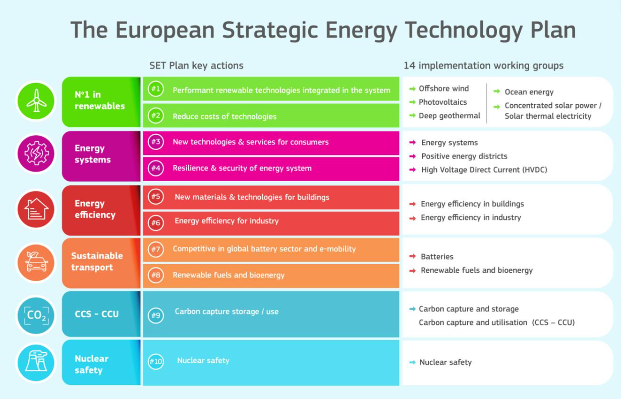
IWG
European Technology and Innovation Platforms (ETIPs)
European Energy Research Alliance (EERA)
Ad hoc members
Notes:
We support the Clean Energy Transition by catalysing European energy research and providing world-leading scientific expertise on …. Joint Programmes are permanent structures that allow EERA members working on defined R&I topics to collaborate.
Their work helps streamline and structure European research in the field of clean energy and align national priorities, thereby supporting the EU in reaching its climate goals.
Their topics and activities Joint Programmes are permanent structures that allow EERA members working on defined R&I topics to collaborate.
Their work helps streamline and structure European research in the field of clean energy and align national priorities, thereby supporting the EU in reaching its climate goals.
Created in 2011 as…
Transversal joint programme connecting all joint programmes

Slide 5
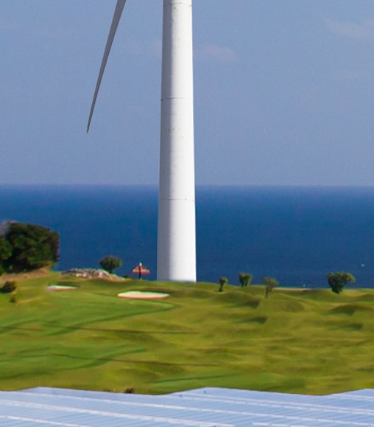















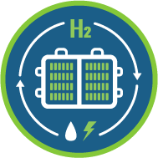




3 thematic categories, 18 Joint Programmes in line with the priorities of the SET Plan
LOW- CARBON TECHNOLOGIES
MATERIALS
SYSTEMIC
TOPICS
AMPEA
E3S
DfE
AMPEA: Advanced Materials and Processes for Energy Applications
Notes:
We support the Clean Energy Transition by catalysing European energy research and providing world-leading scientific expertise on …. Joint Programmes are permanent structures that allow EERA members working on defined R&I topics to collaborate.
Their work helps streamline and structure European research in the field of clean energy and align national priorities, thereby supporting the EU in reaching its climate goals.
Their topics and activities Joint Programmes are permanent structures that allow EERA members working on defined R&I topics to collaborate.
Their work helps streamline and structure European research in the field of clean energy and align national priorities, thereby supporting the EU in reaching its climate goals.
Created in 2011 as…
Transversal joint programme connecting all joint programmes

Slide 6


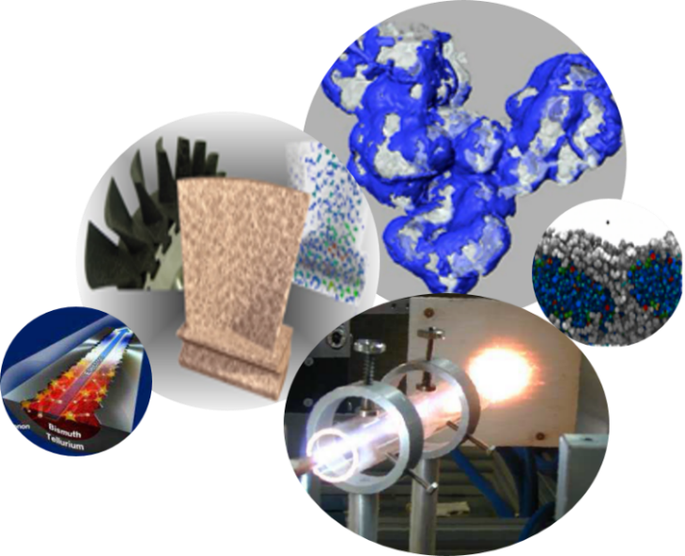
AMPEA Joint programme: 29 institutes from 13 countries
From materials discovery and multiscale modeling to devices:
  Rational designs and ‘Nature’ guided designs of new materials
  Hierachical materials and Exascale modeling
  Large scale synthesis
  Digital-twin ….
Applications:
  Bioenergy
  Carbon capture and storage
  Concentrated Solar Power
  Energy Storage
  Fuel cells and hydrogen
  Photovoltaic
  Artificial photosynthesis
  Waste-heat recovery ….
Characterization and testing:
  Advanced experimental techniques
  Large-scale facilities
  Extreme conditions
  In situ and operando techniques
  High-throughput ….
Sustainability:
  Supply Chain & Resource Efficiency
  Life Cycle Analysis
  Sustainable and Safe by Design manufacturing
Coordinate and promote multidisciplinary joint research in basic materials science and processes for energy (TRL 1 → 4) for mastering future & emerging energy technologies, and improve established ones through innovation uptake.
Notes:
New materials: bulk, for coating …
For hierachical = nano and micro, and from mesoscopic materials properties to devices and processes)

Slide 7
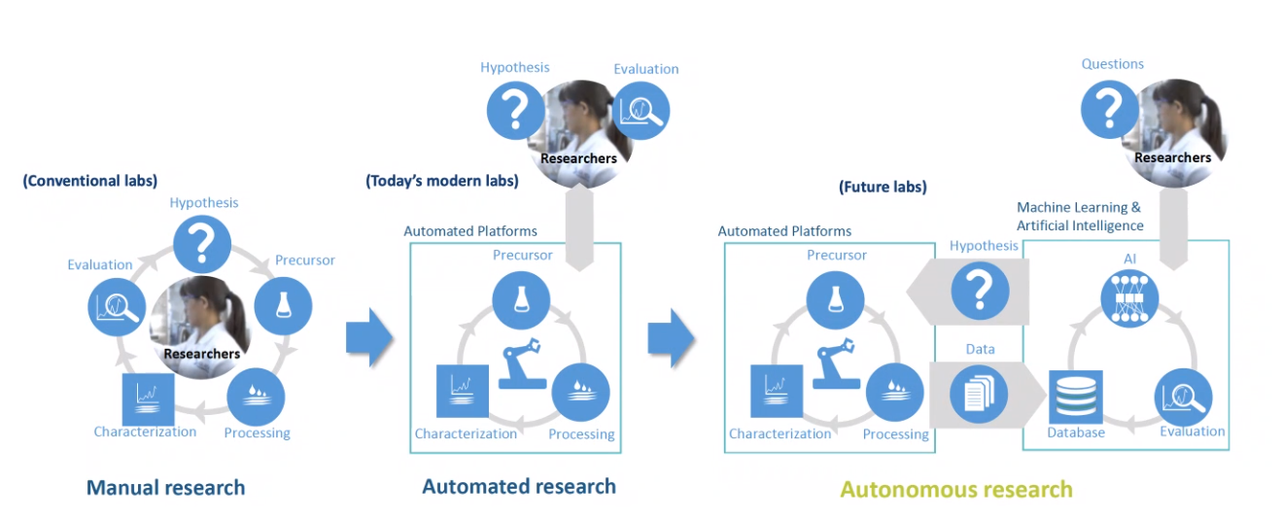

+
Focus on: Materials Acceleration Platform (MAP)
AMPEA
Digitalisation for Energy
Nuclear Materials
Eco, Env & Soc Impacts
Only 2% of materials R&D make it to commercialization
Courtesy of
AMPEA

Slide 8
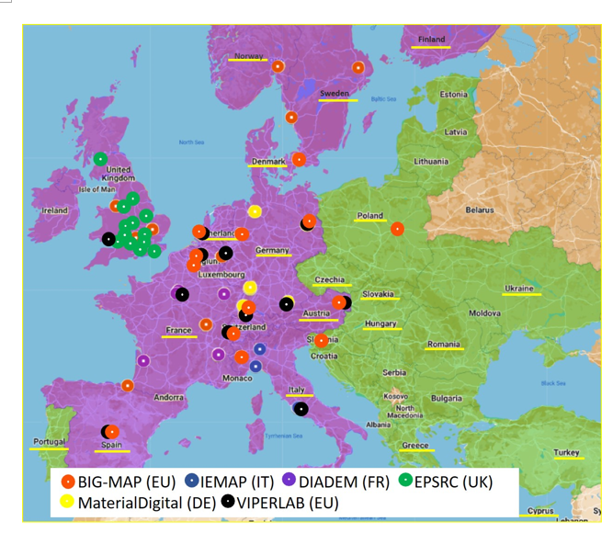
MAPs in Europe
Systemic challenges:
Many labs not participating in MAP
  Can benefit from using MAP
  Hold valuable data and skills
MAPs are being born all over EU but not communicating
  Share best practices & bad experiences, complement one another
New tools (ML, robotics..) are available but not enough experts and teachers
Industrial involvement
Technical challenges:
Metadata management
Device integration
Lab-to-Lab integration
Wider class of materials
Societal challenges :
Circularity
Safety
Resource efficiency
    Create: Transversal Energy Materials and Integration Acceleration Platform Network for succeeding CET
AMPEA
Notes:
CSA focused on MAPS and how to connect?
Differentiate WPs and Innovation acceleration actions.
Need management skills (persons with knowledge of whole R&I value chain)
-start with activities with people working with a certain class of materials – pre-selection.
-selection criteria: could be application needs/oriented. Can be from existing MAP needs/wishes. (many MAPS are being born. Perovskite for TE, hydrogen … etc.)
List selection candidates… functional material = perovskites (very broad and address a wide range of JPs), + structural materials
And accept applications (bio/organic)polymers, metals
KIT built MAP for batteries.

Slide 9
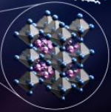

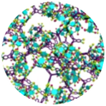

Working Groups, goals and Cross-cutting Tasks
WG1: Perovskites
WG2: Met. alloys
WG3: New mat.
G1: Increase accessibility to existing MAPs to all EU countries
G2: Provide communication & collaboration network among MAPs
G3: Establish systemic approach for next gen., solution-oriented adv. materials
T3.0: Mat. selection
T1: Conduct and build ‘Expert’ and ‘MAP’ list
T2: Develop a framework for mat. integration (data-stand, digital twin ....)
T3: Implement ‘sustainability-by-design’ approach in MAP scheme
T4: Organize workshops inviting key stakeholders
AMPEA
Notes:
Eligibility criterion on Inclusiveness Target countries:

Slide 10


More WGs and Tasks
G4.1: Enhance research acumen of ECIs and PhDs
G4.2: Increase mutual understanding disciplines & sectors
WG4
Training
T4.1: Organize training schools for ECIs, PhDs & ind. participants
T4.2: Build a framework for future ERASMUS programmes
G5.1: Maximize impact of Action results & achievements
G5.2: Bring adv. mat. and systemic research approach to the
forefront of EU-CET strategy
WG5
Diss., Comm.
& Promotion
G5.3: Accelerate mat. Integration into market/technology
T5.1: Create comm/dissemination platforms
T5.2: Seek opportunities (conferences, job offers …)

Slide 11
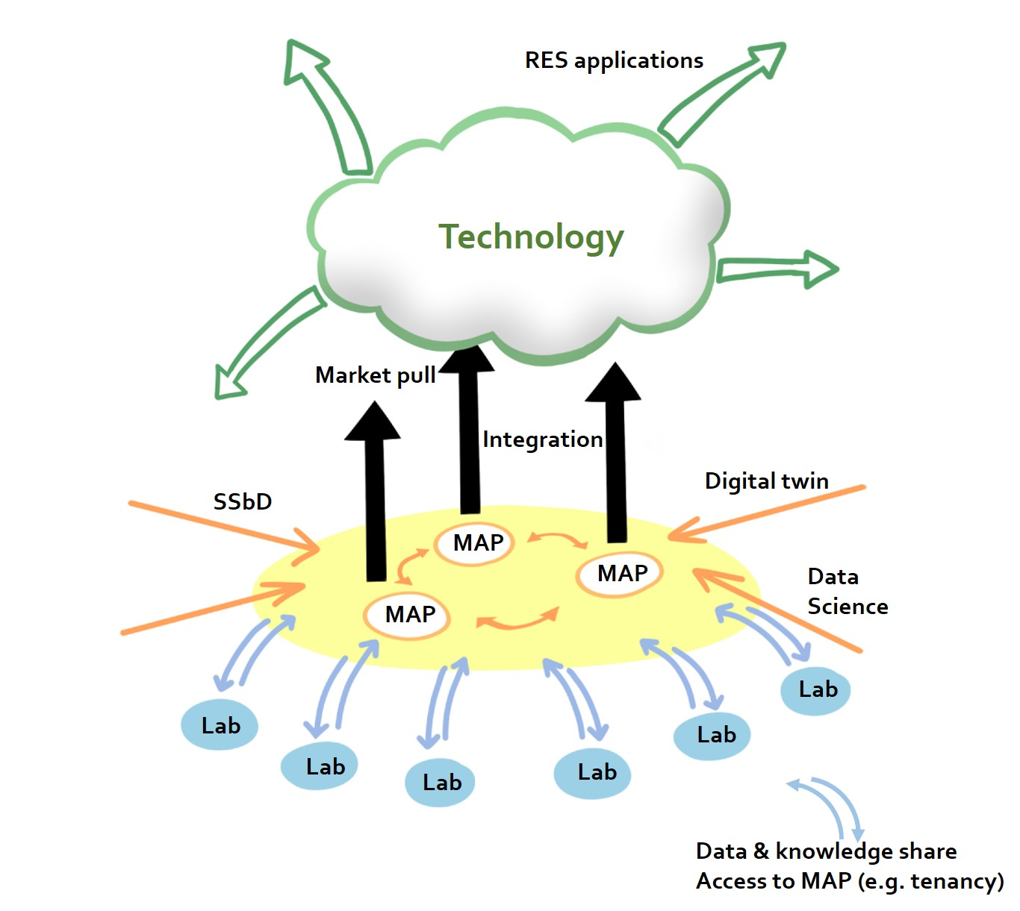
Action concept in a nutshell
    Industry participation (B2B)
    Incubation of future MAPs, MAP⁺s & hybrid MAPs
    Future RIA, CSA, & RI projects
    Create MAP network: worshops, STSMs, etc.
    Traning network (e.g., ERASMUS) & Continued education
    Integration of research groups into existing MAPs
AMPEA
Notes:
CSA focused on MAPS and how to connect?
Differentiate WPs and Innovation acceleration actions.
Need management skills (persons with knowledge of whole R&I value chain)
-start with activities with people working with a certain class of materials – pre-selection.
-selection criteria: could be application needs/oriented. Can be from existing MAP needs/wishes. (many MAPS are being born. Perovskite for TE, hydrogen … etc.)
List selection candidates… functional material = perovskites (very broad and address a wide range of JPs), + structural materials
And accept applications (bio/organic)polymers, metals
KIT built MAP for batteries.

Slide 12
EU-MACE where we are now (Nov. 5th)
  Grant period Nov. 1, 2023 – Oct 31, 2027
  Members: 190 researchers and investigators (29 countries: 15 ITC)
  Management Committee: 31 from (20 countries: 11 ITC)
  From France: CEA, ULE & UGA
  Representatives from BIG-MAP, IEMAP, VIPER, GC-MAC, NOMATEN, DIADEM …
  Lisaing with EU platforms and programmes: AMI2030, EIC …
  Liasing with EU projects: StoRIEs, RISEnergy, DECODE ….
  First joint workshop on « Digitalisation and Automation Boost Energy Materials Research » in Rome, January 24-25, 2024.
AMPEA
Notes:
Eligibility criterion on Inclusiveness Target countries:

Slide 13

How to join
  Application open (until the end of the project):
    Individual participation: Anyone can apply (incl. students)!
    Connect with other MAPs, improve MAPs, create MAPs, learn about/from MAPs, contribute to MAPs, use MAPs, teach associated skills
  Participation of French labs & platforms is highly welcome:
    1st workshop on « digitalization and Autmation Boost Energy Materials Research » Rome – January 24 & 25, 2024
    Selection of « New Materials » (~ Spring 2024)
    Become a part of EU and global MAP network
https://www.cost.eu/actions/CA22123/
    Establish winning strategy for fast-track & sustainable materials innovation
    Nurture next generation researchers with a broader mind-set
AMPEA
Notes:
Any CSA?

