Slide 1
Preparation of 3D electrodes for microsupercapacitors by spin-coating
Journées Plénières GDR NAME 2023, Rennes, November 8th-10th 2023
N. Poirot, M. Gabard, M. Boufnichel, R.Omnée , E. Raymundo-Piñero

Slide 2
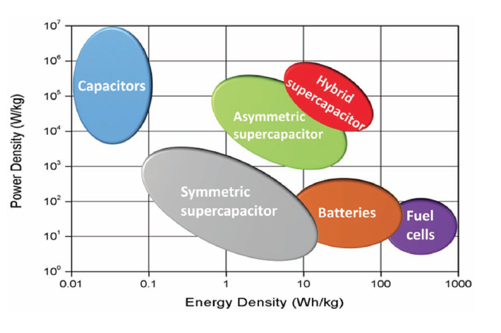
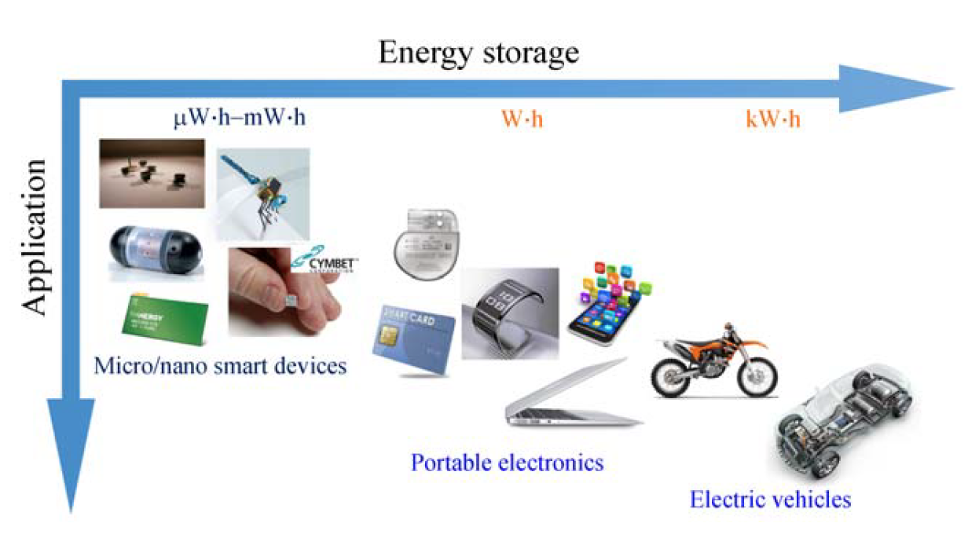
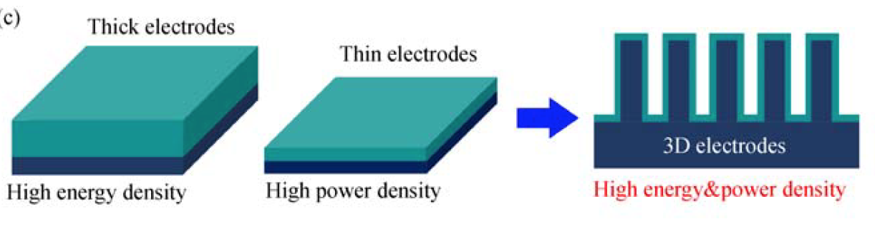
Context
Experimental
TiO₂ coating
3D-electrodes performances
Conclusion
Energy storage devices: Key technology for the development of energy autonomous systems
Industrial areas
  Photovoltaics, micro-sensors, robotics, electronic components, memory circuits, portable devices (computers, phones), portable medical devices, IoT, etc.
Current objective: energy microsources: microbatteries, microsupercapacitors (MSC)
3D structuration: Superior performance / planar technology
3D Si-based micro-LIB / MSC energy storage systems
  High specific surface area
  High energy/power density
  Type of structuration depends on the final use of the 3D systems
**Applications of different Li-ion battery energy storage systems
*Ragone plot comparing the energy and power densities of various state-of-art supercapacitors and batteries with ASCs
*Choudhary et al. Adv. Mater. 2017, 29, 1605336
**YUE et al. Front. Mech. Eng. 2017, 12(4): 459–476

Slide 3
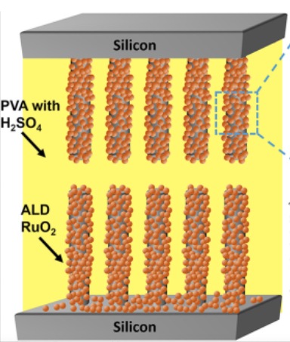
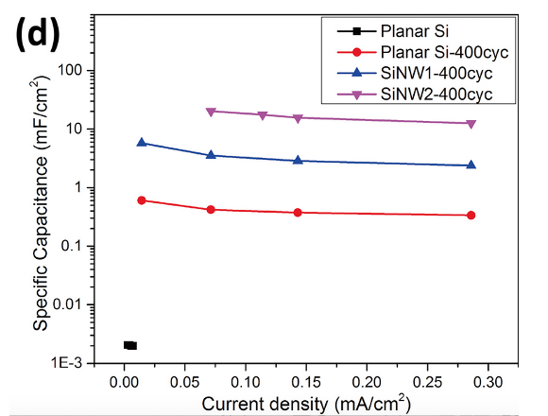
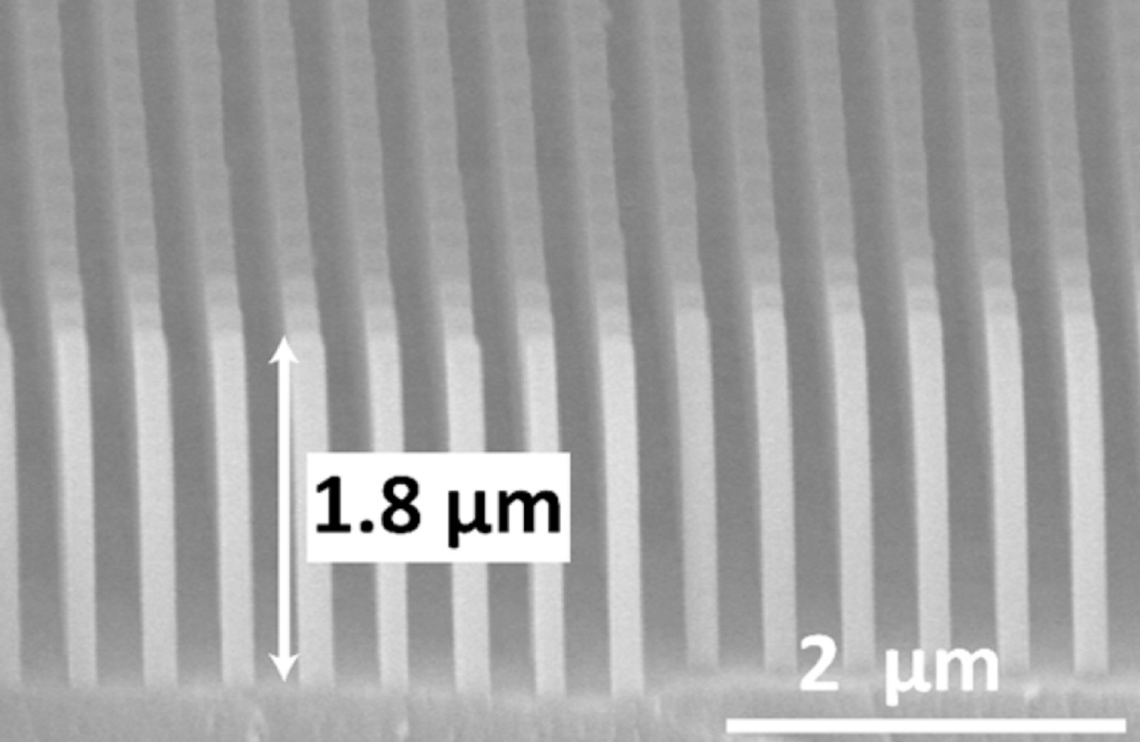
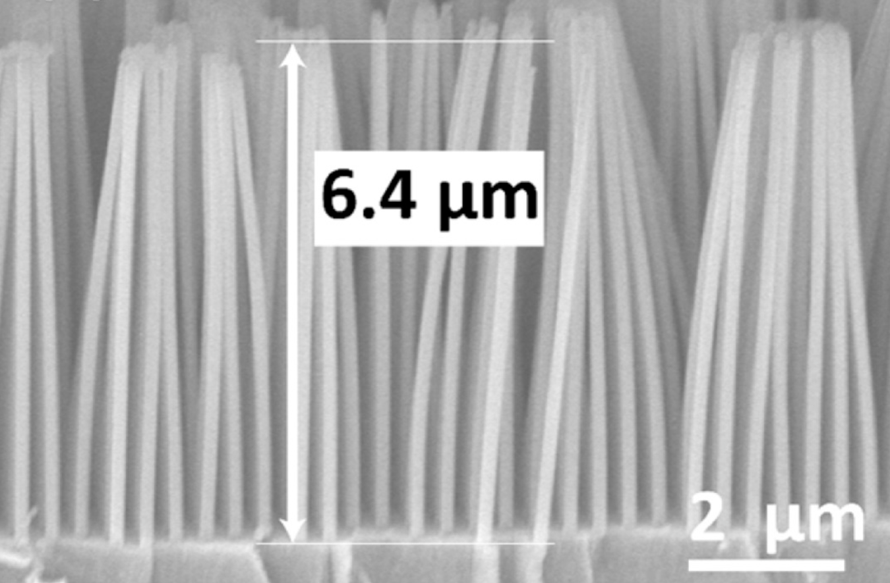
Context
Experimental
TiO₂ coating
3D-electrodes performances
Conclusion
3D-Microsupercapacitor
7.4 SiNW1
23.6 SiNW2
Si nanowires (Metal assisted anodic etching (MAAE))
Increasing of specific capacity with AEF (*8)
Na₂SO₄ electrolyte
0,07 mF/cm² à 20 mF/cm²
W. Zheng et al. J. of Power Sources 341 (2017), doi.org/10.1016/j.jpowsour.2016.11.093

Slide 4
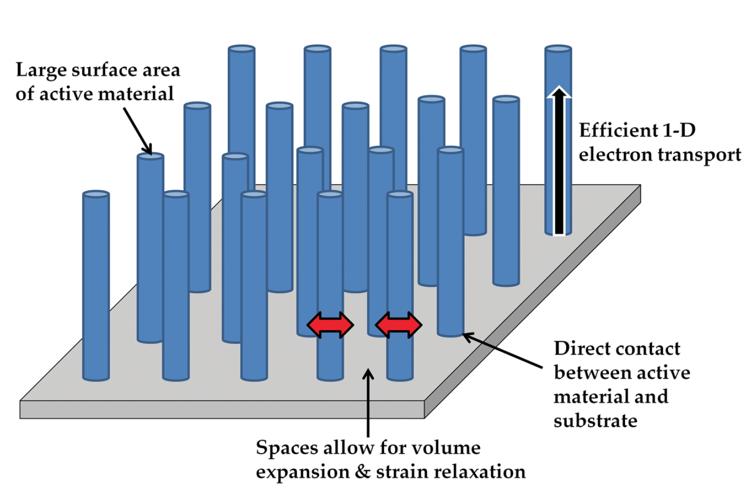
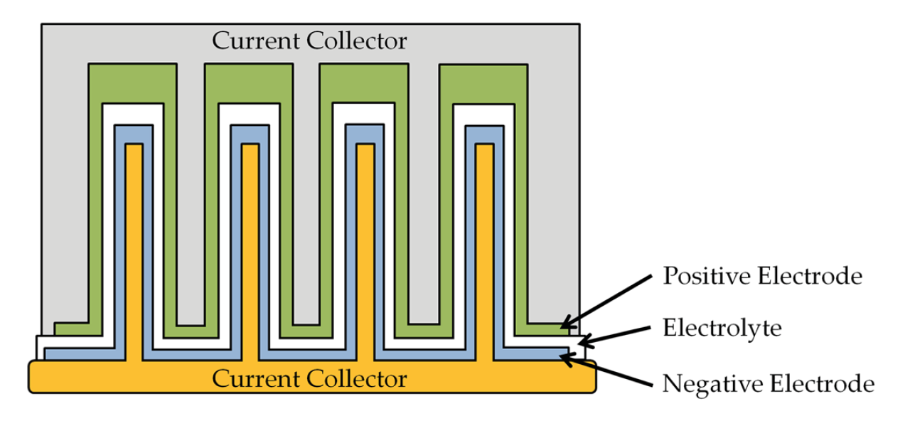
Context
Experimental
TiO₂ coating
3D-electrodes performances
Conclusion
Challenge
  Active material conformal deposition by liquid route on the 3D template high aspect ratio
Ours objectives
  Preparation of 3D electrodes : sol-gel and spin-coating techniques
  Easy to implement, fast and low-cost method compared to techniques as PVD, ALD, CVD,…
Ellis et al., Adv. Mater., 26, 3368–3397, (2014)
Notes:
On s’est inspiré des travaux de Li. Ils élaborent des films TiO2 avec du noir de carbone sur des feuilles d’aluminium pour une application de photocatalyse. Ti butoxide précurseur de Ti, solvent propanol et acétylacétone et eau pour l’hydrolyse

Slide 5

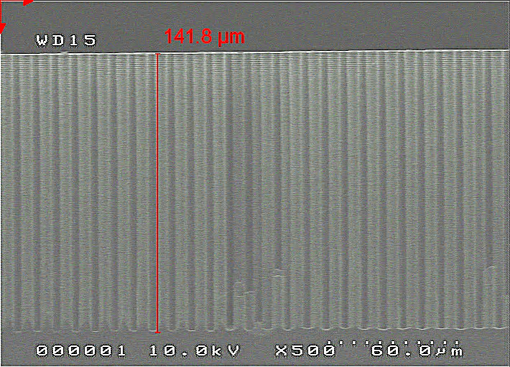
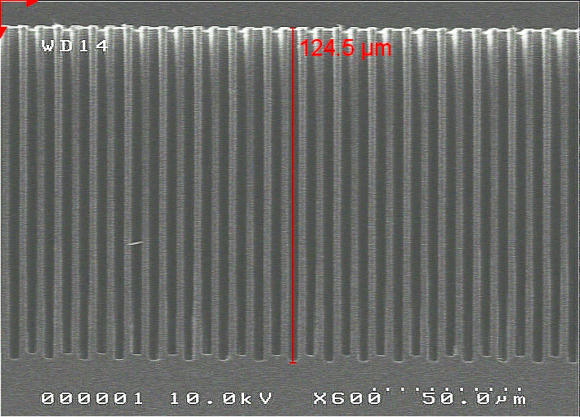
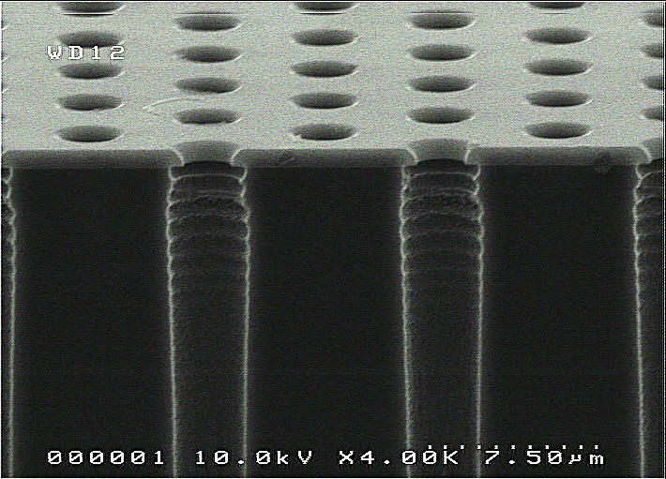
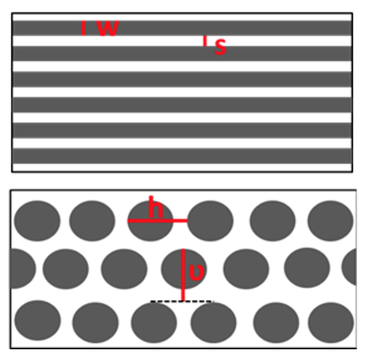
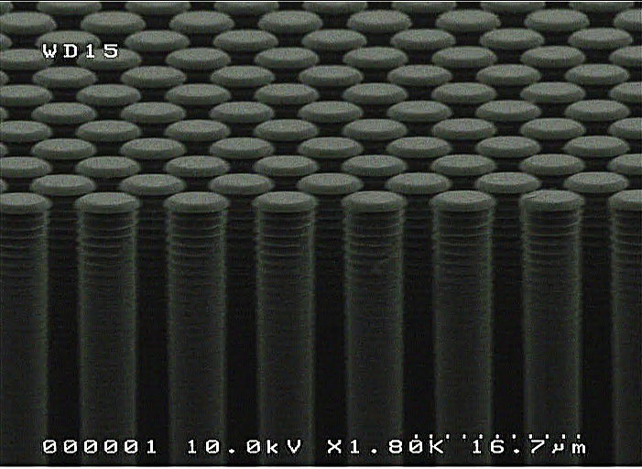
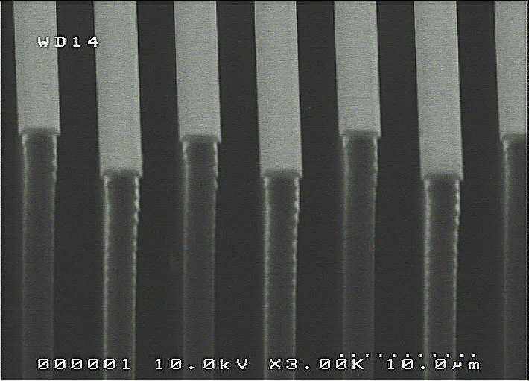
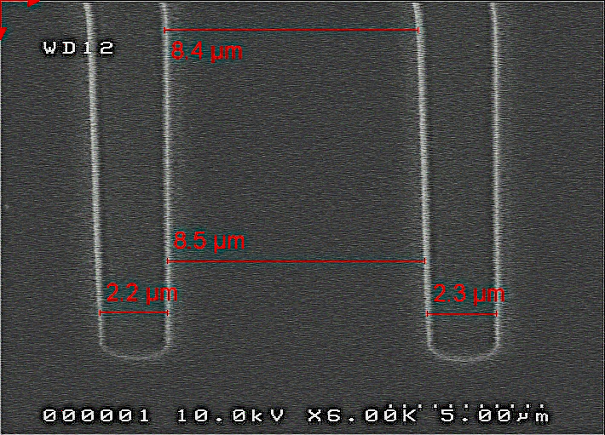
Context
Experimental
TiO₂ coating
3D-electrodes performances
Conclusion
Gravure Bosch process
142 μm
125 μm
Dimensions and area enlargement factor
Topology | Aspect Ratio | Etched Depth µm | Width µm | Spacing µm | Footprint Length cm | h µm | ν µm | Area Enlargement Factor (AEF)
*Trenches | 9 | 52 | 6 | 3 | 0.7 | - | - | 12.6
Trenches | 29 | 117 | 4 | 3 | 0.7 | - |  | 34.4
**Pillars | 29 | 144 | 5 | - | - | 9 | 8 | 32.4
8,4 μm
6 μm
8,5 μm
2,2 μm
2,3 μm
3 μm
**Eustache et al., Adv. Energy Mater., vol.4, 1301612 (2014)
*Baggetto et al., Adv. Energy Mater., vol.18, p. 1057-1066 (2008)

Slide 6
Context
Experimental
TiO₂ coating
3D-electrodes performances
Conclusion
Active material deposition on Si-3D substrates
Preparation sol
Deposition by spin coating of (Sol + PE)
Oxide precursors, solvant, complexant,…
Impregnation of 3D substrate
Polymerisation of resin
PE resin
Thermical decomposition on hot plates
Oxide crystallisation by RTA
Patent A.Vincent, N. Poirot, WO 2015\044582 Al (2015)
Patent « Réalisation de microbatteries 3D par voie liquide », M. Gabard, N. Poirot, F. Ghamouss, T. Tillocher, N°1000376145 (2016)
Patent « Dépôt conforme par voie liquide sur topologie 3D », N. Poirot, N° 1000409098 (2017)
M. Gabard, M. Zaghrioui, D. Chouteau, V. Grimal, T. Tillocher, F. Ghamouss, N. Poirot, ChemEngineering 1(1), 5 (2017)

Slide 7
Context
Experimental
TiO₂ coating
3D-electrodes performances
Conclusion
Process steps of capillary coating
Polymerization at room temperature
Pore ​​filling, spin coating
Evolution monitoring of the polymer solution in temperature (camera)
Low internal constraints
Removal

Slide 8
Context
Experimental
TiO₂ coating
3D-electrodes performances
Conclusion
Process steps of capillary coating
Thermal decomposition after 40 min
Strong internal constraints
Preferential fracture zone
N. Poirot, T. Tillocher, and P.I. Raynal, “Conformal coating by liquid route on three-dimensional topology” Eur. Phys. J. Spec. Top. (2022)

Slide 9
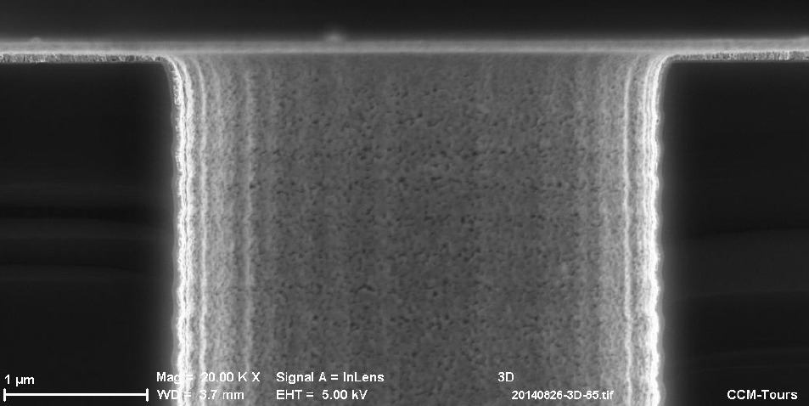
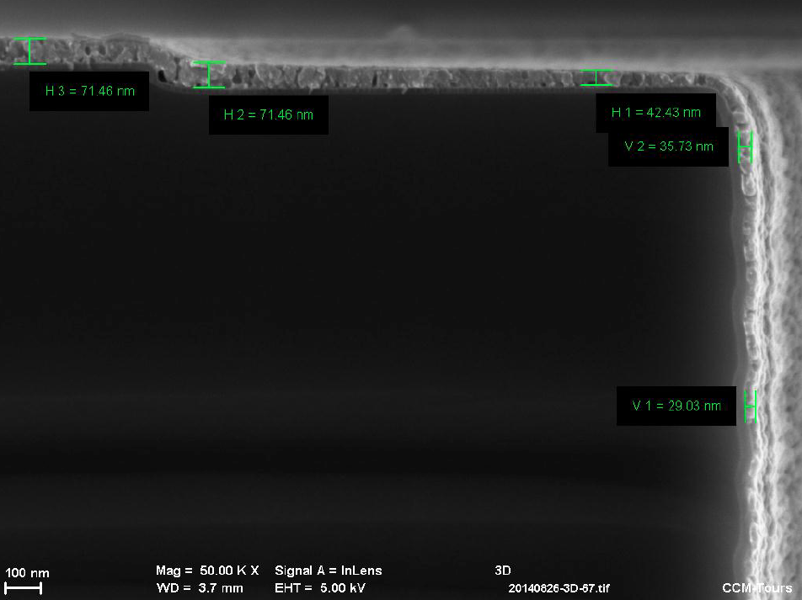
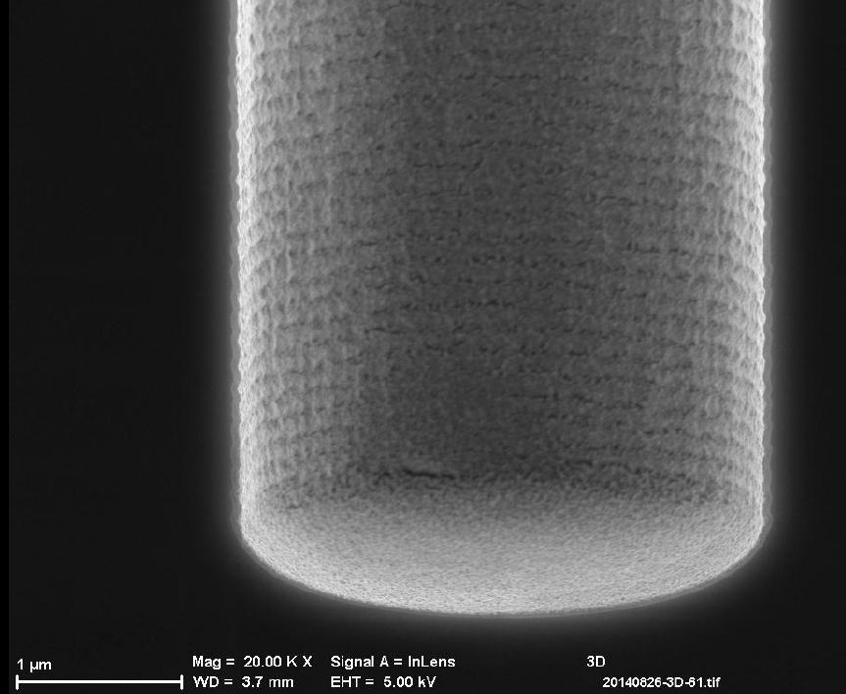
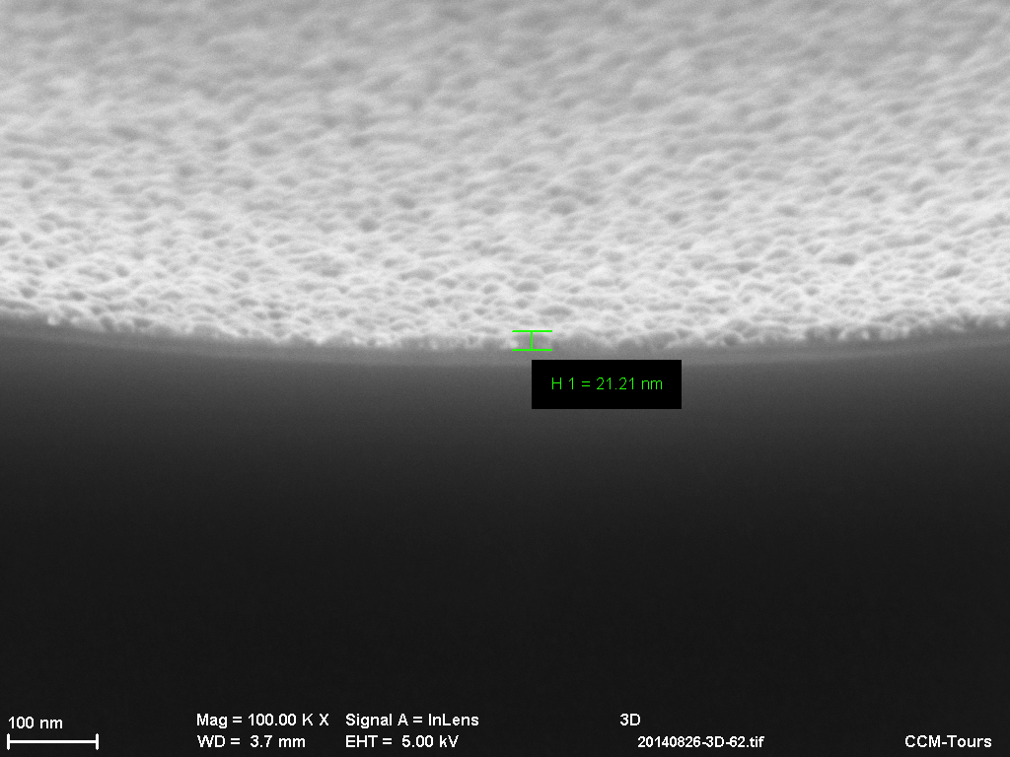
Context
Experimental
TiO₂ coating
3D-electrodes performances
Conclusion
LaNiO₃ oxide: metal electrode, MIM capacitor
Plots
H=32 μm, L= 3 μm
FF = 10
Layer thickness : 30 nm
Conformal coating
70 nm
35 nm
30 nm
1 μm
100 nm
25 nm
1 μm
100 nm

Slide 10
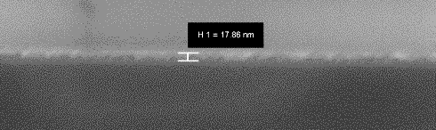
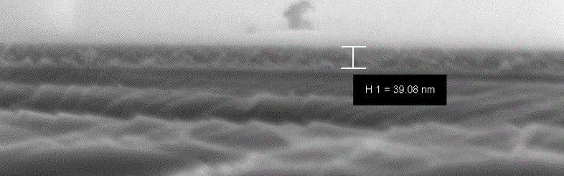
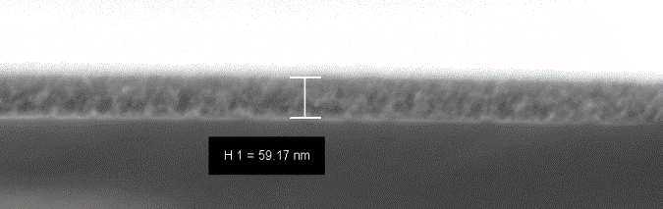
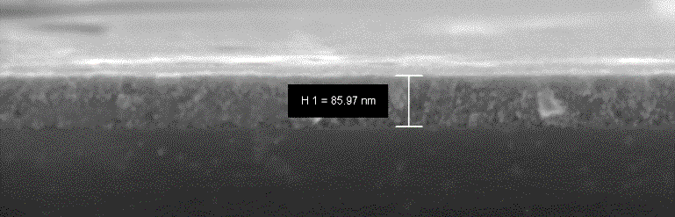
Context
Experimental
TiO₂ coating
3D-electrodes performances
Conclusion
TiO₂ thin layers on Si-2D substrates
  Optimal thickness of the active material layer
  Optimal electrochemical performance
20 nm
120 nm
100 nm
Film thickness
  by adding coating layers
  by varying the precursor solution concentration
Homogeneous TiO₂ films without cracks and fissures
Good adhesion
100 nm
40 nm
200 nm
200 nm
100 nm
60 nm
300 nm
200 nm
90 nm
100 nm
100 nm
N. Poirot, M. Gabard, M. Boufnichel, R. Omnée, Encarnacion Raymundo-Piñero, “A suistainable approach for the development of TiO₂ based 3D electrodes for micro-supercapacitors”, Batteries 2023,9, 258.

Slide 11
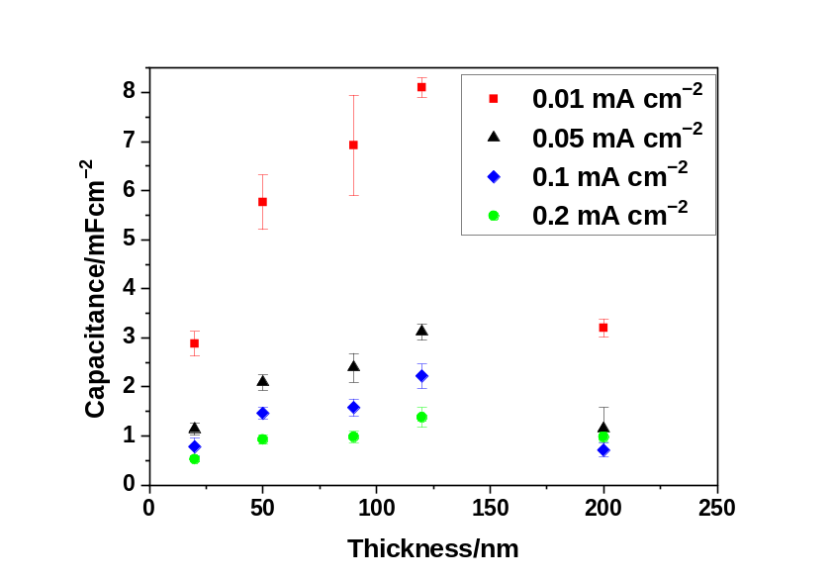
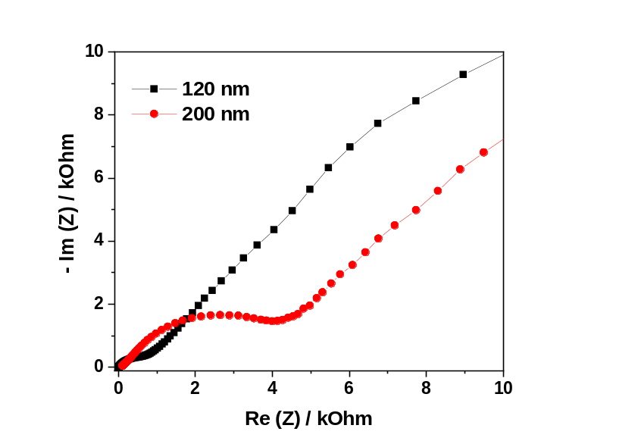
Context
Experimental
TiO₂ coating
3D-electrodes performances
Conclusion
Electrochemical characterization on 2D-Si electrodes – TiO₂
  *Electrolyte: 1 M LiPF₆ (EC:PC:3DMC); Ti/Si/TiO₂ (PVD)
Surface capacitance at different current densities vs. film thickness*
Nyquist plot withTiO₂ thicknesses of 200 nm or 120 nm
Optimum surface capacitance : 120 nm
For 200 nm : low electrical conductivity
TiO₂ layer : thickness of 120 nm selected to be deposited over 3D supports having high surface areas for optimal performance.

Slide 12
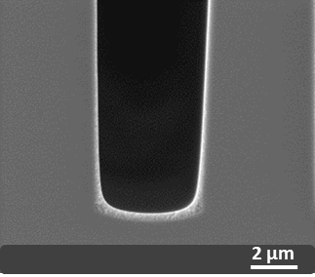
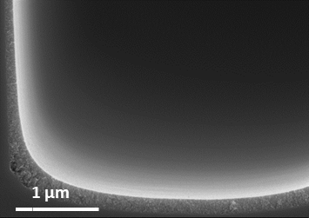
Context
Experimental
TiO₂ coating
3D-electrodes performances
Conclusion
Coating on 3D trenches
AR 9 AR 29
50 µm
117 µm
10 µm
10 µm
top
bottom
2 µm
Layer thickness 110 nm

Slide 13
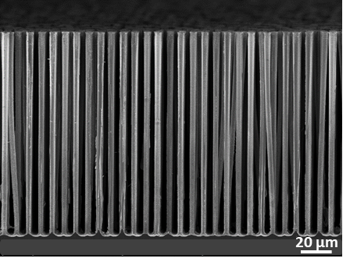
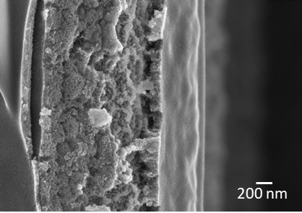
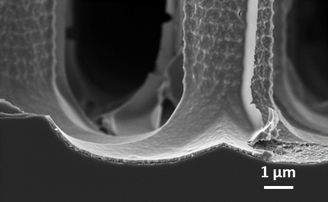
Context
Experimental
TiO₂ coating
3D-electrodes performances
Conclusion
Coating on 3D pillars with AR 29
144 µm
Detail of a pillar wall
  Advantages
  Low cost
  Simple, easy (clean room not required)
  Deposit covering the walls of the structure
  Controlled microstructure and thickness of the active layer
Thickness
130 nm
Details of bottom pillar
bottom
200 nm

Slide 14
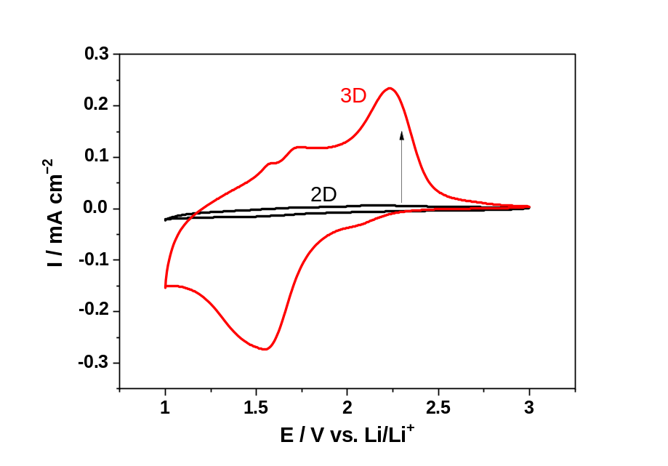
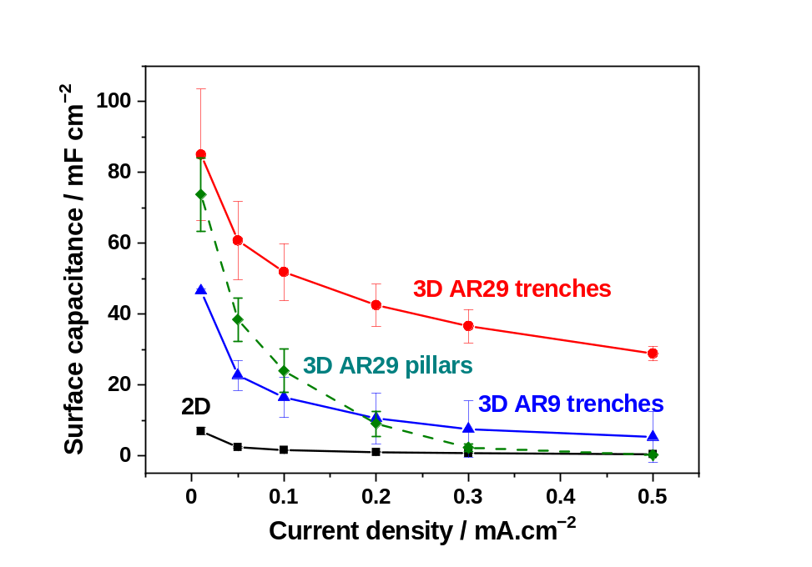
Context
Experimental
TiO₂ coating
3D-electrodes performances
Conclusion
Cyclic voltammogramms at 1 mV.s⁻¹ of 2D and 3D AR 29 TiO₂ electrodes (120 nm)
  Faradic and capacitive contribution with different OR waves at the same potentials : TiO₂ has the same structure in two morphologies
Surface capacity at different current densities for electrodes 2D et 3D
  Trenches topology more efficient
  Improvement in the energy and the power density : requirements of a supercapacitor

Slide 15
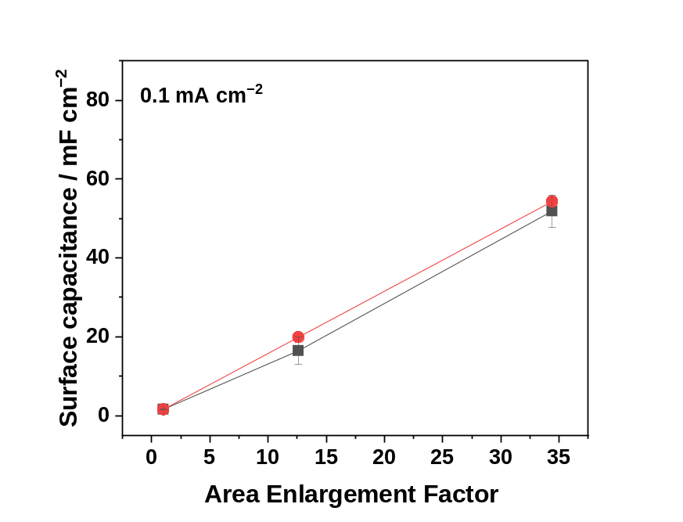
Context
Experimental
TiO₂ coating
3D-electrodes performances
Conclusion
Surface capacity at different current densities for electrodes with a layer of 120 nm of TiO₂
Experimental and theoretical surface capacitances obtained against the surface AEF -Trenches
Current Density mA cm⁻² | Surface Capacitance mF.cm⁻²
 | 2D | 3D AR9 Trenches | 3D AR29 Trenches | 3D AR29 Pillars
0.01 | 8.1 | 46.5 | 85.0 | 73.7
0.05 | 2.4 | 22.7 | 60.8 | 38.4
0.1 | 1.6 | 16.5 | 51.9 | 23.9
0.2 | 1.0 | 10.5 | 42.5 | 9.0
0.3 | 0.7 | 7.5 | 36.6 | 2.3
0.5 | 0.4 | 5.3 | 28.8 | 0.2
Current Density mA cm⁻² | Surface Capacitance mF.cm⁻²
 | 2D | 3D AR9 Trenches | 3D AR29 Trenches | 3D AR29 Pillars
0.01 | 8.1 | 46.5 | 85.0 | 73.7
0.05 | 2.4 | 22.7 | 60.8 | 38.4
0.1 | 1.6 | 16.5 | 51.9 | 23.9
0.2 | 1.0 | 10.5 | 42.5 | 9.0
0.3 | 0.7 | 7.5 | 36.6 | 2.3
0.5 | 0.4 | 5.3 | 28.8 | 0.2
Theo.
Exp
Trenches topology more efficient
Quality of TiO₂/Si interface
Perfect correlation
Contribution of surface capacitive
Performance proportional to the 3D specific surface

Slide 16
Context
Experimental
TiO₂ coating
3D-electrodes performances
Conclusion
  Simple method to implement
  Feasibility of liquid deposition on 3D Si substrates with different aspect ratios
  The thickness of the active material layers : solution concentration and the number of layers
  Homogenous TiO₂ thin film coating on 3D substrates : uniformly covers the walls, top and bottom
    For trenches (AEF 34) : surface capacitance of 85.0 mF cm⁻² (0,01mA cm⁻²)
    At 0.5 mA cm⁻² : 69-fold increase in the surface capacitance : capacitance value of 28.8 mF cm⁻²
  Method for depositing oxide for high AEF efficient for developing high-energy and high-power devices.
  Others applications : SOFC, photovoltaic, ferroelectric, MIM capacitor,…

Slide 17
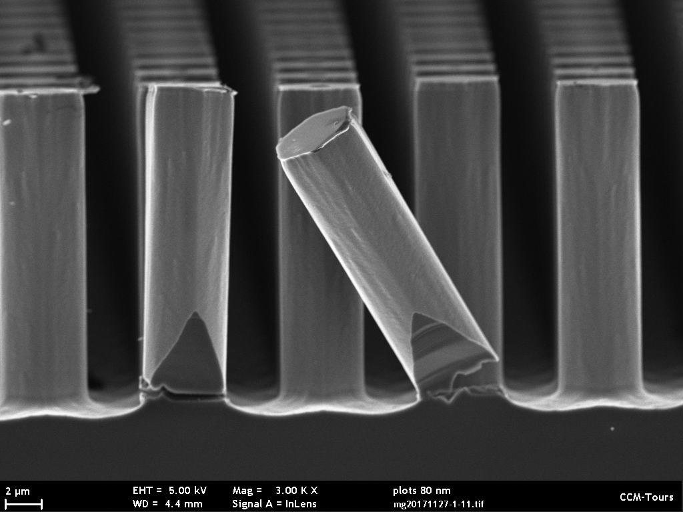
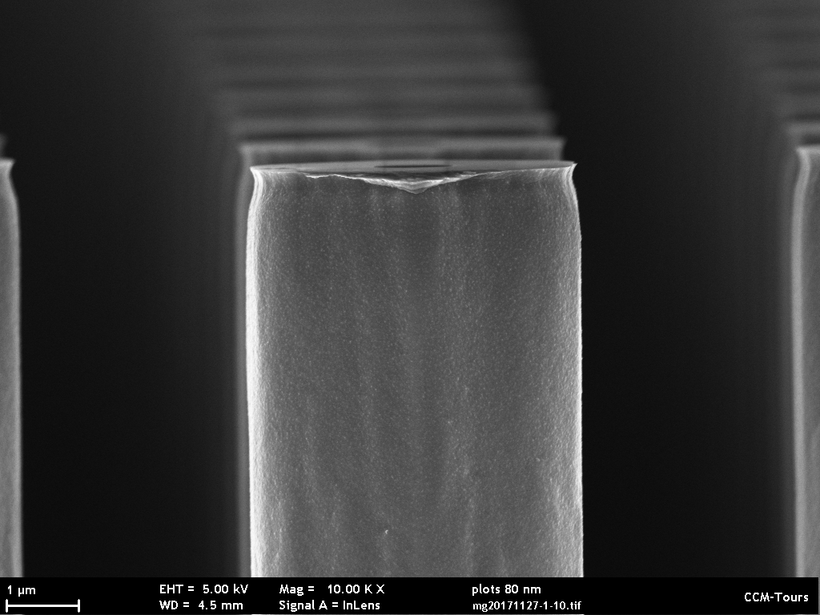
Acknowledgments
GREMAN
  A. Vincent, T. Defforge, G. Gautier, V. Grimal, M. Gabard, S. Desplobain, D. Chouteau
Collaborations
  Thomas Tillocher, GREMI Orléans
  E. Raymundo, R. Omnée, CEMHTI, Orléans
  Zaid Abdelali, StMicroelectronics-Tours : réalisation de condensateurs MIM
  Mohamed Boufnichel, Morgane Dutour, StMicroelectronics-Tours : gravure Si
Région Centre Val de Loire
Programme Lavoisier/CEA
ANR
2 μm
1 μm
Thanks for your attention

