Slide 1

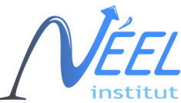
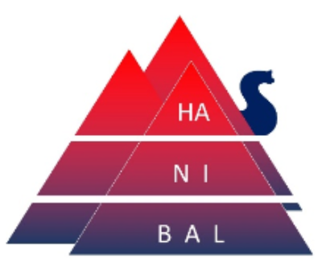
PHONON TRANSPORT IN ASYMMETRIC NANOSTRUCTURES IN THE QUASI-BALLISTIC REGIME
GDR NAME plenary days, 2023 Rennes
Boris Brisuda, Institut Néel, Cnrs
Thesis Supervisors: Olivier Bourgeois and laurent saminadayar

Slide 2
Phonon physics at low temperatures
Heat manipulation through phonon engineering → thermal metamaterials
Objectives:
  Coherent effects, quantization of thermal conductance
  Phononic crystals
  Thermal rectification
Umklapp scattering, phonon inclusions
Ballistic transport
Long phonon mean free path
Fully diffusive phonon transport
Quantum behaviours
Phononic crystals
Boundary scattering, size limited phonon transport (Casimir/Ziman)
300 K
Absolute Zero
Notes:
Introduce phonon physics, phonon engineering, and our objectives of study. Why low temperature is interesting

Slide 3
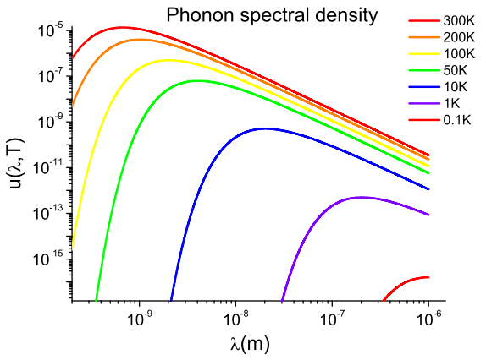
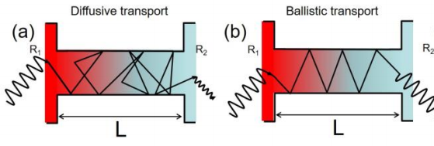
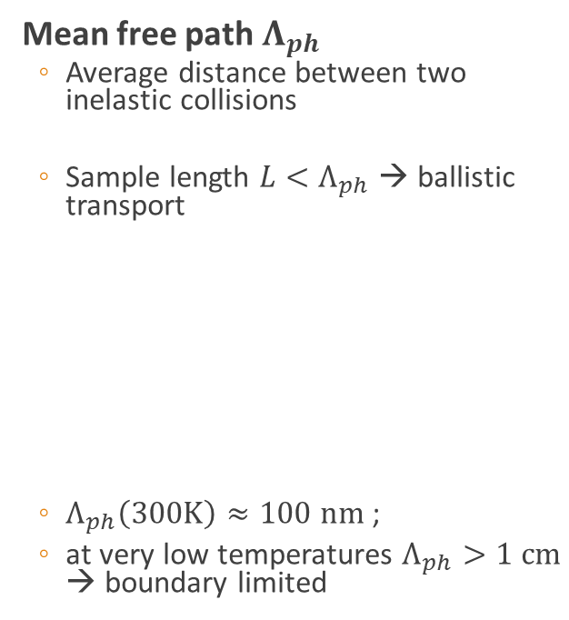

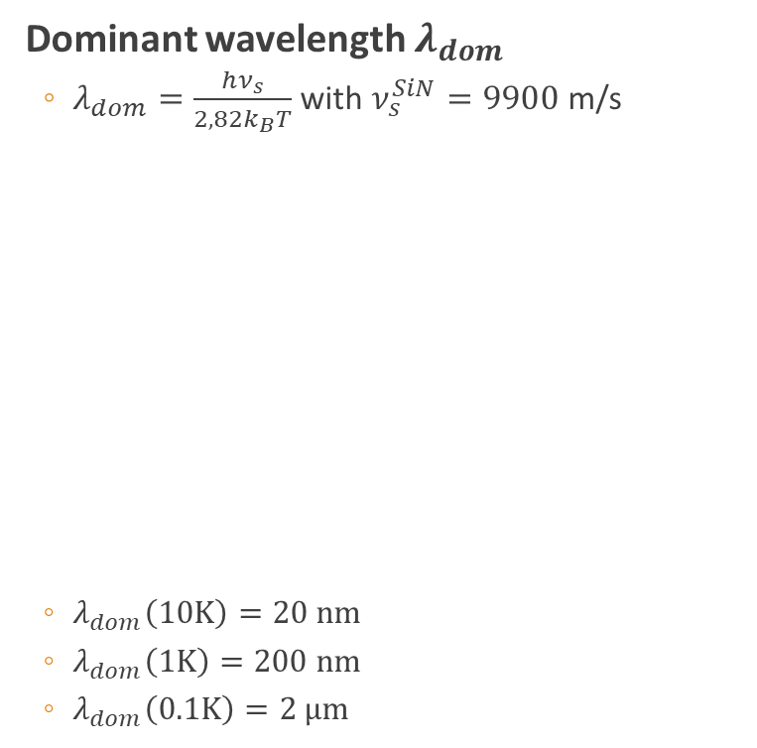

Phonon characteristic lengths at low temperatures
Mean free path $Λ_{ph}$
  Average distance between two inelastic collisions
  Sample length $L<Λ_{ph}$ → ballistic transport
  $Λ_{ph}\left(300K\right)≈100 nm$ ;
  at very low temperatures $Λ_{ph}>1 cm$ → boundary limited
Dominant wavelength $λ_{dom}$
  $λ_{dom}=\frac{hν_{s}}{2,82k_{B}T}$ with $ν_{s}^{SiN}=9900$ m/s
  $λ_{dom}\left(10K\right)=20 nm$
  $λ_{dom}\left(1K\right)=200 nm$
  $λ_{dom}\left(0.1K\right)=2 µm$
$$W=2−6 µm$$
$$=7 µm$$

Slide 4
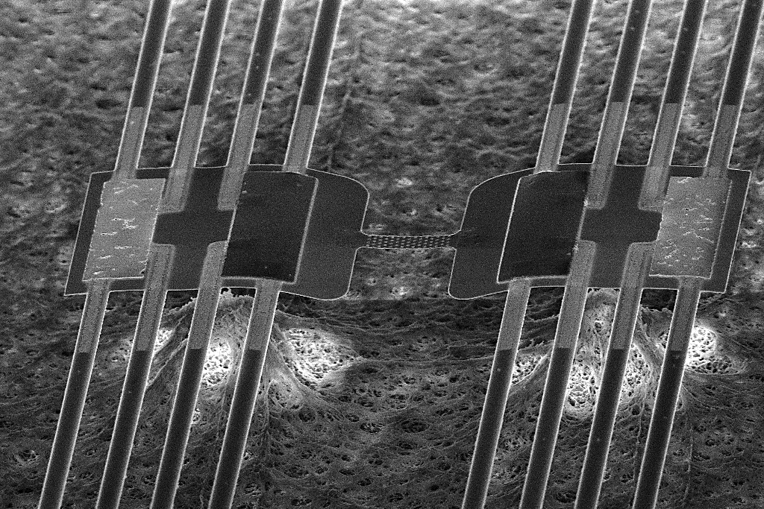
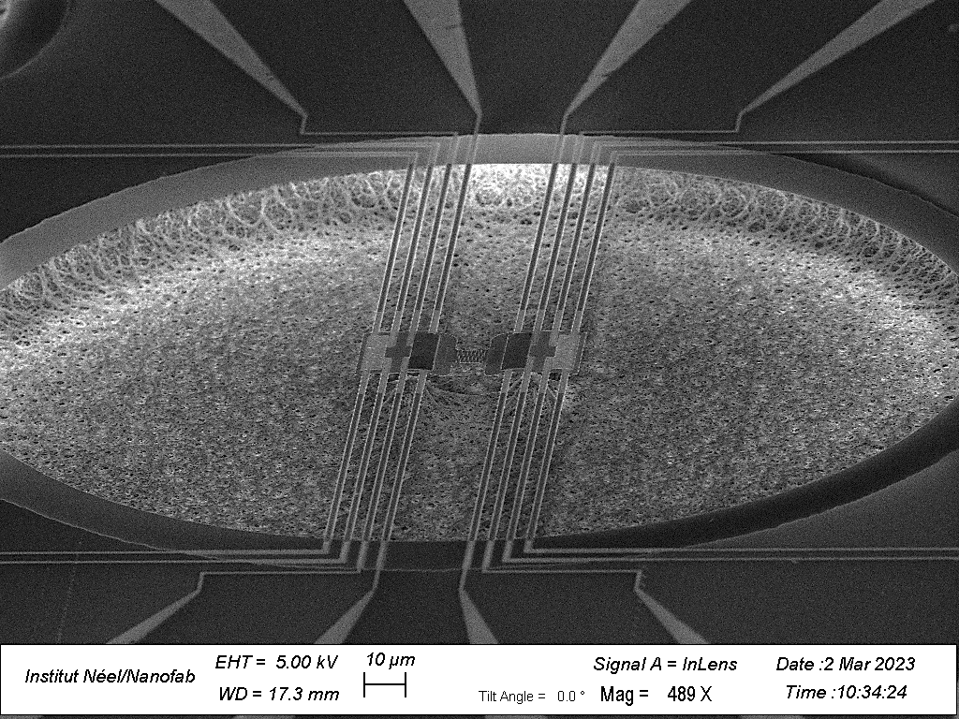
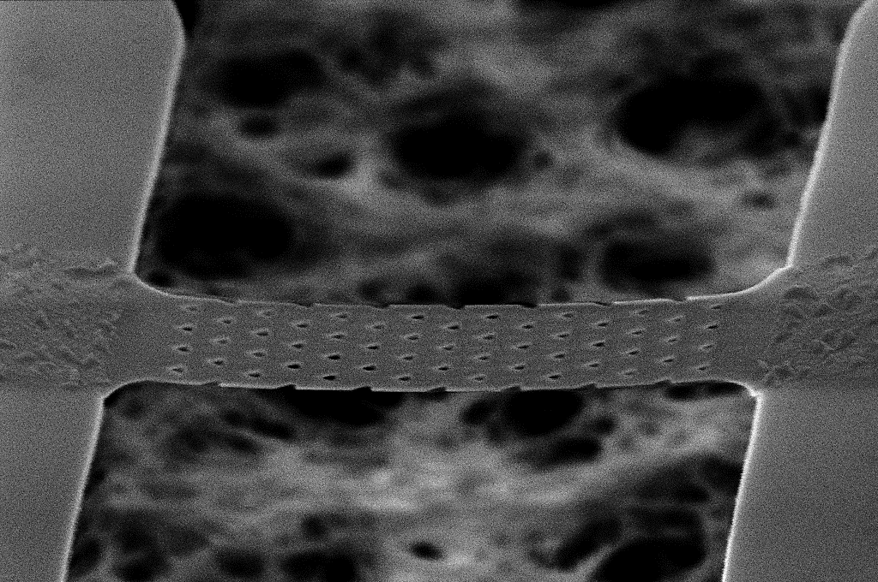
Suspended SiN thermal bridge sensor
  Mechanically suspended for thermal isolation
  NbN thermometer and Au heater for reversible measurement
  Suspended nanostructured strip
40 steps in fabrication
process
  Resist spinning
  Lithography
  Deposition
  Lift-off
  Etching
→1 month minimum
Heaters
Thermometers
5 µm
20 µm
2 µm

Slide 5
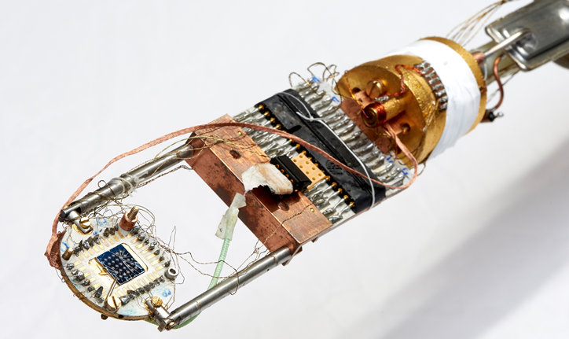
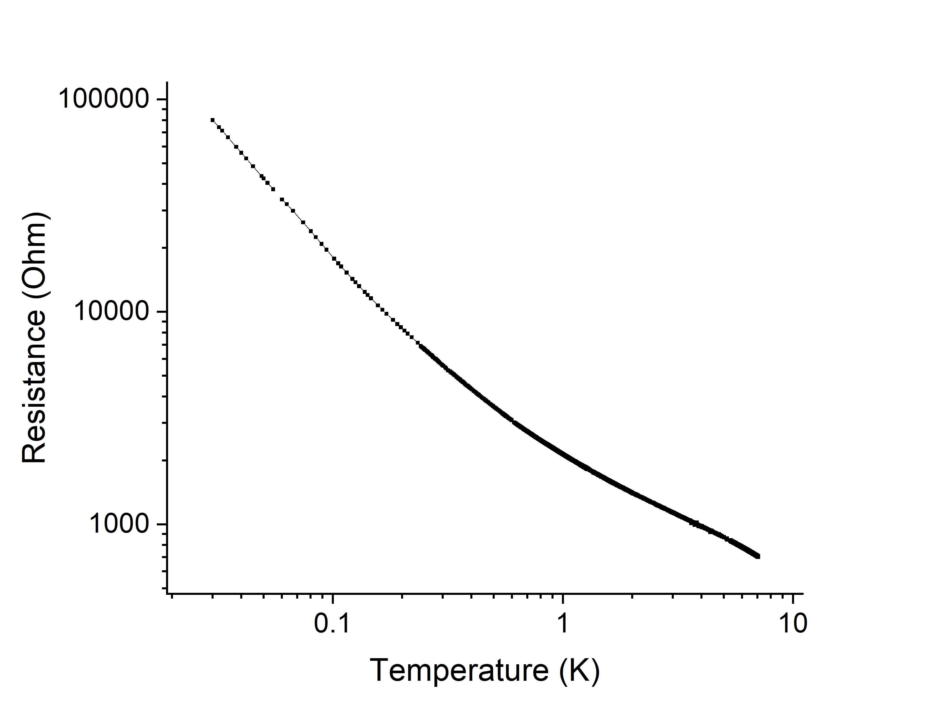
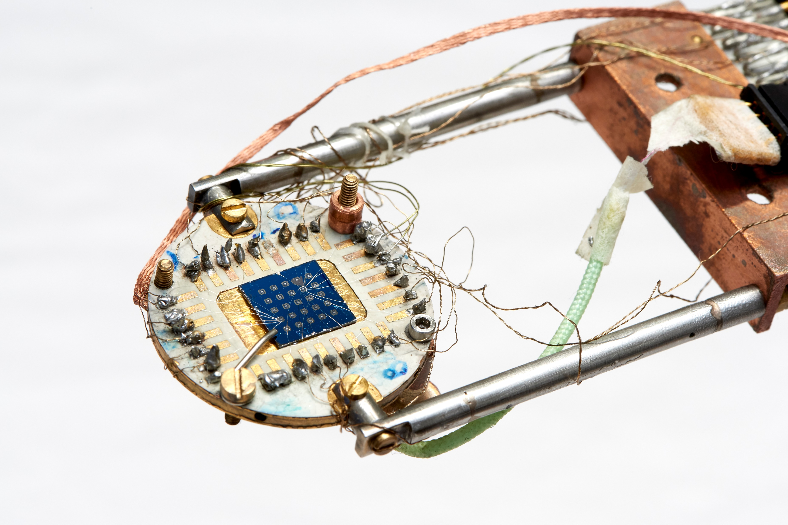
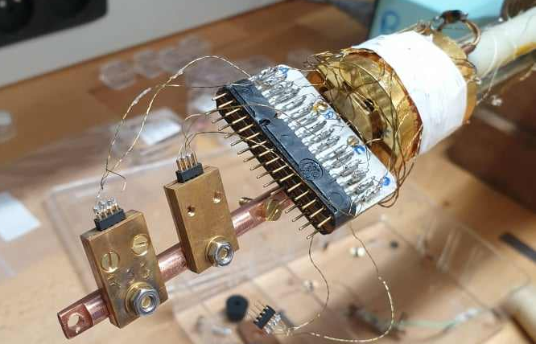
Measurement setup
NbN sample holder thermometer calibration
Nguyen, T., Tavakoli, A., Triqueneaux, S. et al. Niobium Nitride Thin Films for Very Low Temperature Resistive Thermometry. J Low Temp Phys 197, 348–356 (2019). https://doi.org/10.1007/s10909-019-02222-6

Slide 6
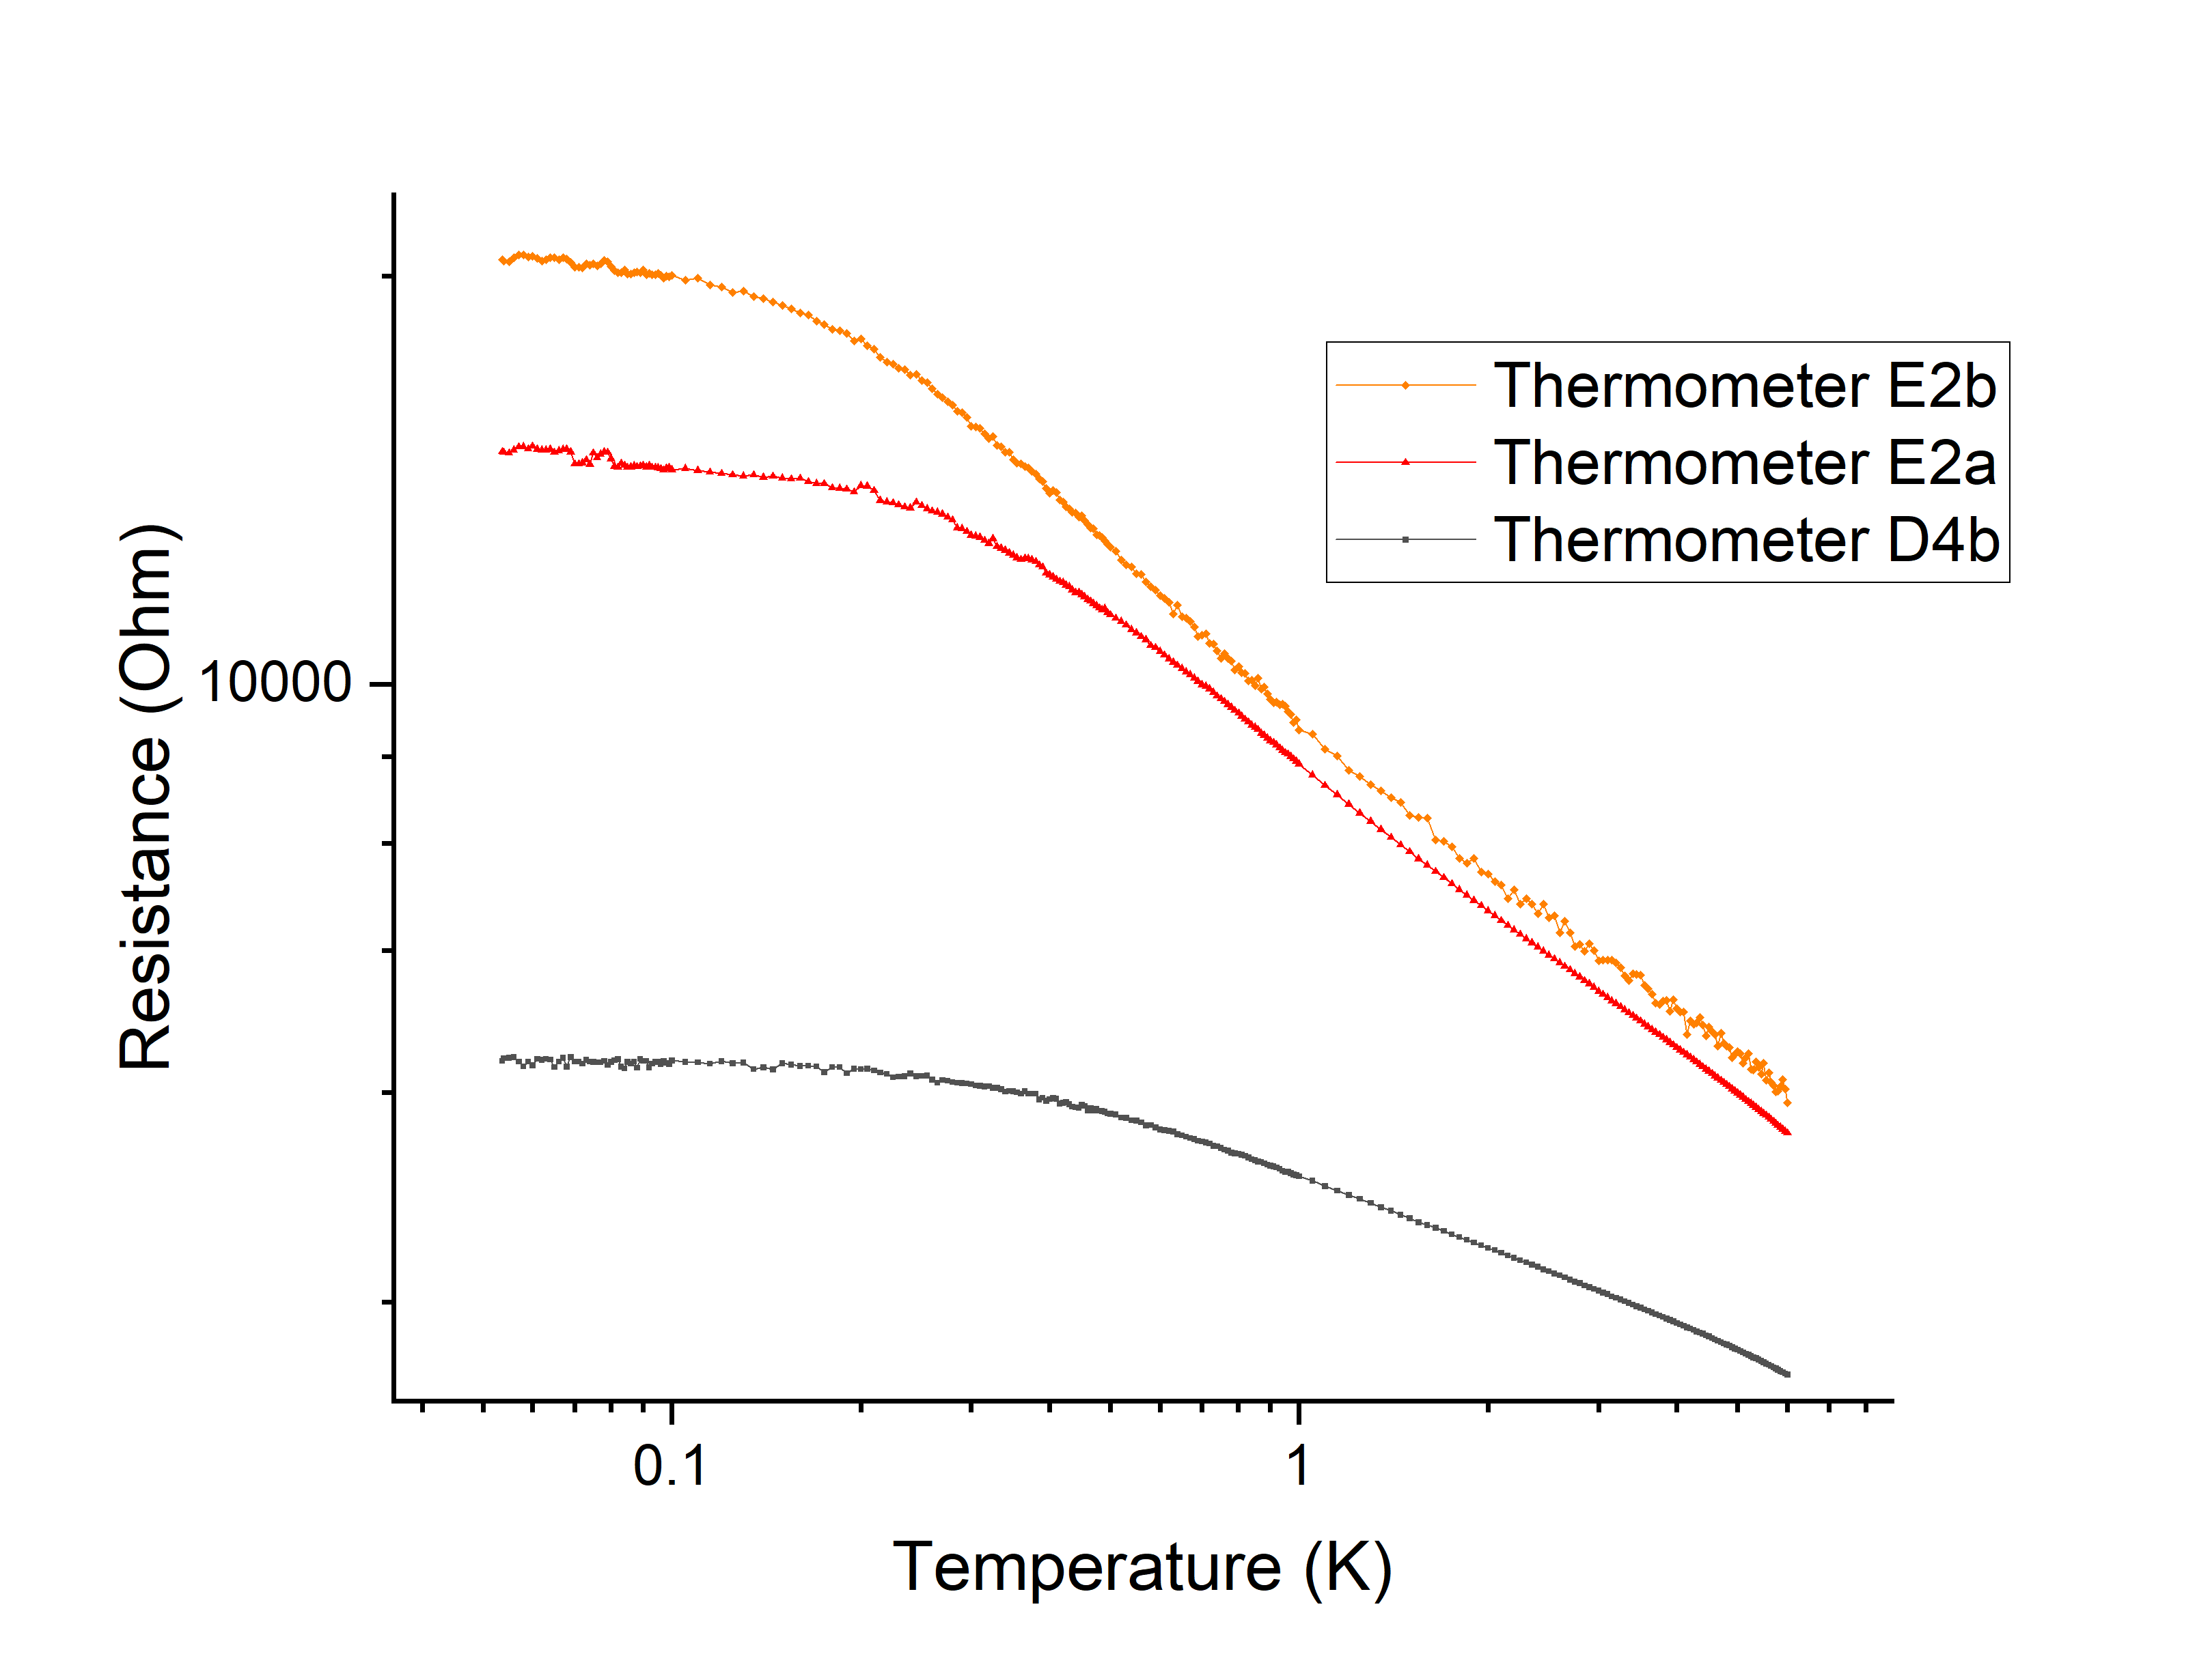
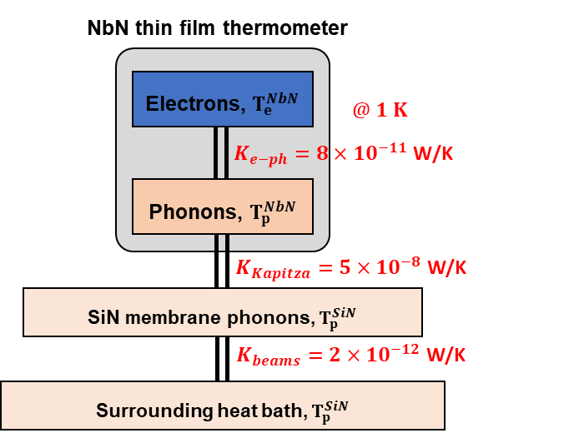
Measurement of BB38
  3 membranes per measurement campaign
    1 single membrane setup
    1 thermal bridge setup
  Thermometer calibration
    Saturation below 100 - 150 mK
  Heating and measurement of the membranes done by the thermometers !
    DC current used for heat dissipation through the thermometer and low AC current used to measure its resistance
    Sub-optimal, risk of decoupling electrons from phonon bath below 100 mK

Slide 7
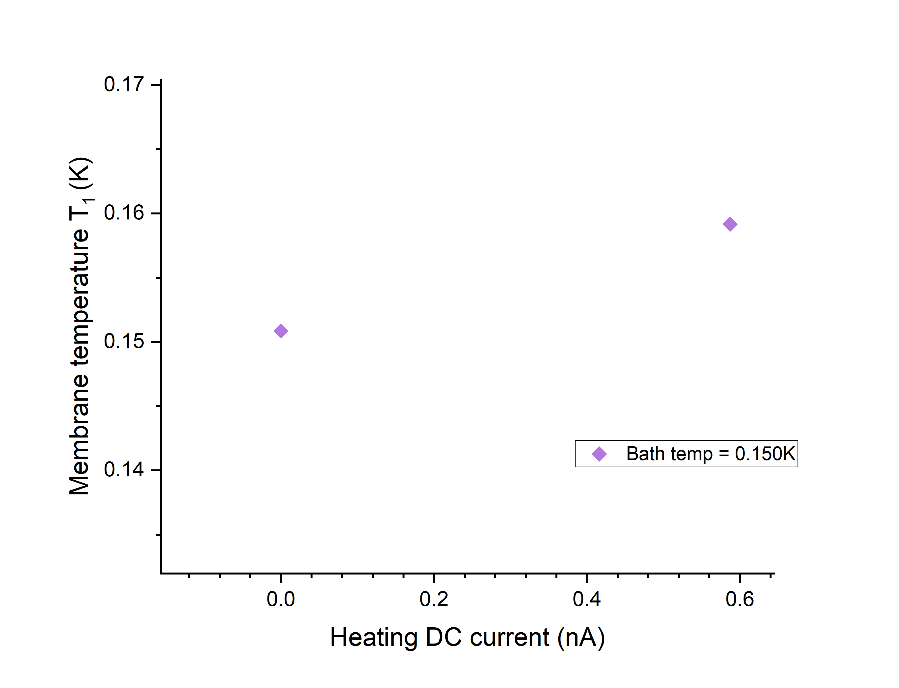
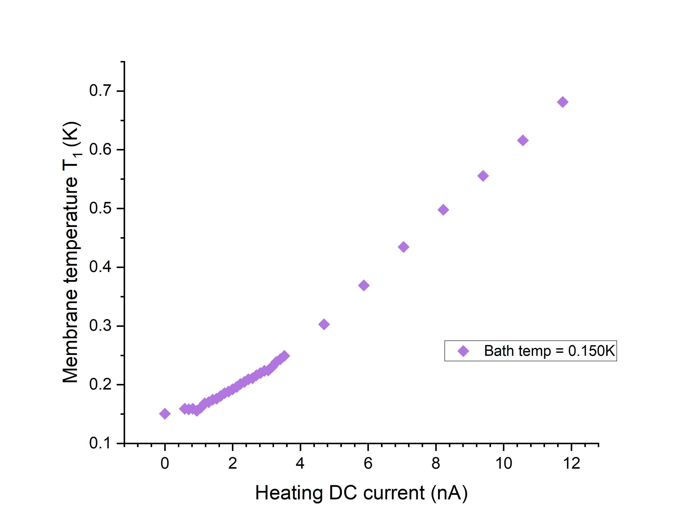
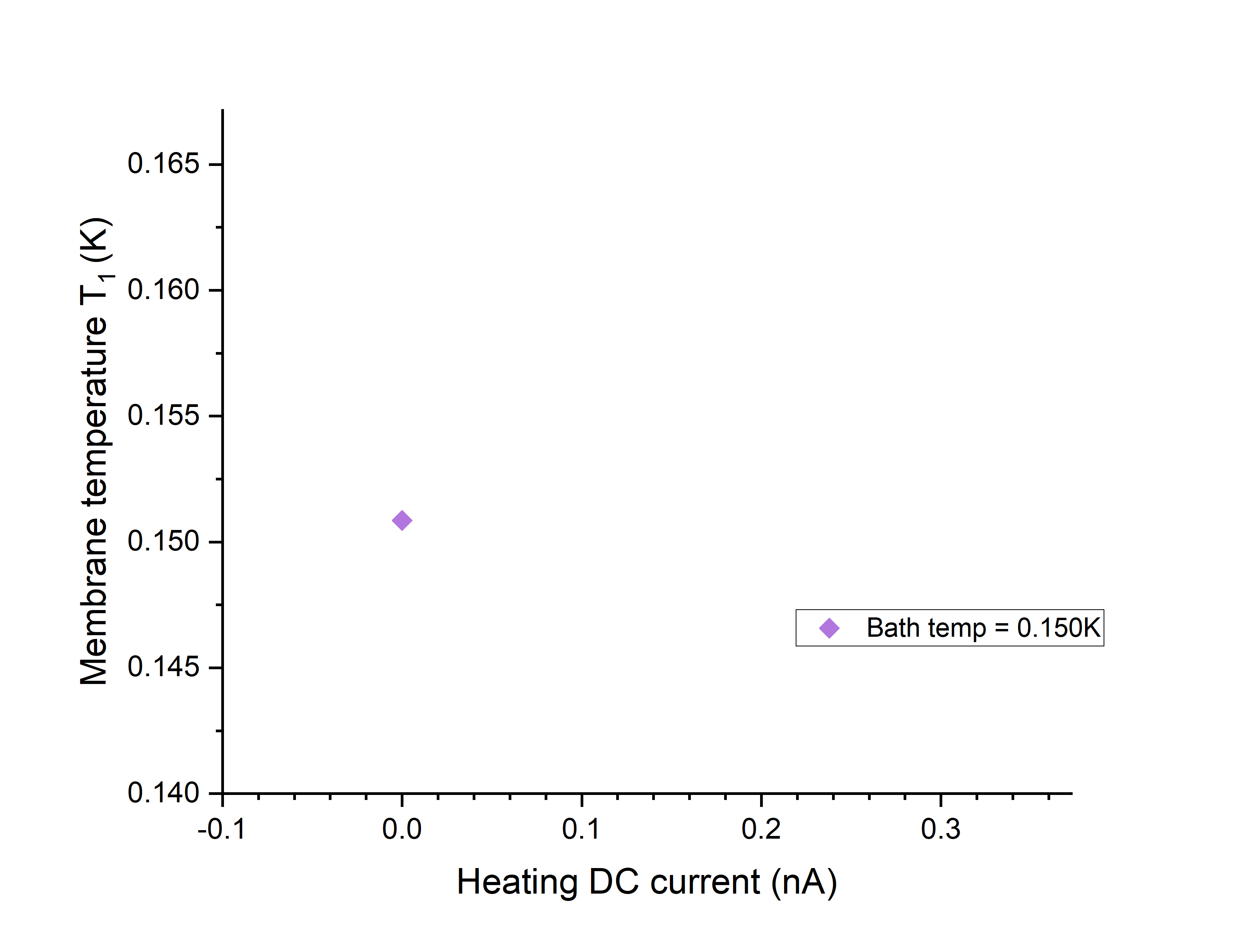
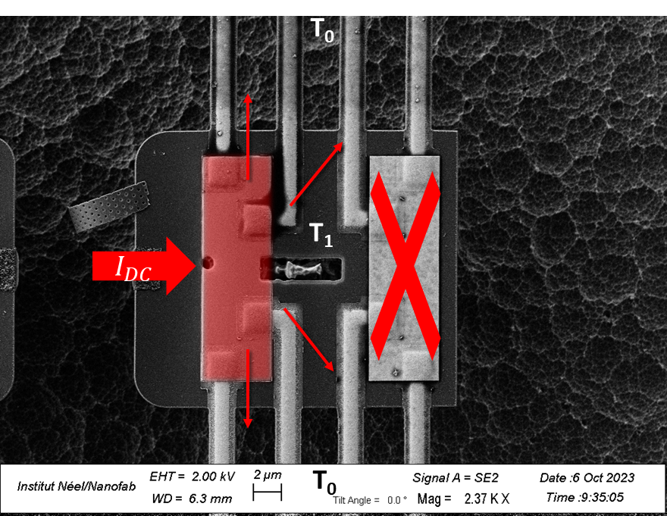
Single membrane setup
Fixed temperature bath T₀
  Fixed probe current I_{AC}
  Apply ramping heating current I_{DC} = f(T₀)
  Measure the increased T₁ for each I_{DC}
T₀
T₀

Slide 8
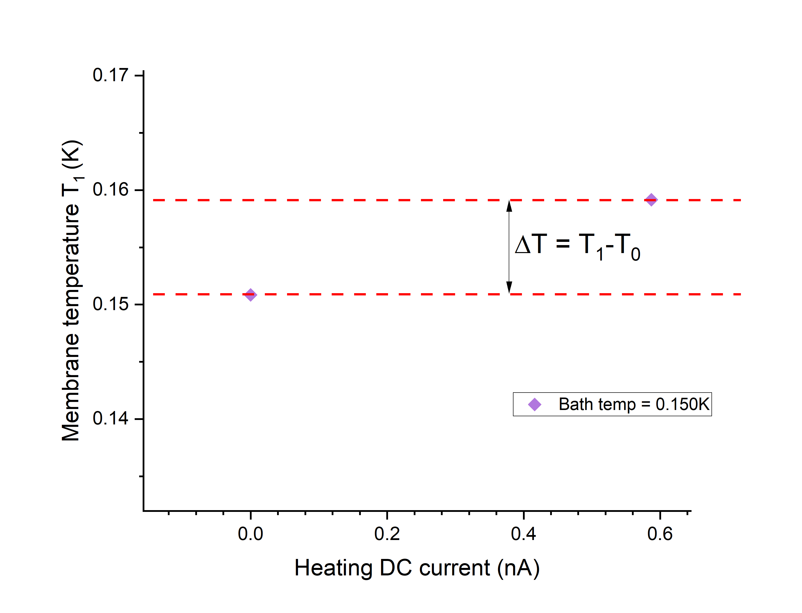
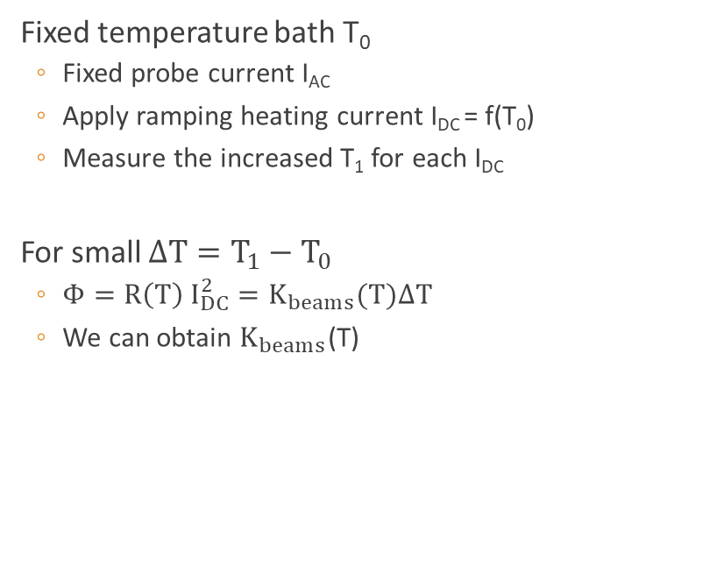
Single membrane setup
Fixed temperature bath T₀
  Fixed probe current I_{AC}
  Apply ramping heating current I_{DC} = f(T₀)
  Measure the increased T₁ for each I_{DC}
For small $ΔT=T_{1}−T_{0}$
  $Φ=R\left(T\right) I_{DC}^{2}=K_{beams}(T)ΔT$
  We can obtain $K_{beams}$(T)

Slide 9

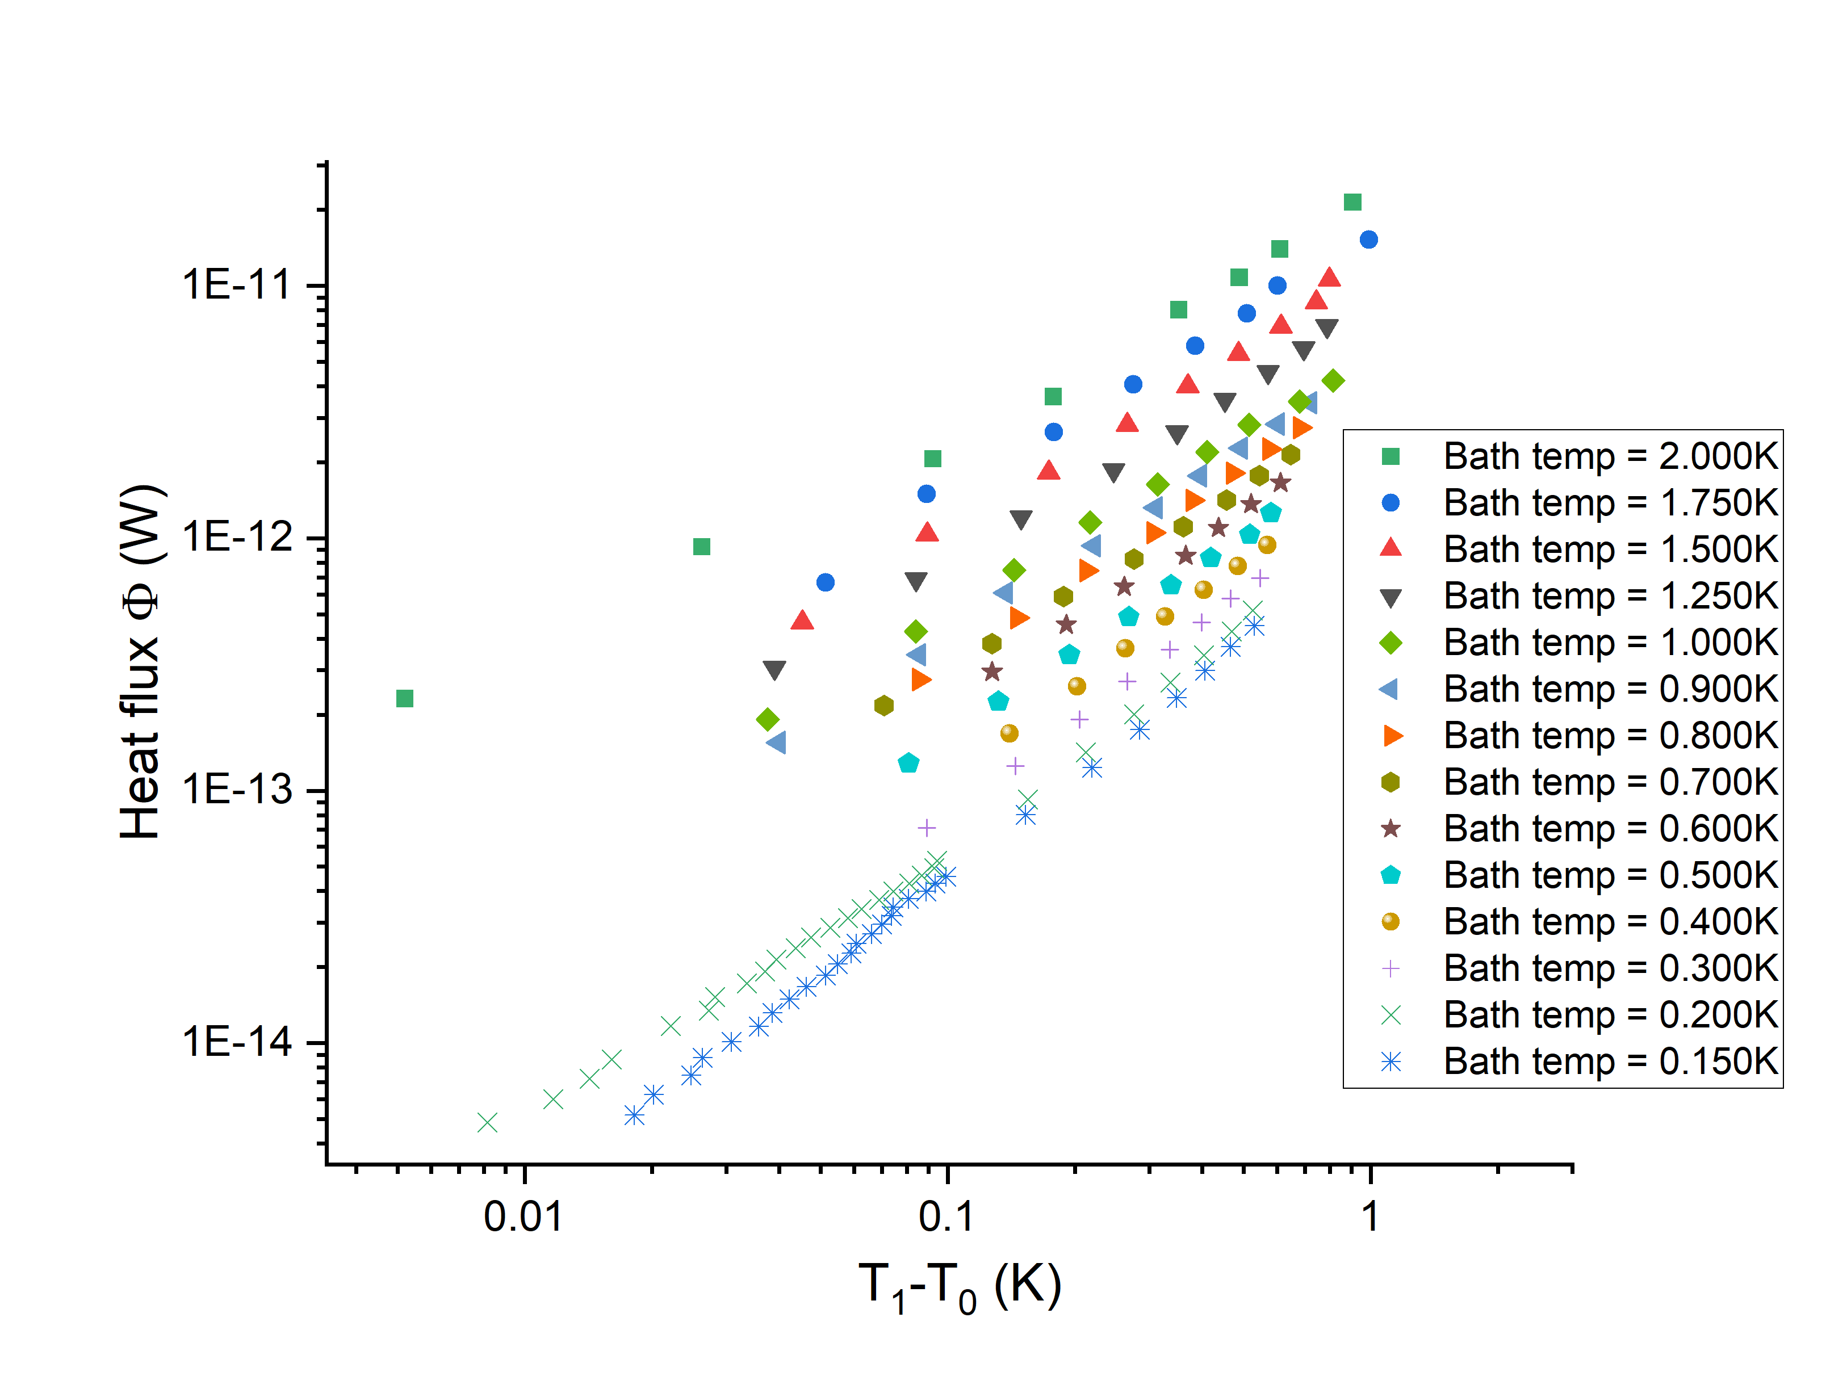
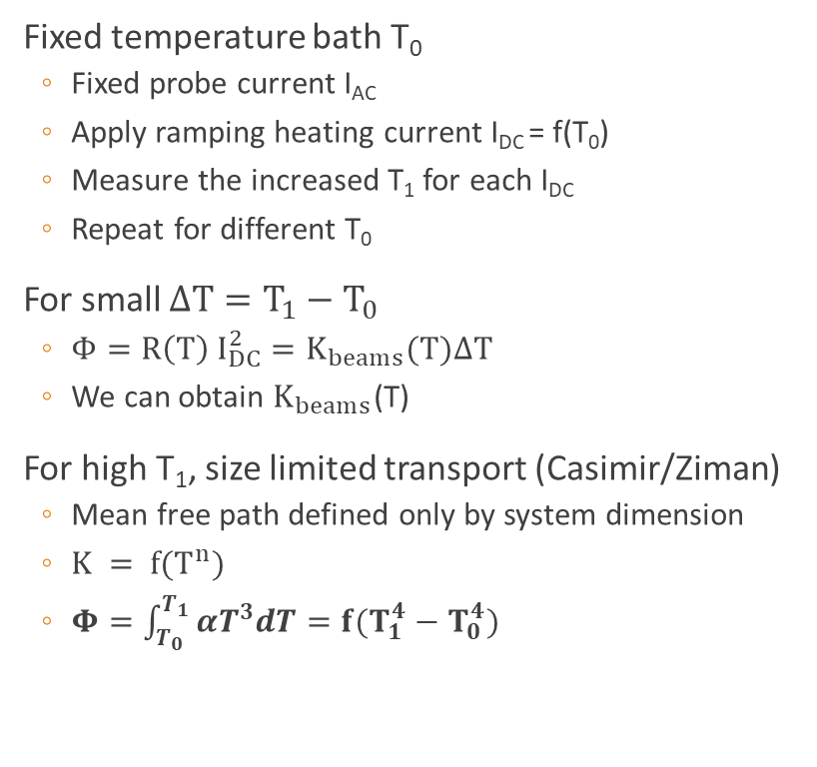
Single membrane setup
Fixed temperature bath T₀
  Fixed probe current I_{AC}
  Apply ramping heating current I_{DC} = f(T₀)
  Measure the increased T₁ for each I_{DC}
  Repeat for different T₀
For small $ΔT=T_{1}−T_{0}$
  $Φ=R\left(T\right) I_{DC}^{2}=K_{beams}(T)ΔT$
  We can obtain $K_{beams}$(T)
For high T₁, size limited transport (Casimir/Ziman)
  Mean free path defined only by system dimension
  $K = f(T^{n})$
  $Φ=\int_{T_{0}}^{T_{1}}{αT^{3}dT}=f(T_{1}^{4}−T_{0}^{4})$

Slide 10
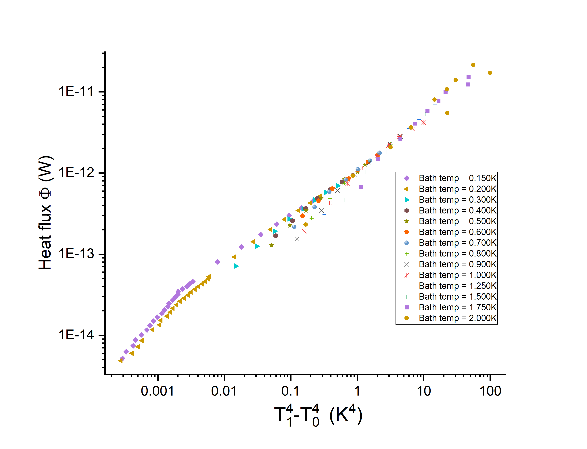
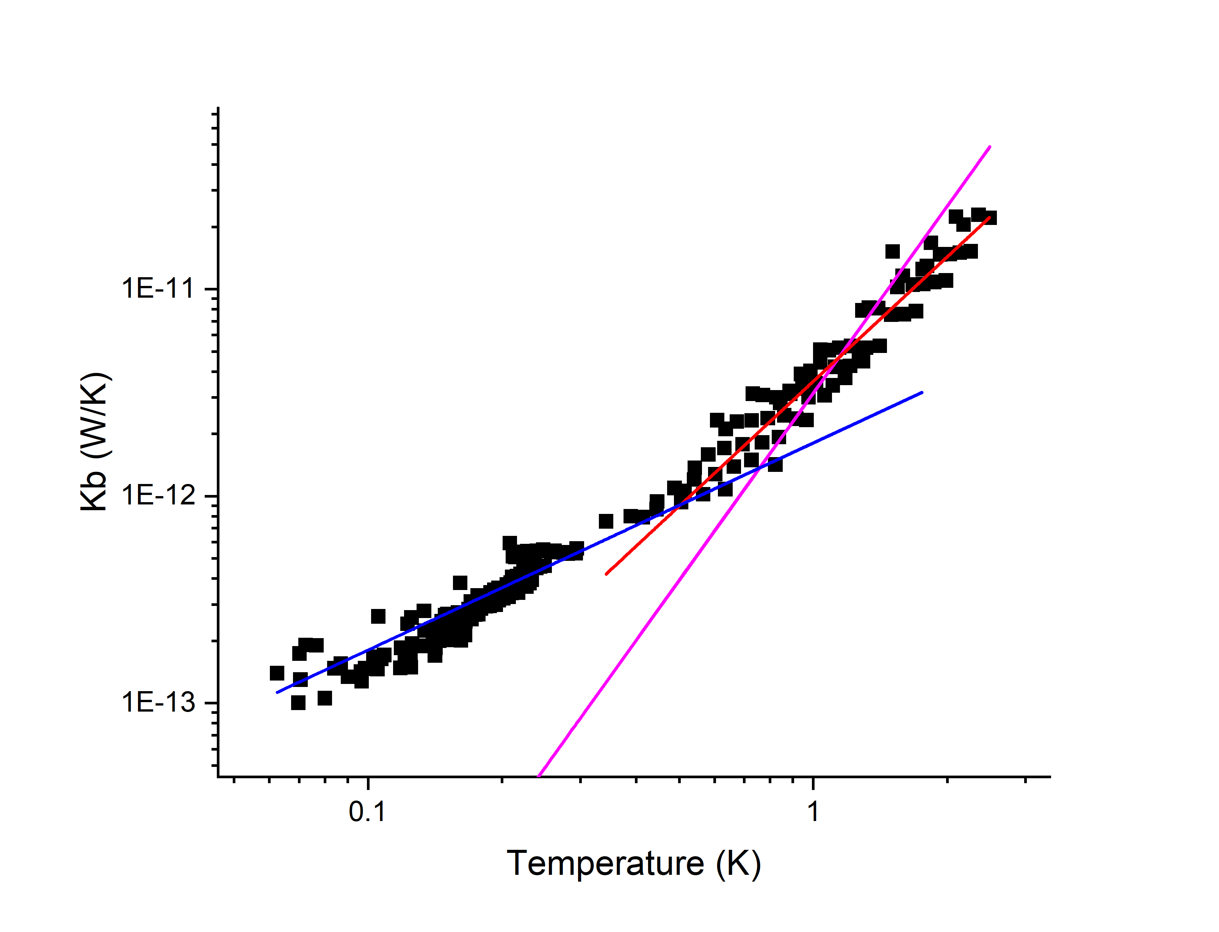










Single membrane results
$$Φ=R\left(T\right) I_{DC}^{2}=f(T_{1}^{4}−T_{0}^{4})$$
$$K_{beams}\left(T\right) for small ΔT$$
$∝T^{3}$ (Casimir)
$$Φ$$
$$∝T^{2}$$
$$K_{beams} (W/K)$$
$$∝T$$
$$I_{DC}$$
$$Φ$$
Temperature $T_{1} (K)$

Slide 11
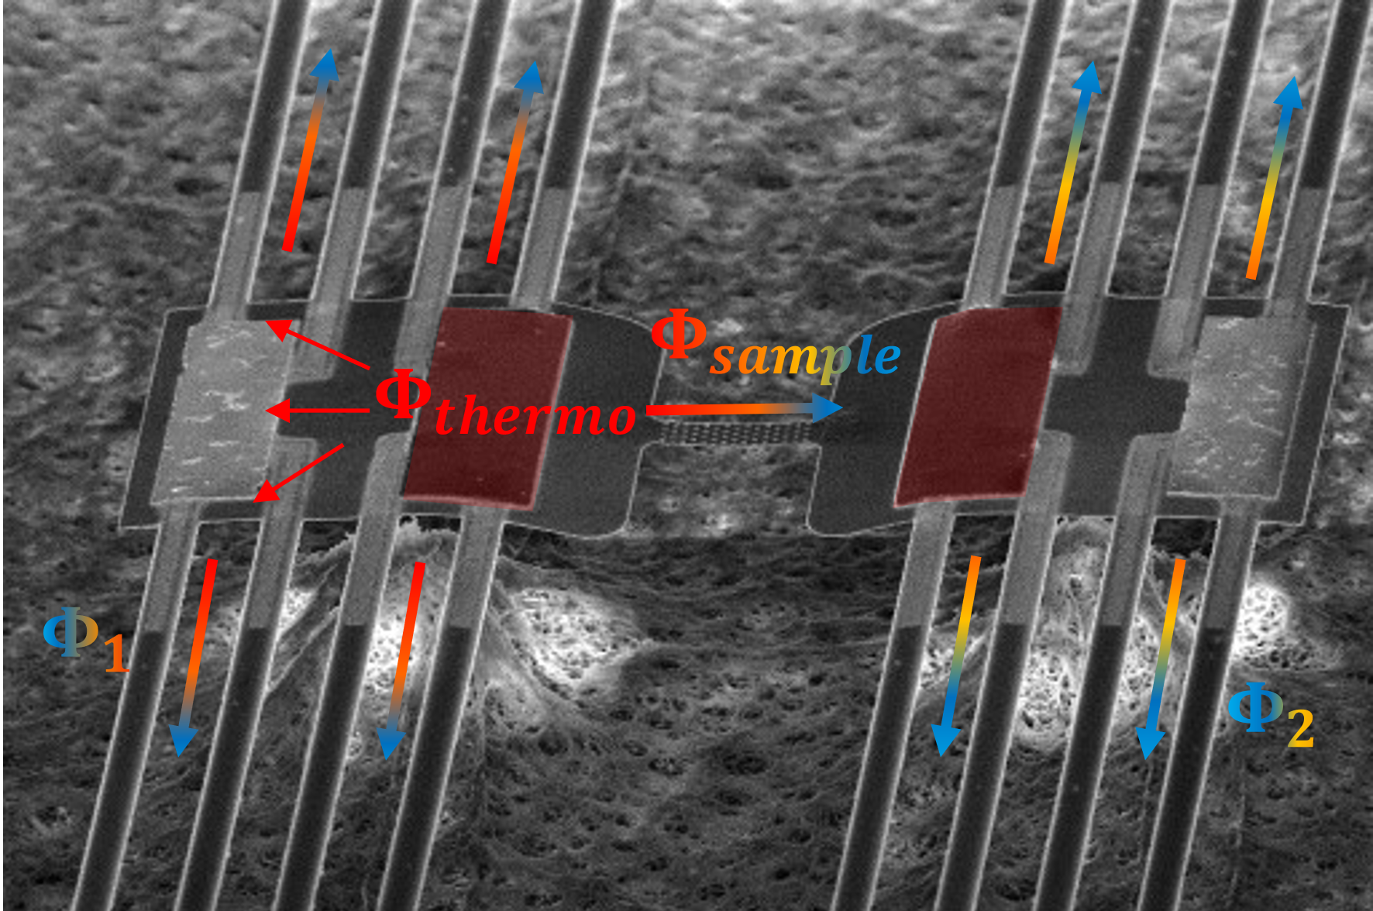
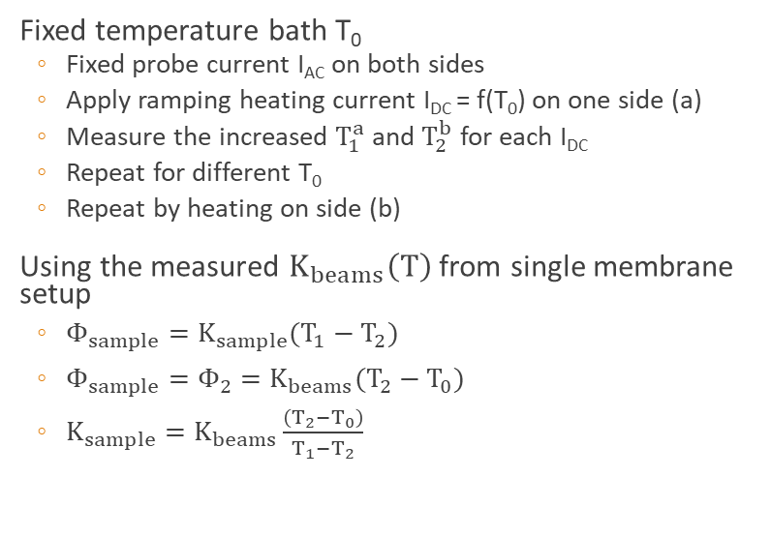
Thermal bridge setup
Fixed temperature bath T₀
  Fixed probe current I_{AC} on both sides
  Apply ramping heating current I_{DC} = f(T₀) on one side (a)
  Measure the increased $T_{1}^{a}$ and $T_{2}^{b}$ for each I_{DC}
  Repeat for different T₀
  Repeat by heating on side (b)
Using the measured $K_{beams}\left(T\right)$ from single membrane setup
  $Φ_{sample}=K_{sample}(T_{1}−T_{2})$
  $Φ_{sample}=Φ_{2}=K_{beams}(T_{2}−T_{0})$
  $K_{sample}=K_{beams}\frac{\left(T_{2}−T_{0}\right)}{T_{1}−T_{2}}$
a --> b
a
b
a <-- b
a --> b
260 nm
a
300 nm
b
a side
b side
200 nm
1 µm
a <-- b
5 µm

Slide 12
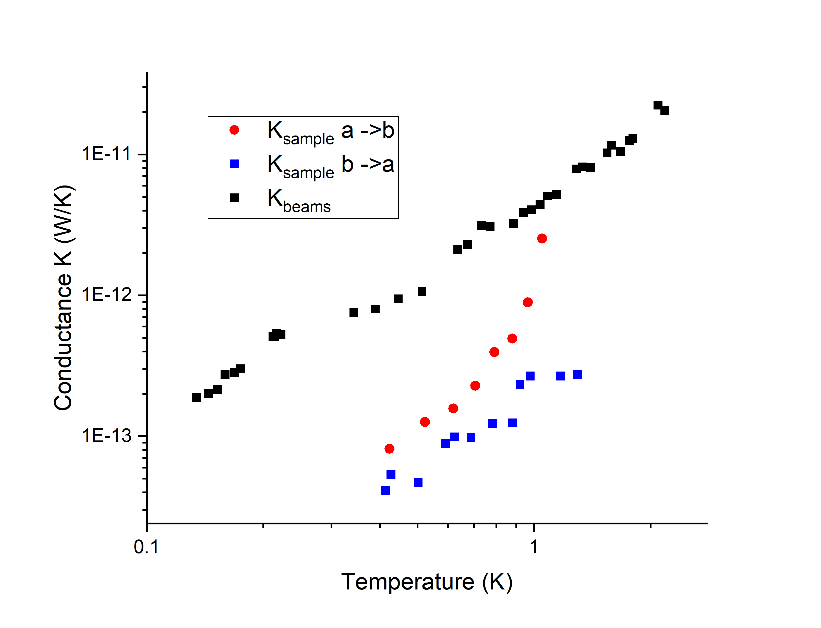
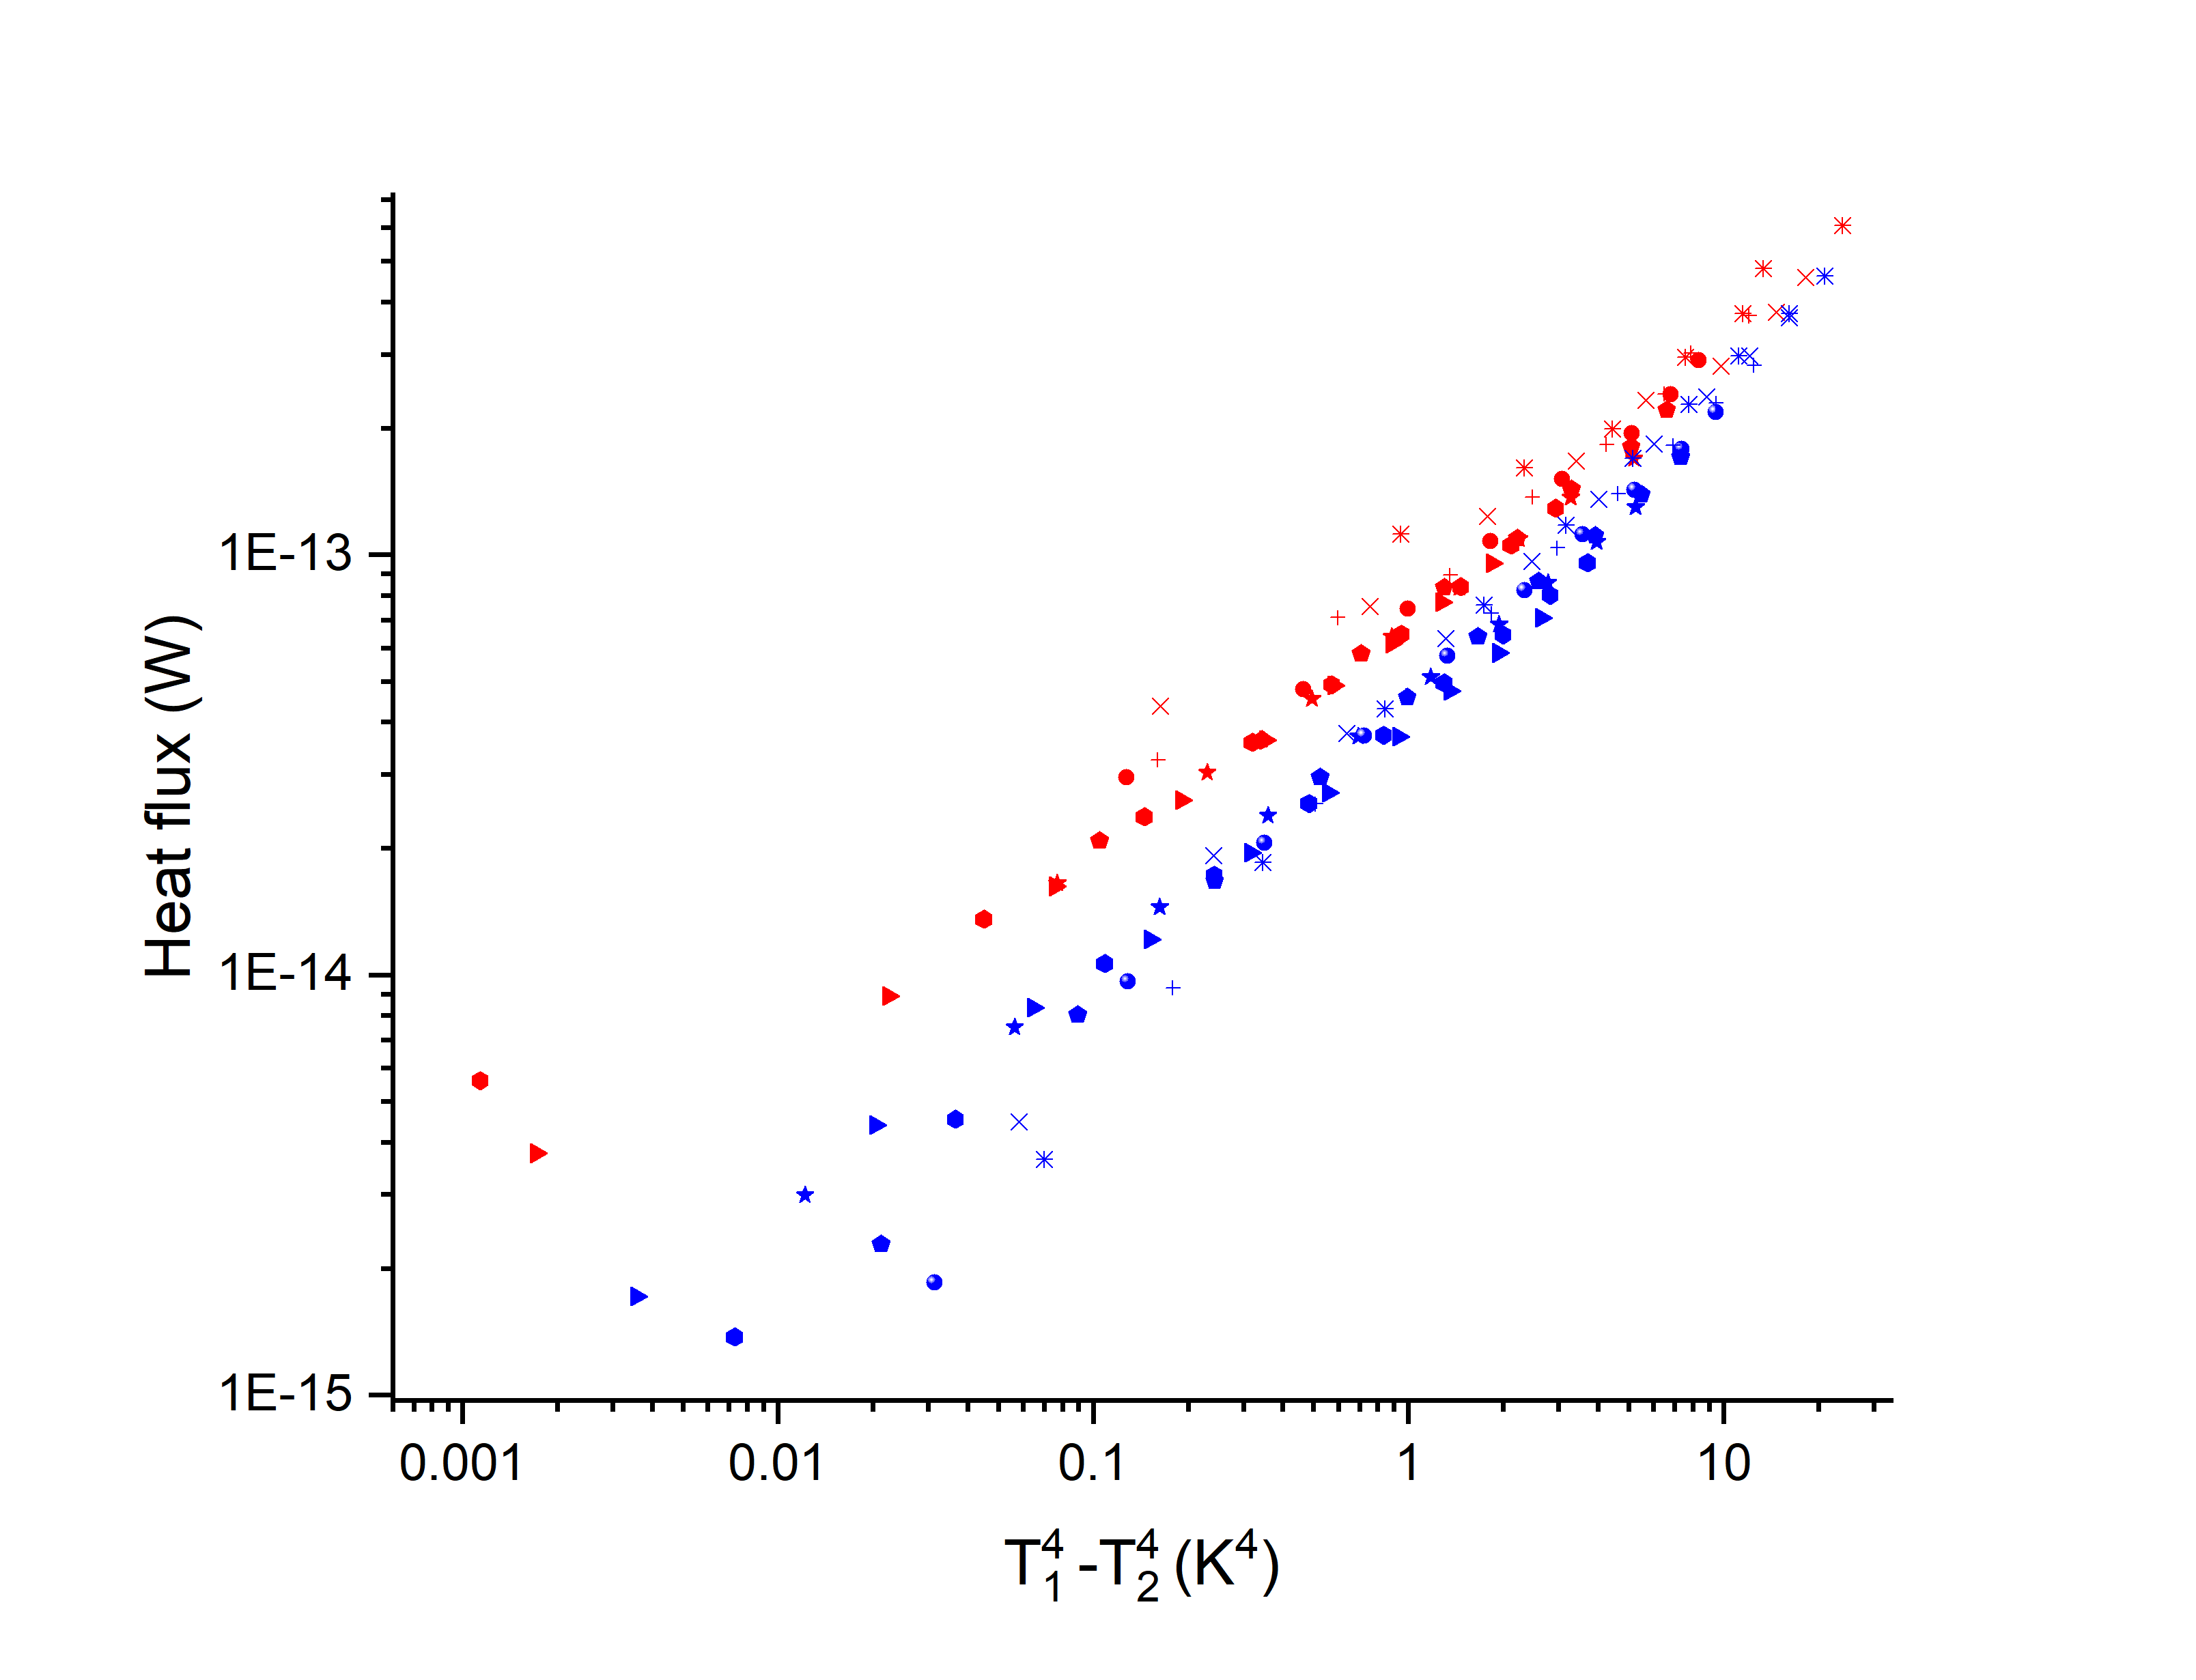
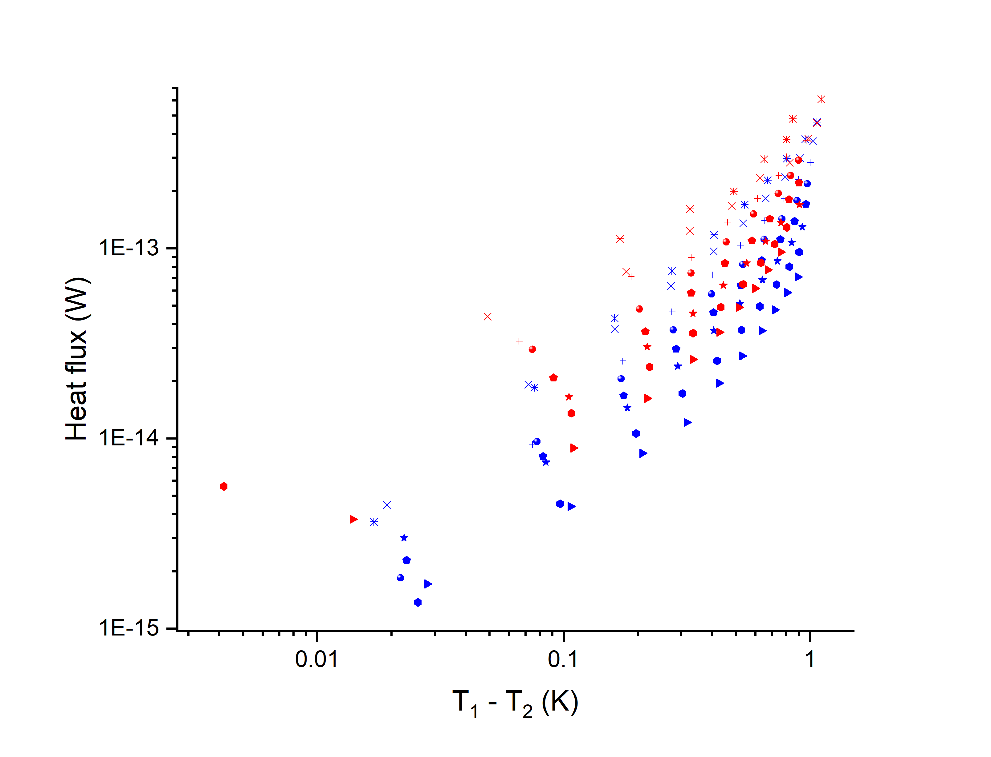
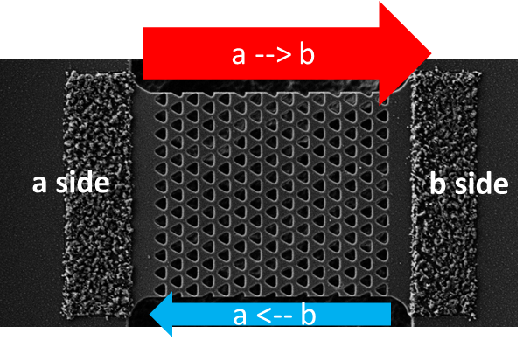

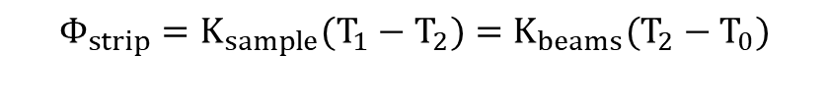
Thermal bridge results
$$K_{sample}=\frac{K_{beams}\left(T_{2}−T_{0}\right)}{T_{1}−T_{2}}$$
$$Φ_{strip}=K_{sample}(T_{1}−T_{2})=K_{beams}(T_{2}−T_{0})$$
a → b
For T₀ = 300 mK - 1 K
b → a
For T₀ = 300 mK - 1 K

Slide 13
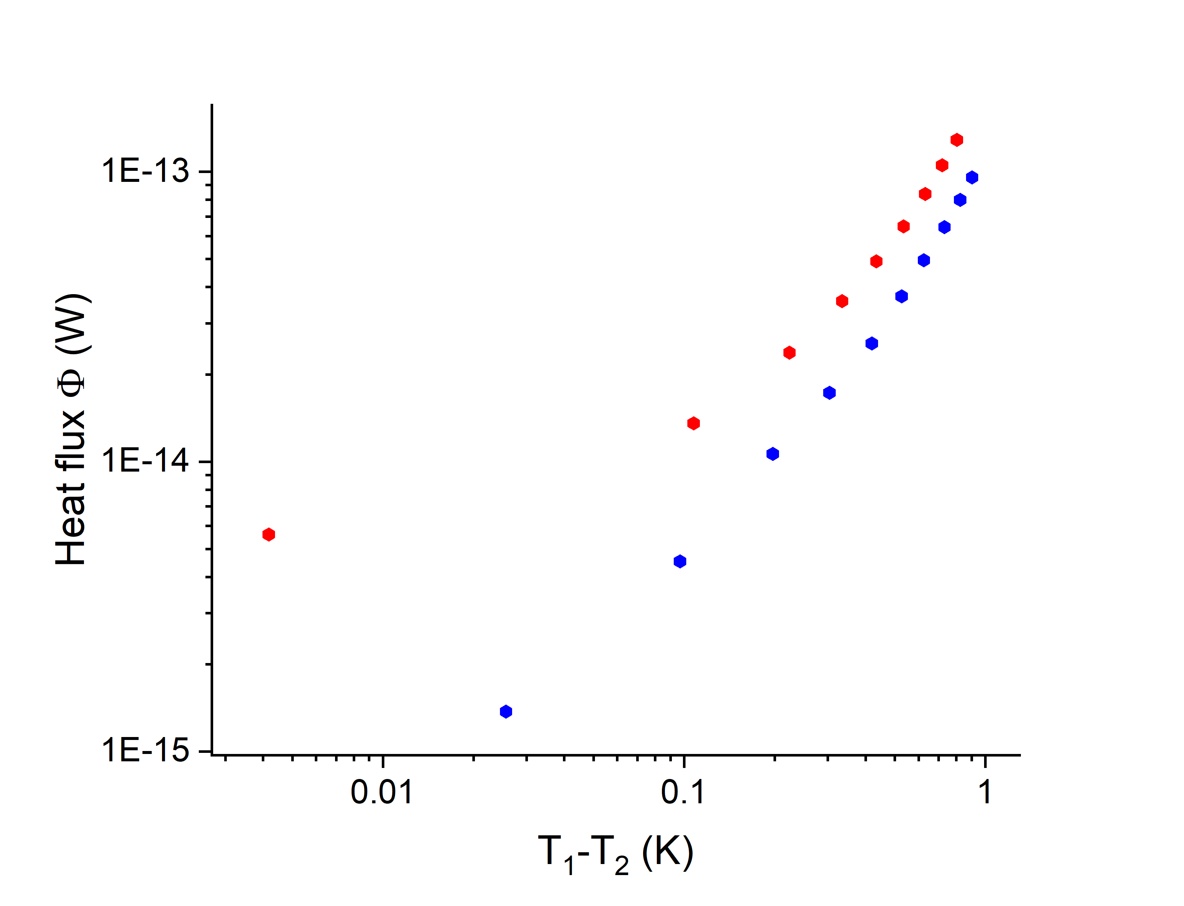
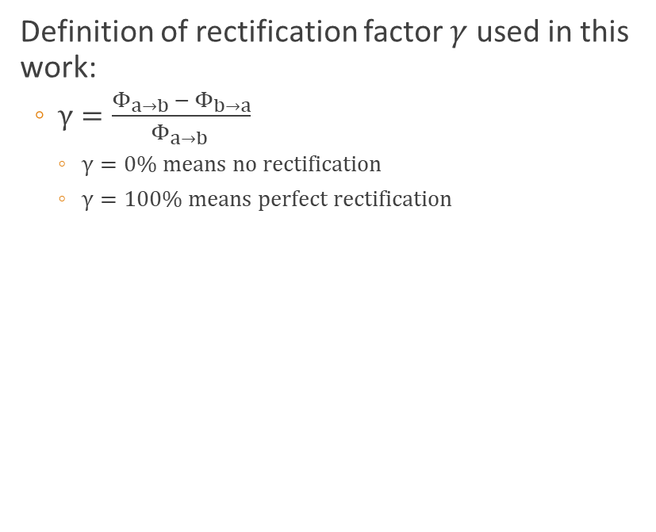
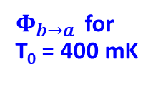
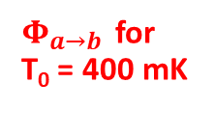
Thermal rectification
Definition of rectification factor $γ$ used in this work:
  $γ=\frac{Φ_{a→b }−{ Φ}_{b→a}}{Φ_{a→b }}$
    $γ=0\% means no rectification$
    $γ=100\% means perfect rectification$
$Φ_{a→b }$ for
T₀ = 400 mK
a --> b
$Φ_{b→a }$ for
T₀ = 400 mK
a side
b side
1 µm
a <-- b

Slide 14
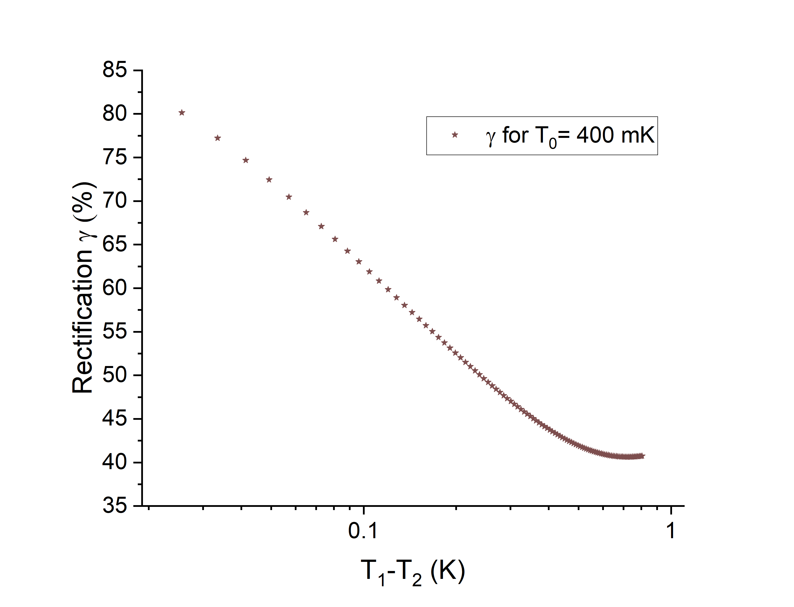
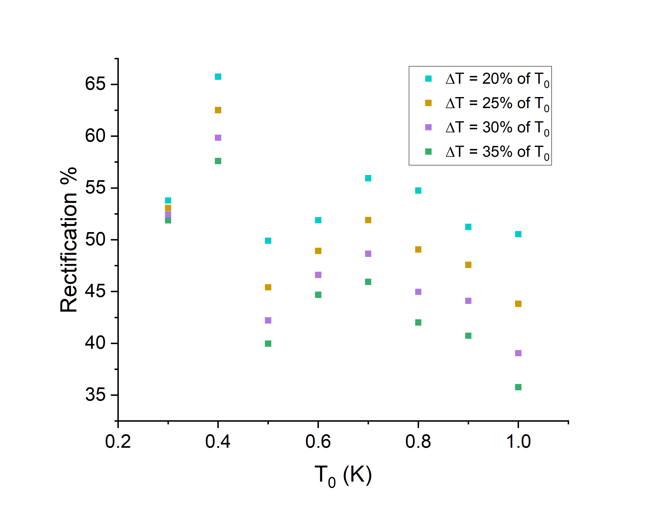

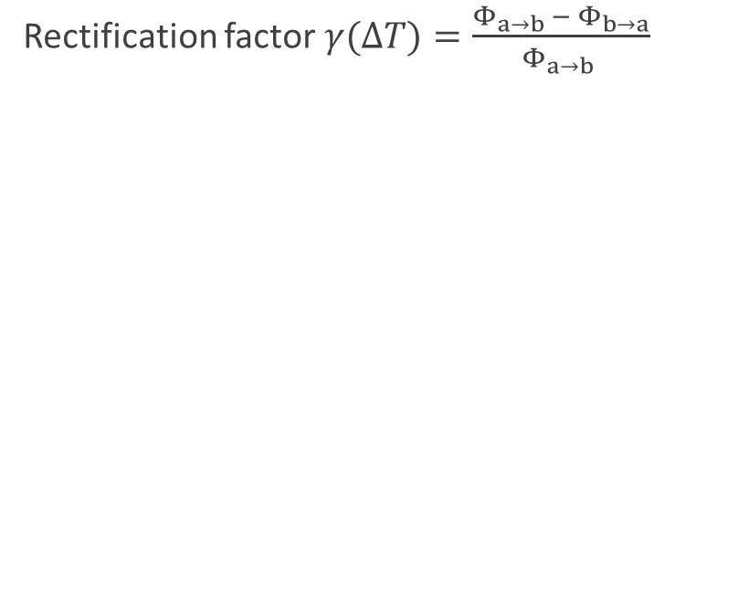

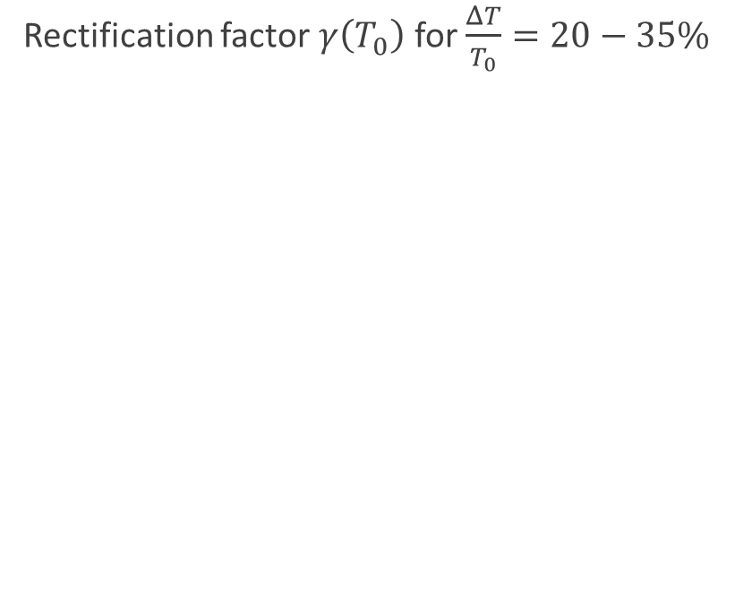
Thermal rectification factor
Rectification factor $γ(ΔT)=\frac{Φ_{a→b }−{ Φ}_{b→a}}{Φ_{a→b }}$
Rectification factor $γ\left(T_{0}\right)$ for $\frac{ΔT}{T_{0}}=20−35\%$
$$20\% of T_{0}=80 mK$$
$$30\% of T_{0}=120 mK$$

Slide 15

Conclusion
  Fabrication of suspended membranes
  First measurement at dilution fridge temperatures
  Rectification observed in asymmetric SiN strips
  More data treatment necessary
  Measurements of different samples

Slide 16

Acknowledgments
ANR HANIBAL
  CEA – Natalio Mingo, Carlos Polanco-Garcia
  IEMN - Jean-François Robillard, Jon Canosa-Diaz
TPS team and technical support of Institut Néel
  Olivier Bourgeois and Laurent Saminadayar
  Thierry Crozes and Pierre Gasner for the fabrication support
  Victor Doebele
Lancaster university

Slide 17
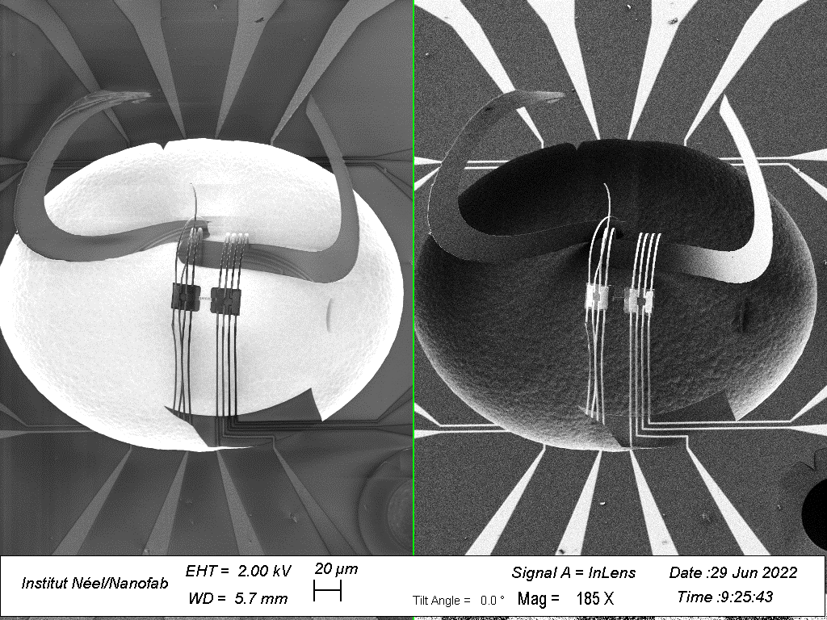
Thank you for your attention !

Slide 18
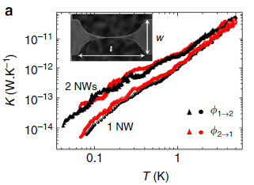
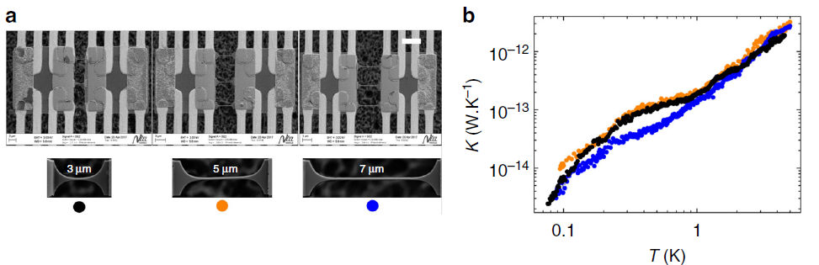
Preliminary results
Ballistic transport Heat flux symmetry
A. Tavakoli et al. Nat. Commun. 9, 4287 (2018)

Slide 19
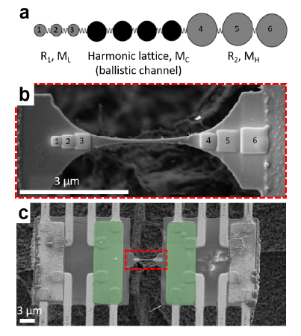
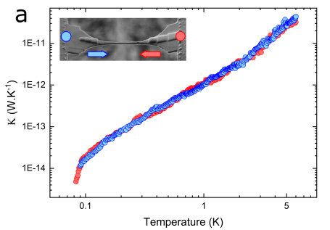
Preliminary results
Probing of rectification through
mass asymmetry
A. Tavakoli, J. Maire, B. Brisuda et al. Sci Rep 12, 7788 (2022)

Slide 20
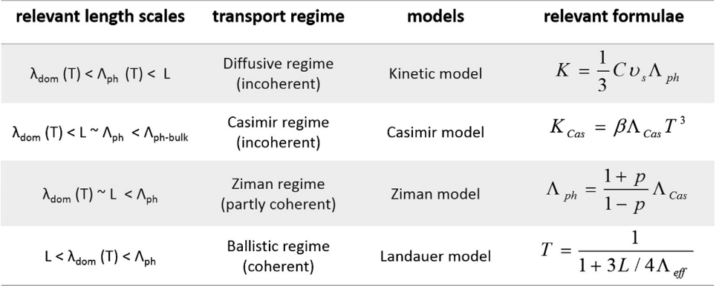
Non-Fourier transport regimes

Slide 21
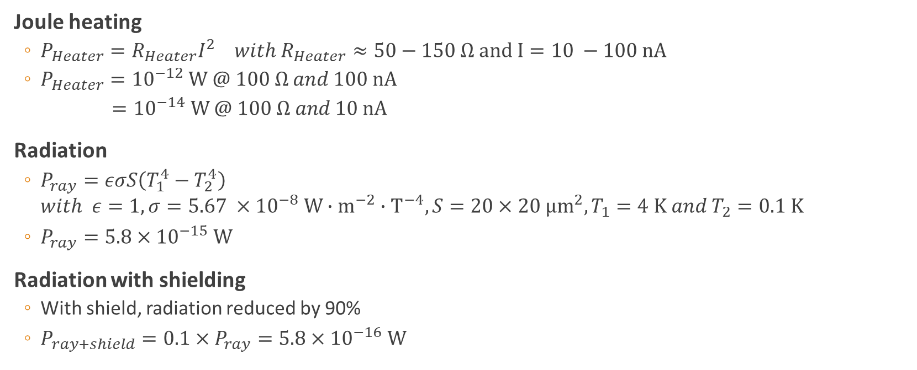
Radiation vs Joule heating
Joule heating
  $P_{Heater}=R_{Heater}I^{2} with R_{Heater}≈50−150 Ω and I=10 −100 nA$
  $P_{Heater}={10}^{−12} W @ 100 Ω and 100 nA$
  $={10}^{−14} W @ 100 Ω and 10 nA$
Radiation
  $P_{ray}=εσS\left(T_{1}^{4}−T_{2}^{4}\right)$
  $with ε=1, σ=5.67 ×{10}^{−8} W∙m^{−2}{∙T}^{−4}, S=20×20 µm^{2}, T_{1}=4 K and T_{2}=0.1 K$
  $P_{ray}=5.8×{10}^{−15} W$
Radiation with shielding
  With shield, radiation reduced by 90%
  $P_{ray+shield}=0.1×P_{ray}=5.8×{10}^{−16} W$

Slide 22
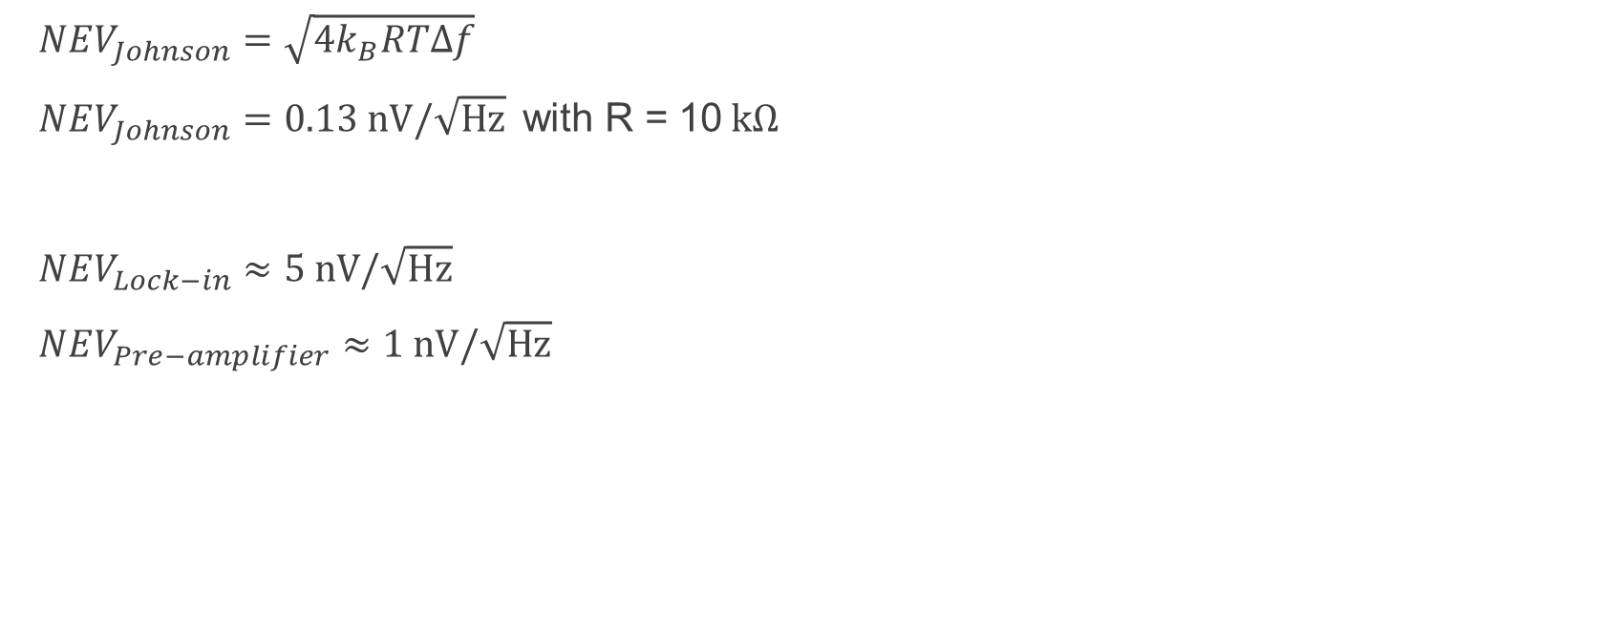
Noise estimation
$NEV_{Johnson}=\sqrt{4k_{B}RTΔf}$
$NEV_{Johnson}=0.13 nV/\sqrt{Hz} \text{with} \text{R}\text{ = 10} kΩ$
$NEV_{Lock−in}≈5 nV/\sqrt{Hz}$
$NEV_{Pre−amplifier}≈1 nV/\sqrt{Hz}$

Slide 23
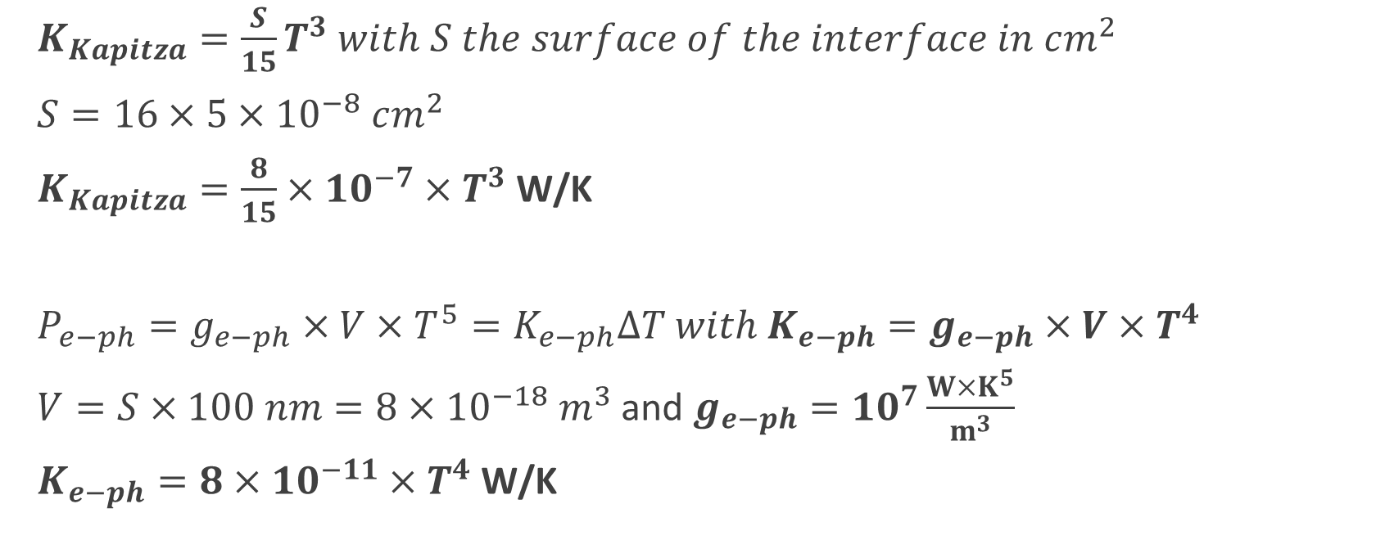
Kapitza and electron phonon coupling
$K_{Kapitza}=\frac{S}{15}T^{3} with S the surface of the interface in cm^{2}$
$S=16×5×{10}^{−8} cm^{2}$
$K_{Kapitza}=\frac{8}{15}×{10}^{−7}{×T}^{3}$ W/K
$P_{e−ph}=g_{e−ph}×V×T^{5}=K_{e−ph}ΔT with K_{e−ph}=g_{e−ph}×V×T^{4}$
$V=S×100 nm=8×{10}^{−18} m^{3}$ and $g_{e−ph}={10}^{7}\frac{{W×K}^{5}}{m^{3}}$
$K_{e−ph}=8×10^{−11}×T^{4}$ W/K

Slide 24
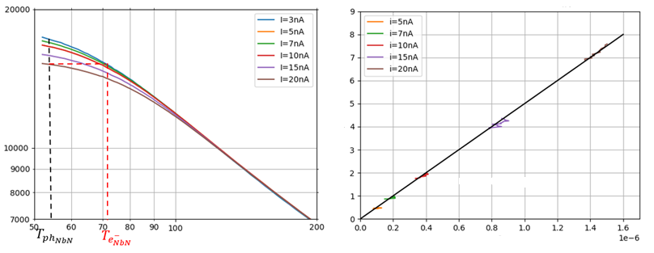









Electron-phonon coupling constant
$\frac{P}{V}=g_{e−ph}(T_{e_{NbN}^{−}}^{5}−T_{ph_{NbN}}^{5})$
Resistance $(Ω)$
Puissance/Volume ($W/m^{3})$
NbN thin film
Electrons, $T_{e}$
$$g_{e−ph}$$
$$g_{e−ph}=5×{10}^{6} W/m^{3}{/K}^{5}$$
Phonons, $T_{p}$
$$R_{Kapitza}$$
$T_{e_{NbN}^{−}}^{5}−T_{ph_{NbN}}^{5} (K^{5})$
Silicon nitride sample phonons, $T_{p,SiN}$
Temperature (mK)

Slide 25

Setup issues
Rectification
  Lack of time reversal asymmetry
  Lack of non-linearity ???
Measurement
  Membrane temperature inhomogeneity
    Below 100mK
    Simulation neglecting several sources of scattering
C.A. Polanco, A. van Roekeghem, B. Brisuda, L. Saminadayar, O. Bourgeois, and N. Mingo, The phonon quantum of thermal conductance: are simulations and measurements estimating the same quantity?, Sci. Adv. 9, 2023

Slide 26

Beams SiN
$κ=\frac{1}{3}C_{D}v_{s}Λ$
  $C_{D}$ is the specific heat related to phonons carrying heat only
  $C_{D}=\frac{2}{5}×\frac{k_{B}^{4}}{ℏ^{3}}×\frac{π^{2}}{v_{s}^{3}}T^{3}=c_{D}^{′}×T^{3}$
For large SiN microwires as measured by Tavakoli, @1K $κ_{microwire}^{1K}=\frac{1}{3}c_{D}^{′}v_{s}Λ_{microwire}^{1K}$
  $κ_{microwire}^{1K}=9×{10}^{−3}$ W/m/K
  $Λ_{microwire}^{1K}=27 µm$
For our experiment : $κ_{SiN_{beams}}=\frac{κ_{microwire}^{1K}}{Λ_{microwire}^{1K}}×Λ_{2memb}^{Cas}×T^{3}$
  $Λ_{SiN_{beams}}^{Cas}=1.12\sqrt{e×w} with e=100 nm and w=2 µm$
  $Λ_{SiN_{beams}}^{Cas}=0.5 µm$
$κ_{SiN_{beams}}=1.7×{10}^{−4}×T^{3}$ W/m/K
$Κ_{2memb}^{eff}=number of beams×\frac{w×e}{L}×κ_{2memb} with 8 beams and L=80 µm$
$Κ_{SiN_{beams}}^{eff}=3.14×{10}^{−12}×T^{3}$ W/K

Slide 27


Slide 28

Strip
$1 strip≈3 narrow microwires$
  ($Λ_{Cas}^{strip}=0.7µm compared to Λ_{narrow−wire}=0.9µm)$
$Κ_{eff}^{strip}=3×κ_{narrow−wire }×\frac{w×e}{L}$ with $w=4 µm and e=100 nm$
$Κ_{eff}^{strip}=3.6×{10}^{−11}×T^{3}$ W/K

Slide 29

Beams NbTi
Resistance of contact leads = difference between normal state and superconductive state
  $R_{aller−retour}=23 kΩ$ → $R_{1wire}=11.5 kΩ$
  $Κ_{1wire}=\frac{L_{0}}{R_{1wire}}×T=2.1×{10}^{−6}×T$ W/K
Nb supra $Κ_{1wire}≈{10}^{−11}×T^{4.5}$ W/K

Slide 30
Overetching

Slide 31















T₀
NbN thin film thermometer
$$Φ_{sample}$$
Electrons, $T_{e}^{NbN}$
$$Φ_{thermo}$$
$$@ 1 K$$
$$K_{e−ph}=8×10^{−11} \text{W}\text{/}\text{K}$$
T₁
$$Φ_{1}$$
$$I_{DC}$$
Phonons, $T_{p}^{NbN}$
$$Φ_{2}$$
$$K_{Kapitza}=5×{10}^{−8} \text{W}\text{/}\text{K}$$
SiN membrane phonons, $T_{p}^{SiN}$
$$K_{beams}=2×{10}^{−12} \text{W}\text{/}\text{K}$$
Surrounding heat bath, $T_{p}^{SiN}$
T₀

