Slide 1


Role of dimensionality and size in controlling the drag Seebeck coefficient of doped silicon nanostructures.
Raja Sen, Nathalie Vast, Jelena Sjakste
Laboratoire des Solides Irradiés, CNRS, Ecole Polytechnique, CEA/DRF/IRAMIS Institut Polytechnique de Paris, France

Slide 2
Outline
Thermoelectric phonon drag effect
Theoretical framework and implementation
- Effect of SOC and nanostructuring on phonon drag in Si
2

Slide 3
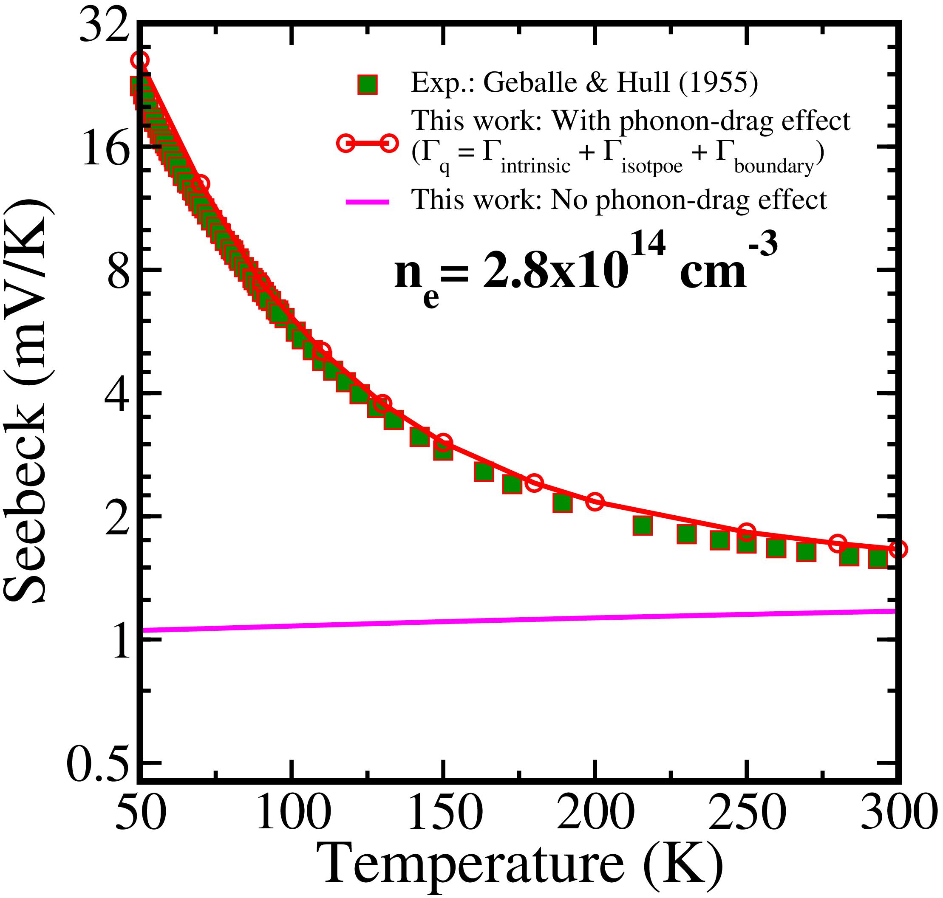
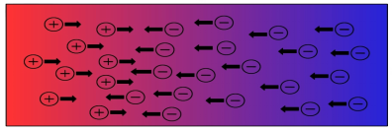
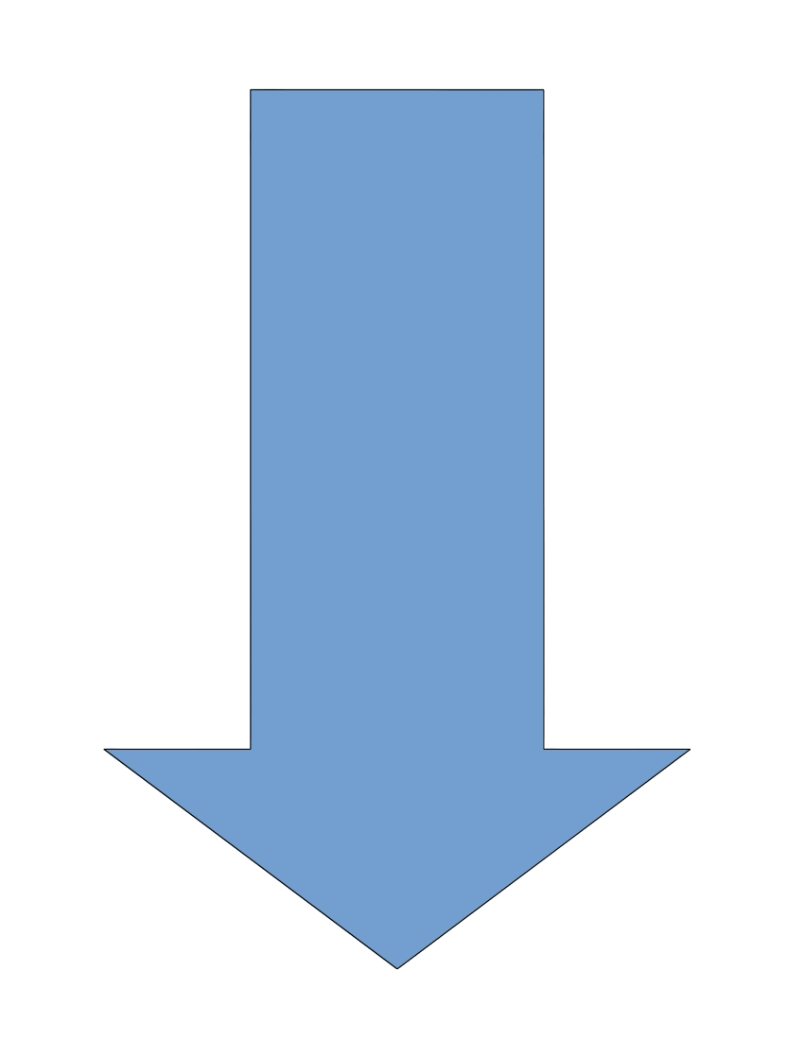
PHONON DRAG EFFECT
Flow of charge carriers (V₁ > V₂)
Si: Seebeck vs. Temperature
Flow of heat (T_{hot} > T_{cold})
V₁
T_{hot}
V₂
T_{cold}
External perturbation
gradient of temperature/voltage difference
Seebeck coefficient - diffusion & drag
The effect of non-equilibrium phonons and electrons
Phonon drag is important even at room temperature
T. Geballe and G. Hull, Phys. Rev. 98, 940 (1955).
3

Slide 4
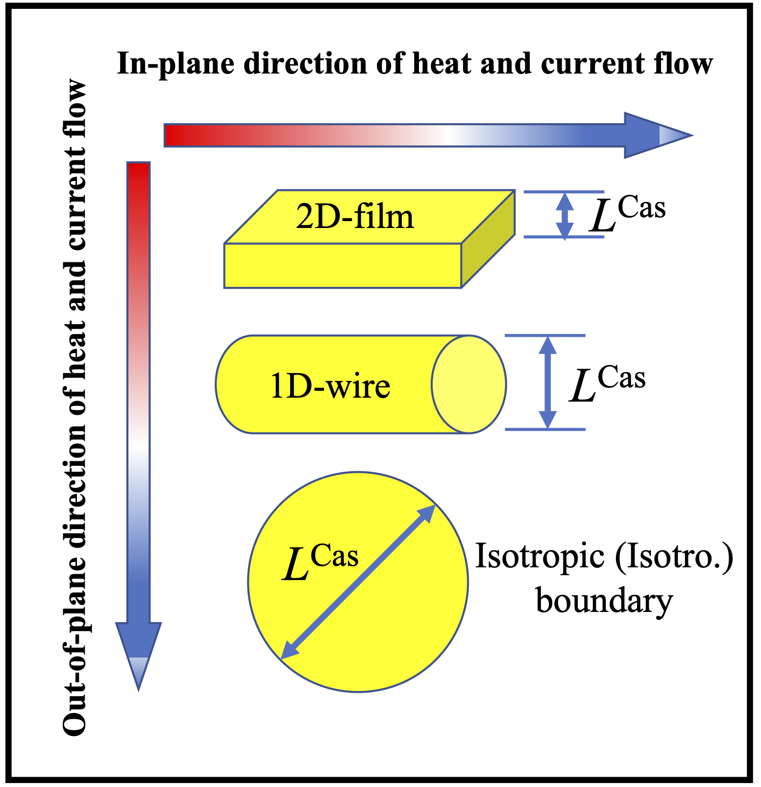
PHONON DRAG EFFECT IN NANOSTRUCTURES ?
Phonon mean free path
Thermal conductivity
Phonon drag effect
Is phonon drag effect completely killed at nanoscale?
Only theory can separate drift and drag contributions
K. Fauziah et al., AIP Adv. 10, 075015 (2020).
N. Bennett et al., Appl. Phys. Lett. 107, 013903 (2015).
4

Slide 5
Outline
Thermoelectric phonon drag effect
Theoretical framework and implementation
- Effect of SOC and nanostructuring on phonon drag in Si
5

Slide 6
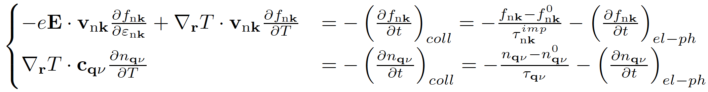
PHONON DRAG: THEORY
Flow of charge carriers (V₁ > V₂)
Flow of heat (T_{hot} > T_{cold})
V₁
T_{hot}
V₂
T_{cold}
Coupled transport equations for electrons and phonons:
6

Slide 7
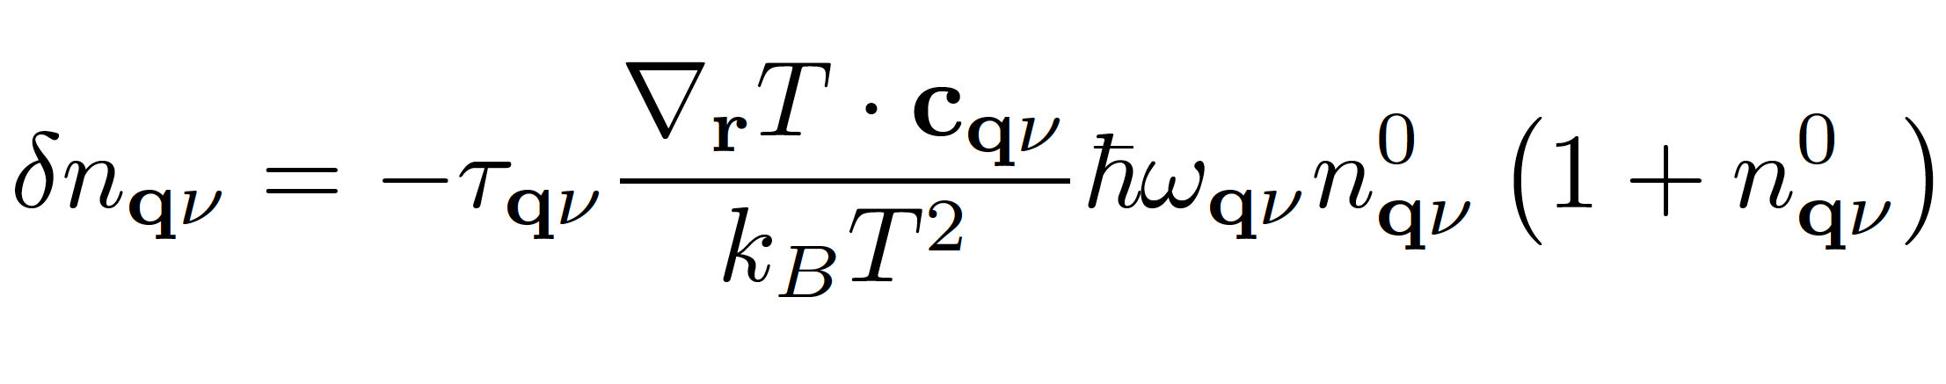
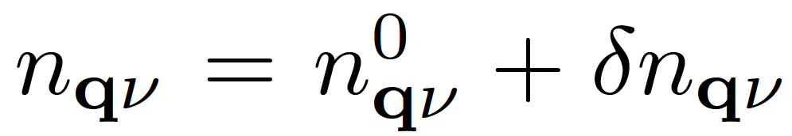
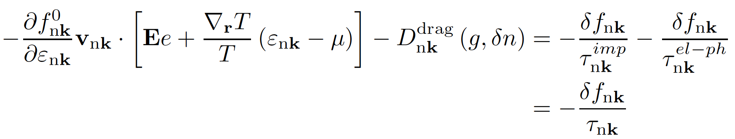
PHONON DRAG: THEORY
Out-of-equilibrium phonon population:
Coupled transport equations for electrons and phonons:
Phonon drag term
7

Slide 8
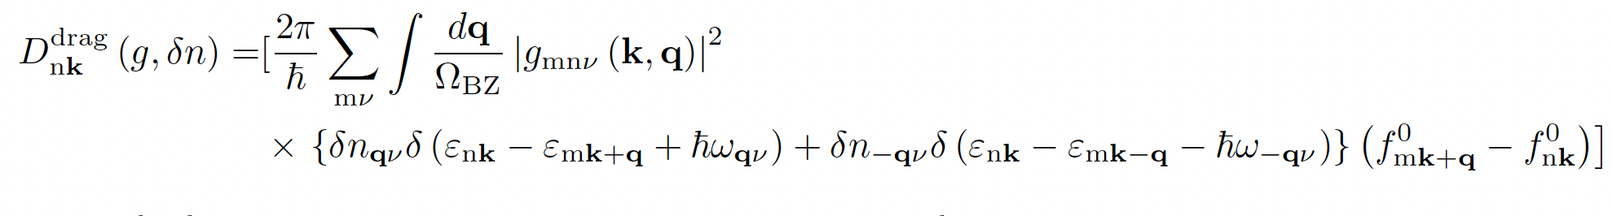
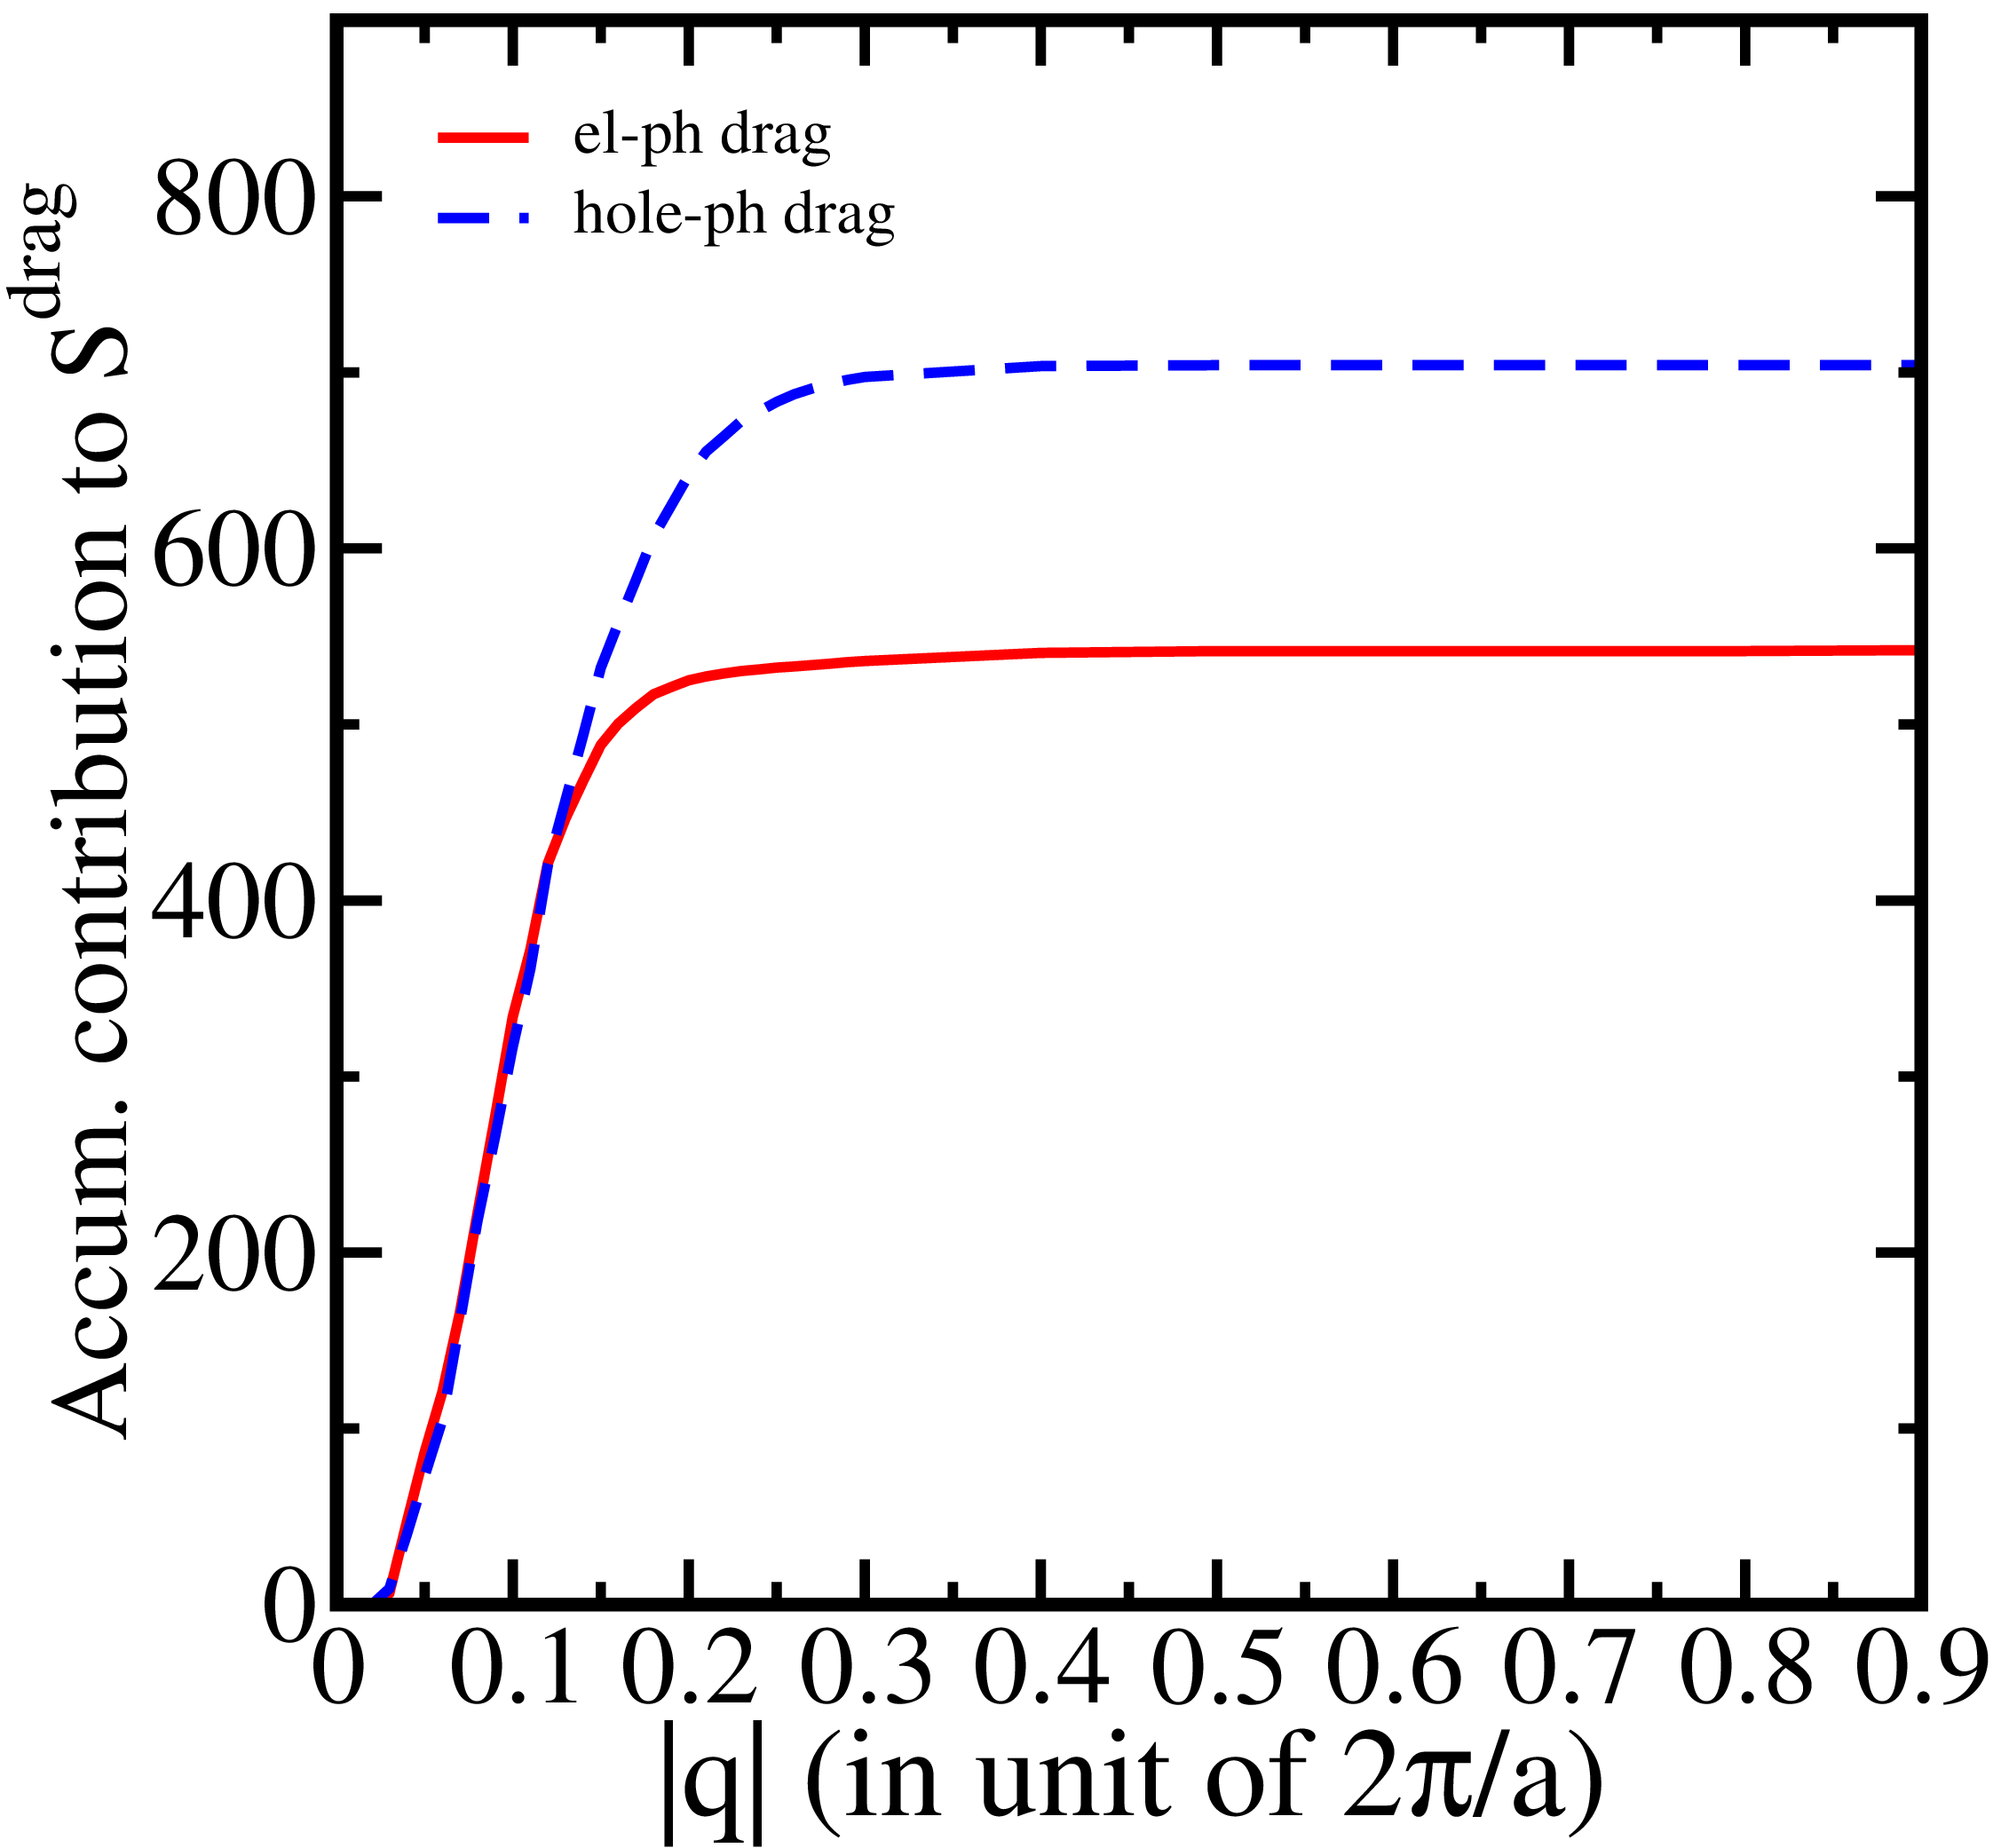


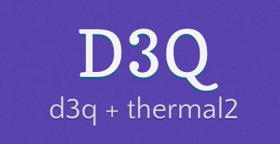
PHONON DRAG TERM
Implementation into EPW code: Raja Sen
Poncè et al. Comput. Phys. Commun. 209, 116 (2016)
P. Giannozzi, et al., J. Phys. Condens. Matter 21, 395502 (2009)
Paulatto et al. Phys. Rev. B 87, 214303 (2013)
8

Slide 9
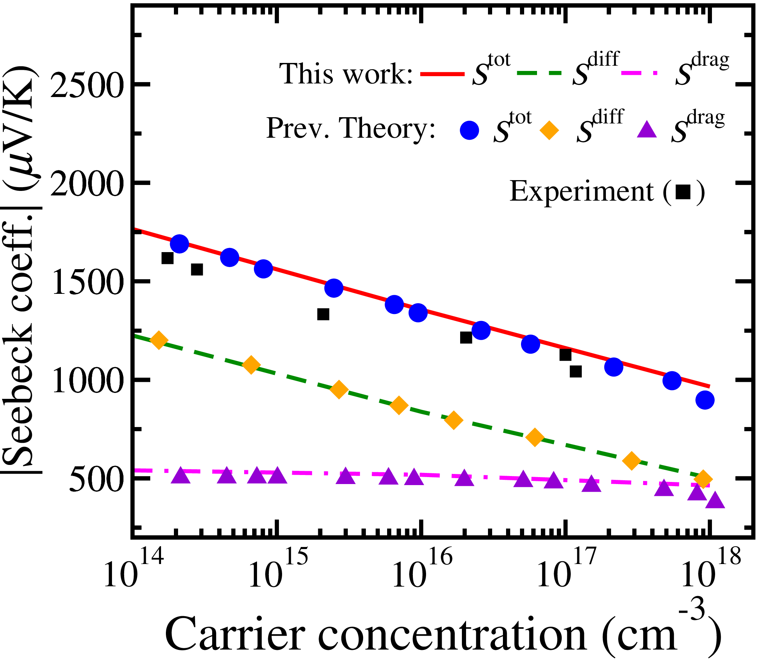
PHONON DRAG IN BULK Si
Implementation into EPW code: Raja Sen
The Seebeck coeff. vs. Temp.
The Seebeck coeff. vs. Carrier concentration
Zhou et al. Proc. Natl. Acad. Sci. USA 112, 14777 (2015)
T. Geballe and G. Hull, Phys. Rev. 98, 940 (1955).
Fiorentini et al. Phys. Rev. B 94, 085204 (2016)
9

Slide 10
Outline
Thermoelectric phonon drag effect
Theoretical framework and implementation
- Effect of SOC and nanostructuring on phonon drag in Si
10

Slide 11
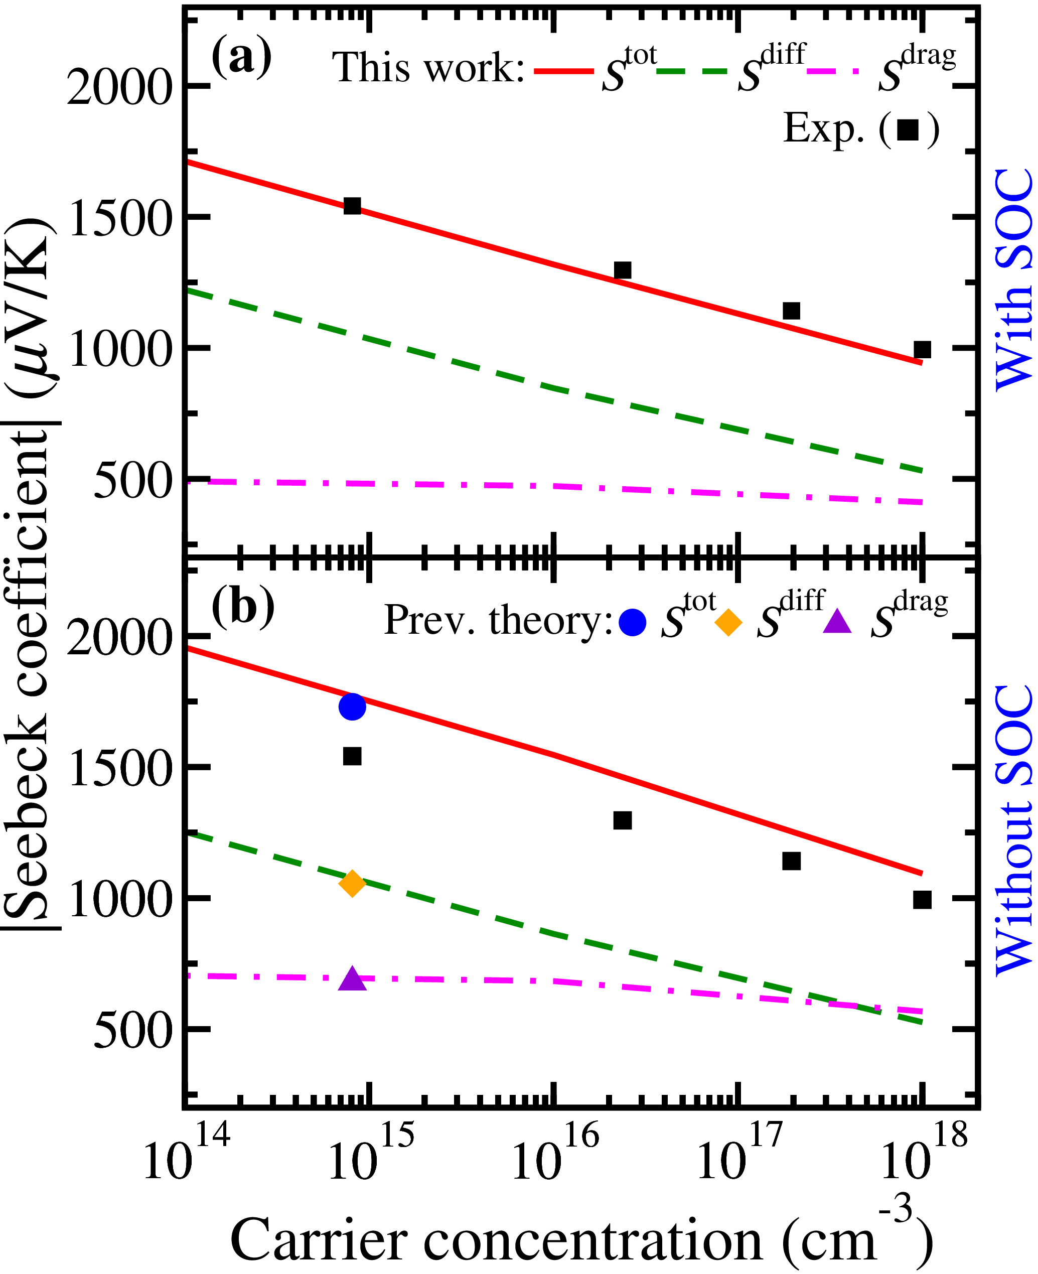
PHONON DRAG FOR HOLES in Si: SOC
SOC improves theory/experiment agreement
Band structure changes (effective mass)
R. Sen, N. Vast, and J. Sjakste, Phys. Rev. B 108, L060301 (2023)
Zhou et al. Proc. Natl. Acad. Sci. USA 112, 14777 (2015)
11

Slide 12
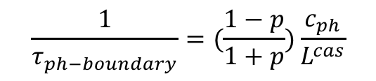
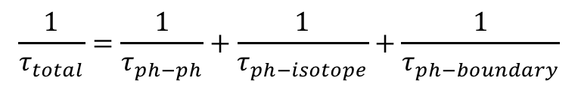
PHONON DRAG IN Si NANOSTRUCTURES
300 K
$$\frac{1}{τ_{total}}=\frac{1}{τ_{ph−ph}}+\frac{1}{τ_{ph−isotope}}+\frac{1}{τ_{ph−boundary}}$$
Direction-dependent Casimir model:
$$\frac{1}{τ_{ph−boundary}}=(\frac{1−p}{1+p})\frac{c_{ph}}{L^{cas}}$$
Geometry and direction dependence
At 100 nm, phonon drag still not completely quenched
in thin films and nanowires for in-plane transport
R. Sen, N. Vast, and J. Sjakste, Phys. Rev. B 108, L060301 (2023)
12

Slide 13
PHONON DRAG IN Si NANOSTRUCTURES
300 K
At 100 nm, phonon drag still not completely quenched
in thin films and nanowires for in-plane transport:
expected to increase at lower T
R. Sen, N. Vast, and J. Sjakste, Phys. Rev. B 108, L060301 (2023)
13

Slide 14
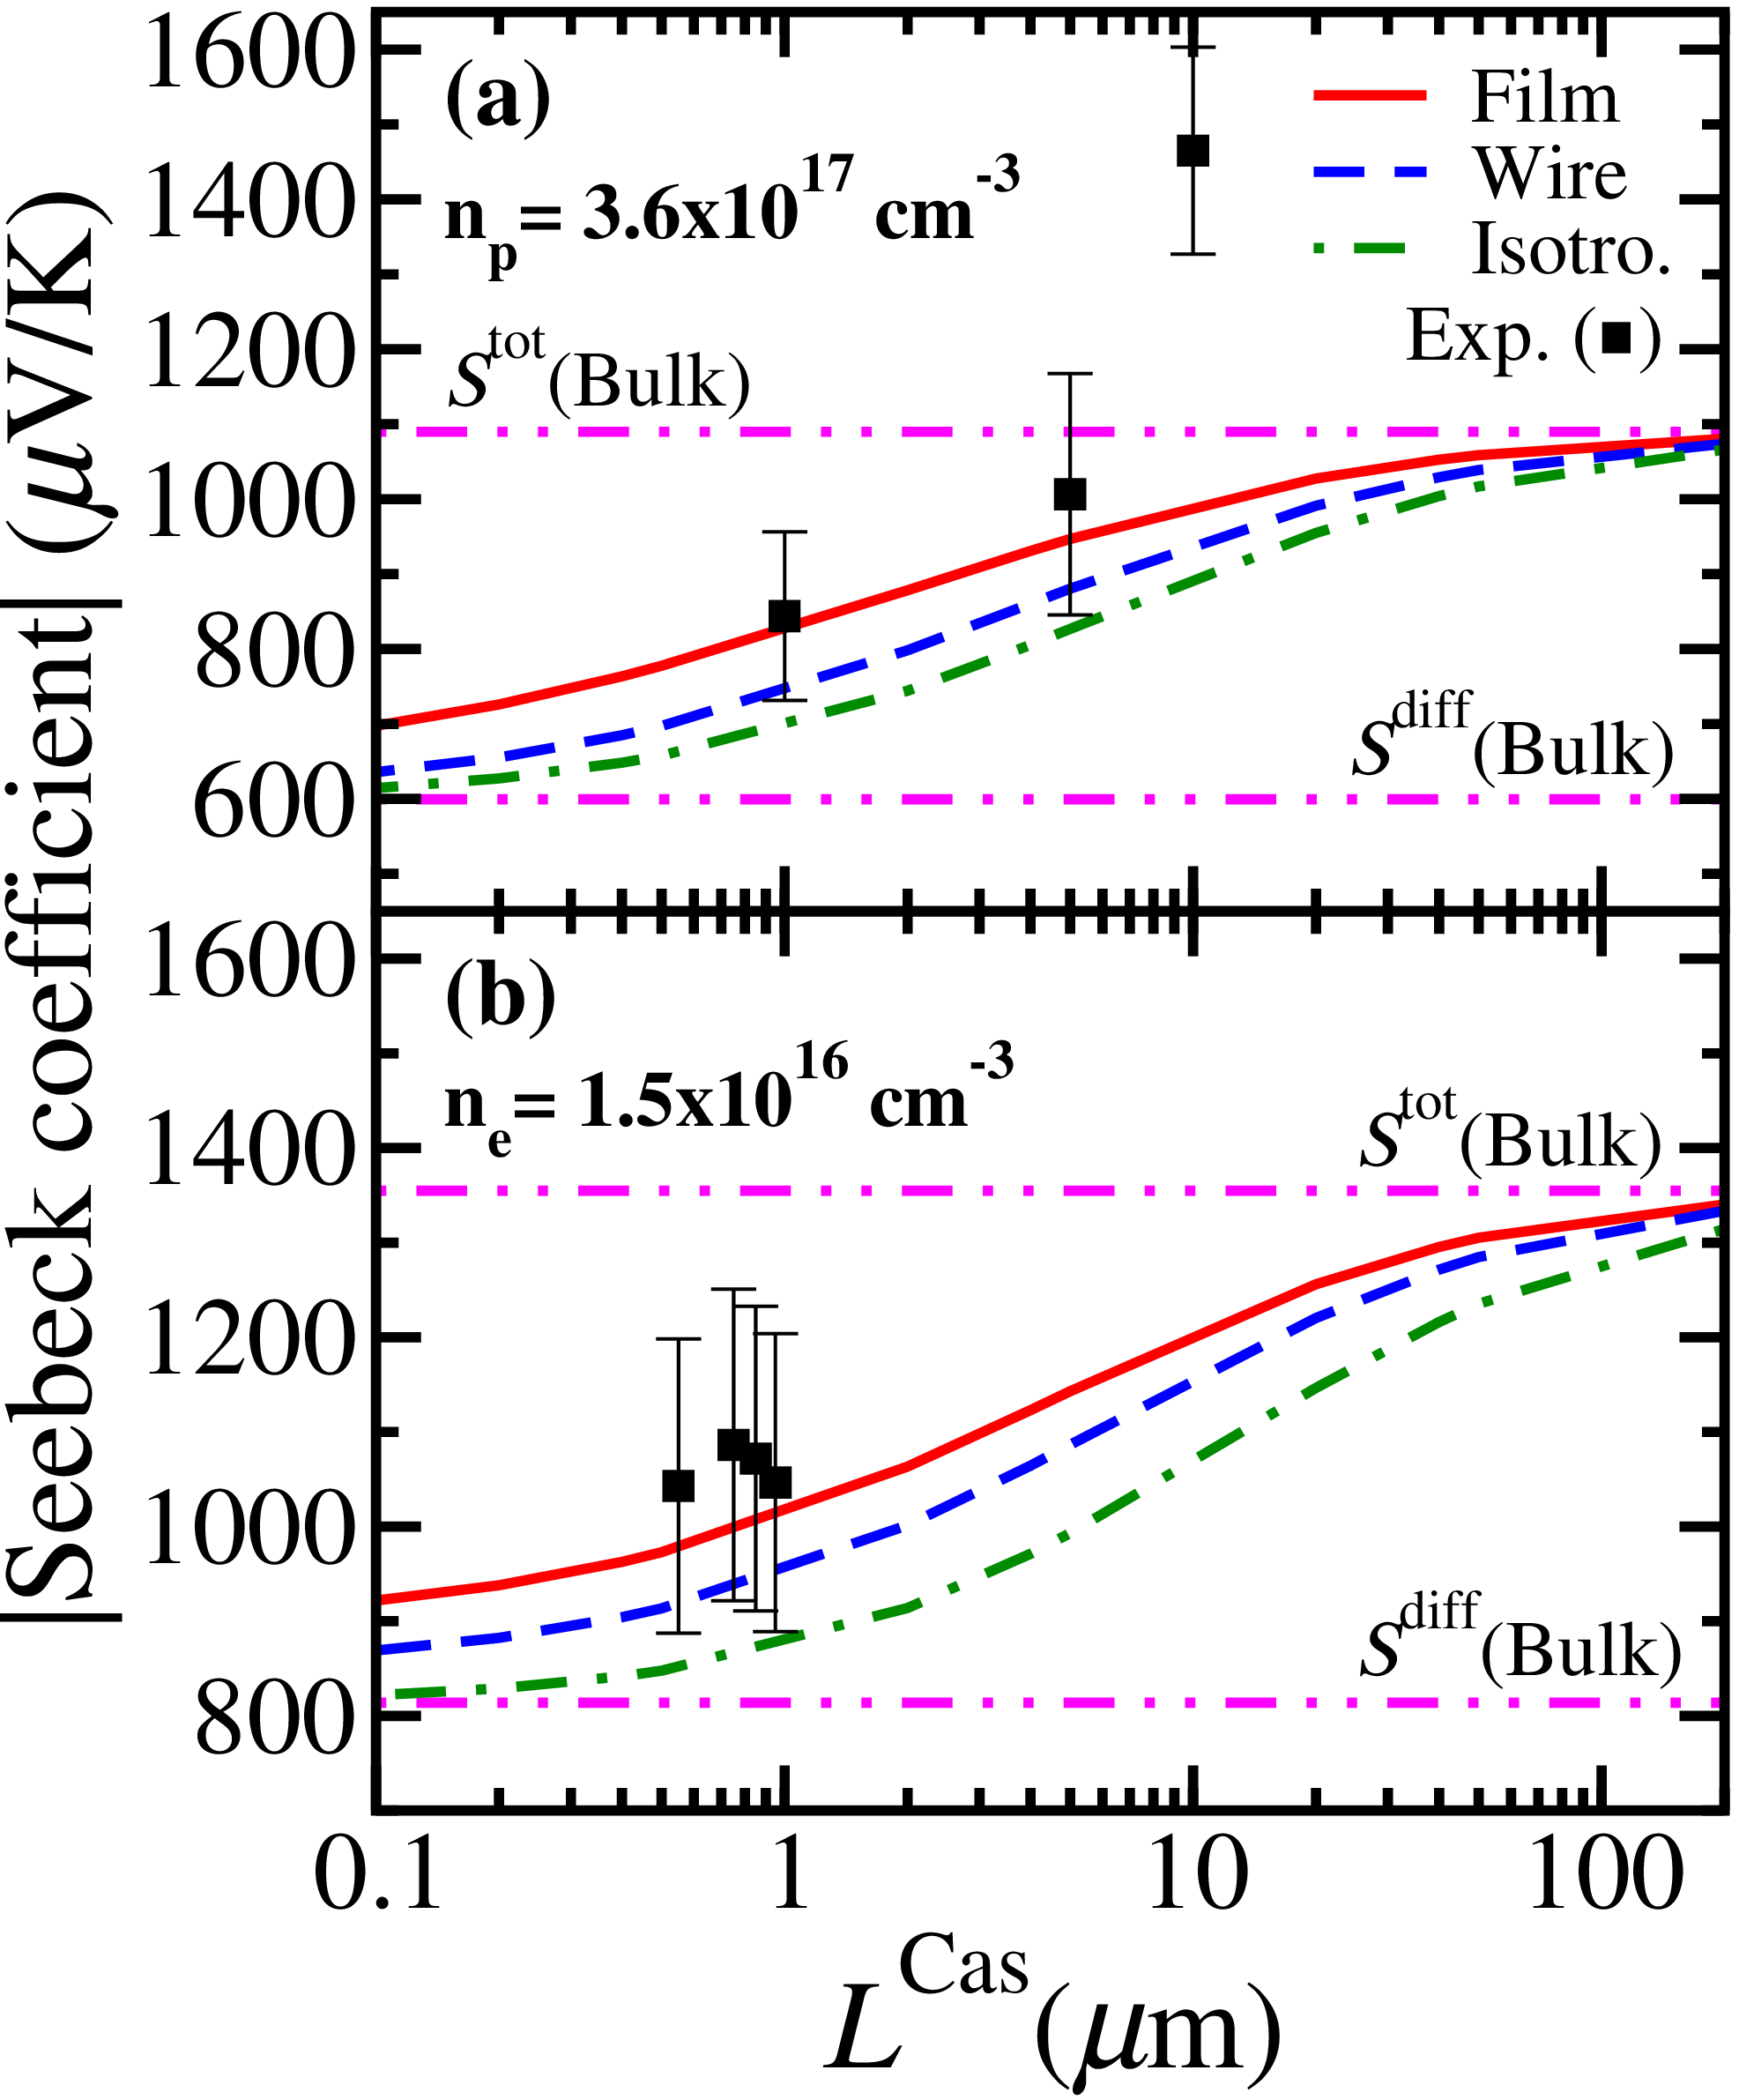
PHONON DRAG IN Si NANOSTRUCTURES
300 K
Geometry and direction dependence
At 100 nm, phonon drag still not completely quenched
Agreement with experiment. But caution!
K. Fauziah et al., AIP Adv. 10, 075015 (2020).
R. Sen, N. Vast, and J. Sjakste, Phys. Rev. B 108, L060301 (2023)
N. Bennett et al., Appl. Phys. Lett. 107, 013903 (2015).
14

Slide 15
Conclusion
Direction-dependent phonon drag term implemented into EPW code
Spin-orbit coupling plays important role for hole phonon drag in Si
At 100 nm, phonon drag still not completely quenched in thin films and nanowires for in-plane transport direction at 300 K.
Calculations help to disentangle phonon drag effect from other ones

Slide 16
Thank you for your attention!

Slide 17
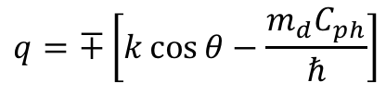
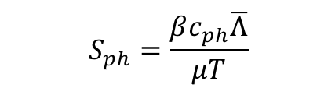
Phonon-drag in Silicon nanostructures:
$$S_{ph}=\frac{βc_{ph}\overline{Λ}}{μT}$$
C. Herring. Phys. Rev. 96, 1163 (1954)
$$q=∓\left[k\cos{θ−\frac{m_{d}C_{ph}}{ℏ}}\right]$$
Jacoboni et al. Rev. Mod. Phys. 55, 645 (1983)
q: phonon momentum
Only zone centered acoustical phonons are responsible for the phonon-drag Seebeck.

Slide 18
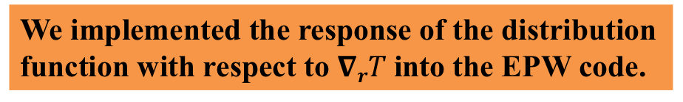
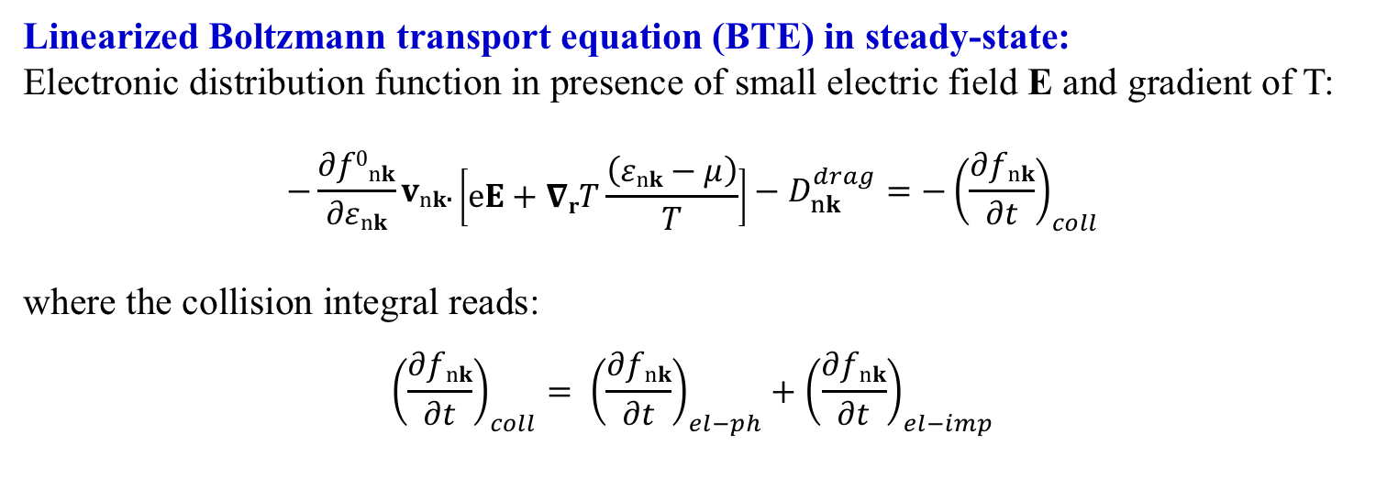
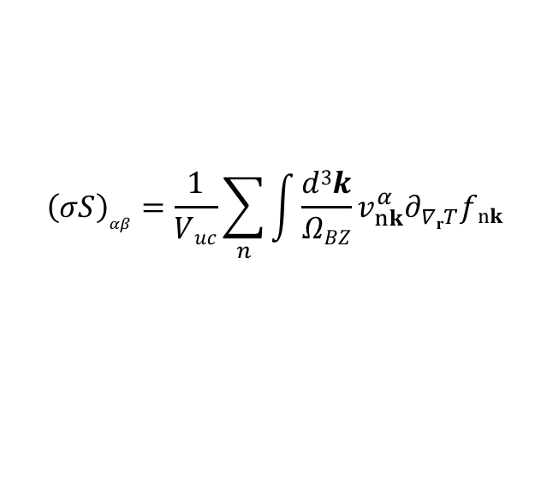
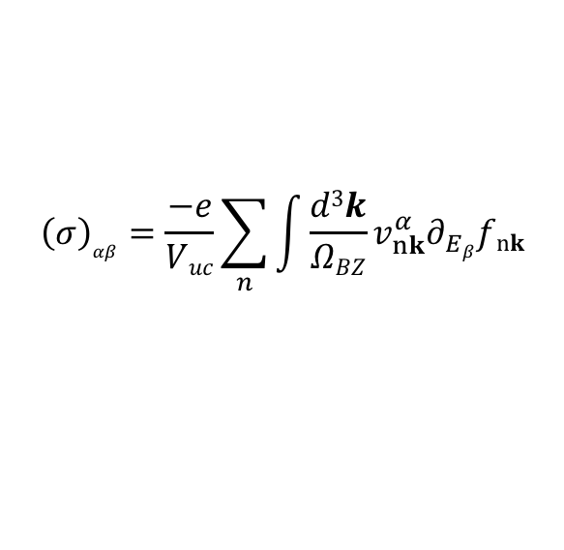
Ab initio study of transport coefficients:
Linearized Boltzmann transport equation (BTE) in steady-state:
Electronic distribution function in presence of small electric field E and gradient of T:
$$−\frac{∂f0nk}{∂εnk}vnk.\left[eE+∇rT\frac{\left(εnk−μ\right)}{T}\right]−D_{nk}^{drag}=−{\left(\frac{∂fnk}{∂t}\right)}_{coll}$$
where the collision integral reads:
$${\left(\frac{∂fnk}{∂t}\right)}_{coll}= {\left(\frac{∂fnk}{∂t}\right)}_{el−ph}+{\left(\frac{∂fnk}{∂t}\right)}_{el−imp}$$
$${\left(σ\right)}_{αβ}=\frac{−e}{Vuc}\sum_{n}{\int{\frac{d3k}{ΩBZ}}}v_{nk}^{α}∂_{Eβ}fnk$$
Conductivity:
Thermopower:
$${\left(σS\right)}_{αβ}=\frac{1}{Vuc}\sum_{n}{\int{\frac{d3k}{ΩBZ}}}v_{nk}^{α}∂_{∇rT}fnk$$
We implemented the response of the distribution function with respect to $∇rT$into the EPW code.

Slide 19
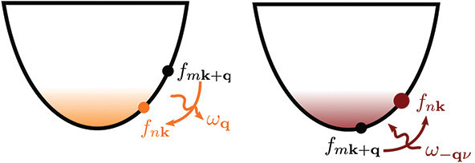
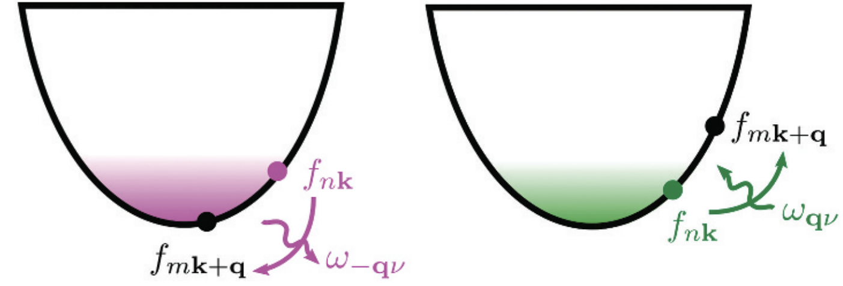
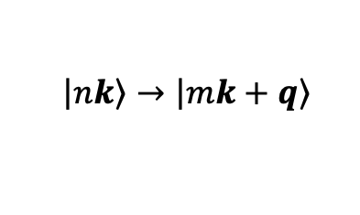
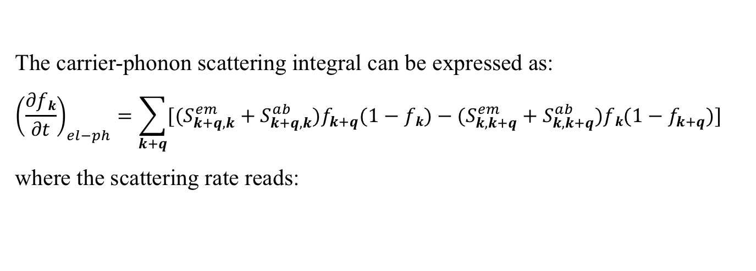
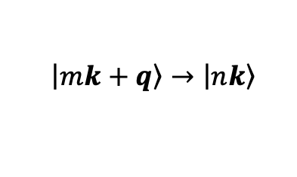
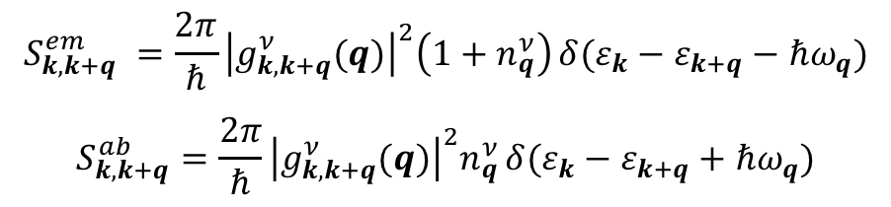
Electron-phonon scattering process:
Schematic representation of the four phonon-assisted scattering processes:
$$\left.\left|m\right.k+q\right\rangle →\left.\left|n\right.k\right\rangle$$
$$\left.\left|n\right.k\right\rangle →\left.\left|m\right.k+q\right\rangle$$
Poncé et al. Rep. Prog. Phys. 83, 036501 (2020)
The carrier-phonon scattering integral can be expressed as:
$${\left(\frac{∂fk}{∂t}\right)}_{el−ph}=\sum_{k+q}{[(S_{k+q,k}^{em}+S_{k+q,k}^{ab})f_{k+q}(1−fk)−(S_{k,k+q}^{em}+S_{k,k+q}^{ab})fk(1−f_{k+q})]}$$
where the scattering rate reads:
$$S_{k,k+q}^{em} =\frac{2π}{ℏ}{\left|g_{k,k+q}^{ν}(q)\right|}^{2}\left(1+n_{q}^{ν}\right) δ(ε_{k}−ε_{k+q}−ℏω_{q})$$
$$S_{k,k+q}^{ab}=\frac{2π}{ℏ}{\left|g_{k,k+q}^{ν}(q)\right|}^{2}n_{q}^{ν} δ(ε_{k}−ε_{k+q}+ℏω_{q})$$

Slide 20
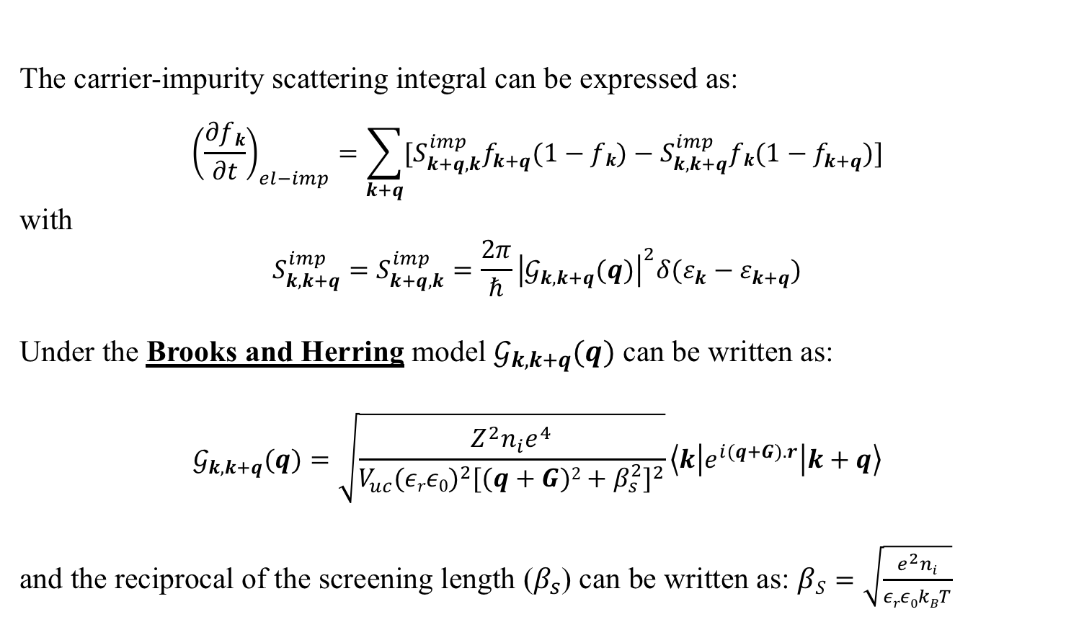
Electron-impurity scattering process:
The carrier-impurity scattering integral can be expressed as:
$${\left(\frac{∂fk}{∂t}\right)}_{el−imp}=\sum_{k+q}{[S_{k+q,k}^{imp}f_{k+q}(1−fk)−S_{k,k+q}^{imp}fk(1−f_{k+q})]}$$
with
$$S_{k,k+q}^{imp}=S_{k+q,k}^{imp}=\frac{2π}{ℏ}{\left|𝒢_{k,k+q}(q)\right|}^{2}δ(ε_{k}−ε_{k+q})$$
Under the Brooks and Herring model $𝒢_{k,k+q}(q)$ can be written as:
$$𝒢_{k,k+q}(q)=\sqrt{\frac{Z^{2}n_{i}e^{4}}{V_{uc}{(εrε0)}^{2}{[(q+G)2+β_{s}^{2}]}^{2}}}\left\langle k | e^{i(q+G).r} | k+q\right\rangle$$
and the reciprocal of the screening length ($β_{s}$) can be written as: $βS=\sqrt{\frac{e^{2}ni}{εrε0kBT}}$
Fiorentini et al. Phys. Rev. 94, 085204 (2016)
We implemented the impurity scattering model into the EPW code.
Jacoboni et al. Rev. Mod. Phys. 55, 645 (1983)

Slide 21
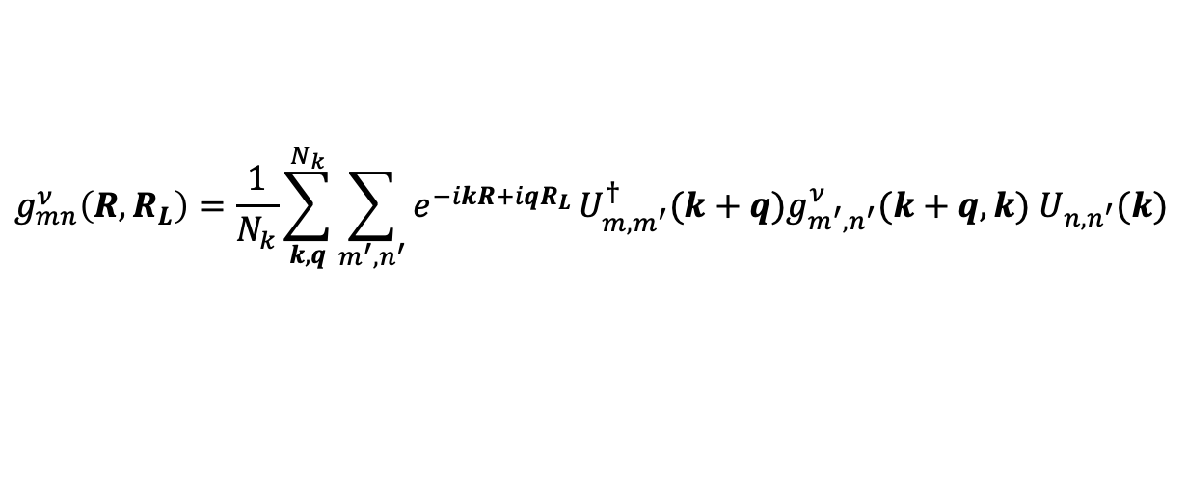


Interpolation of electron-phonon matrix element:
Giustino et al. Phys. Rev. B 76, 165108 (2007)
$$C_{kαk^{′}β}(q)$$
Verdi et al. Phys. Rev. Lett. 115, 176401 (2015)
$$g_{mn}^{ν}(k,q)$$
W90
MLWF
MLWF
Coarse k/q mesh
Dense k/q mesh
Real Space
Real to Bloch space
(Inverse Fourier transform.)
$$g_{mn}^{ν}\left(R,R_{L}\right)=\frac{1}{N_{k}}\sum_{k,q}^{N_{k}}{\sum_{m^{′}{,n}^{′}}{e^{−ikR+iqR_{L}}}U_{m,m^{′}}^{†}(k+q)g_{m^{′},n^{′}}^{ν}(k+q,k) U_{n,n^{′}}(k)}$$
Bloch to Real space (Fourier transform.)
Sjakste et al. Phys. Rev. B 92, 054307 (2015)

