Slide 1




synthesis of doped Molybdenum (oxy)nitride or carbide nanocomposites by Laser pyrolysis for electrochemical H₂ evolution reaction
P. Lonchambon¹, S. Surble¹, N. Herlin¹
G. Dubois², P. Badaki^{1,2}, F. Tessier², C. Lagrost²
F. Grasset³
¹ CEA, CNRS, NIMBE, Université Paris-Saclay
² ISCR UMR6226, Rennes
³ LINK IRL3629, Tsukuba

Slide 2
Outline
Context :
Synthesis and characterizations : laser pyrolysis method
preliminary HER measurements

Slide 3
Context : Hydrogen Evolution Reaction
H₂ is of major interest for energy transition
A promising strategy for production of “clean H₂“ : electrochemical water splitting
Need for the development of efficient catalysts
- the most efficient : Pt
- possible alternatives ? Mo based catalysts

Slide 4
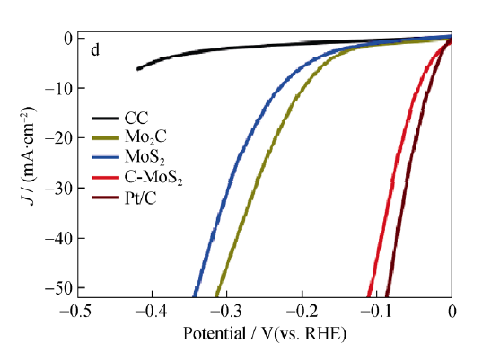
Context : Hydrogen Evolution Reaction
H₂ is of major interest for energy transition
A promising strategy for production of “clean H₂“ : electrochemical water splitting
Need for the development of efficient catalysts
- the most efficient : Pt
- possible alternatives ? Mo based catalysts
polarization curves
Carbon sheet
Mo based materials
Mo based materials in carbon
Pt
Interest pour Molybdenum carbide
Dispersion in carbon materials
W. Hua et al., A review and perspective on molybdenum-based electrocatalysts for hydrogen evolution reaction, Rare Met. 2020, 39, 335.

Slide 5
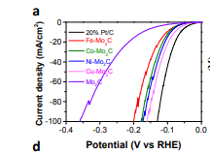
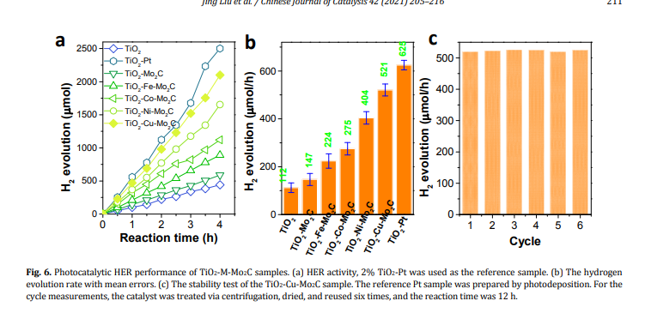
Context : Hydrogen Evolution Reaction using Mo based materials
Tested materials : Mo carbide , M doped Mo carbide M =Fe, Co, Ni, Cu
Polarization curves
Hydrogen production
Stability test (M=Cu)
Direct synthesis of : Mo based materials dispersed in carbon ?
M doped Mo based materials dispersed in carbon ?
J. Liu et al., Metal-doped Mo2C (metal = Fe, Co, Ni, Cu) as catalysts on TiO2 for photocatalytic hydrogen evolution in neutral solution, Chinese J. Catal. 2021, 42, 205

Slide 6
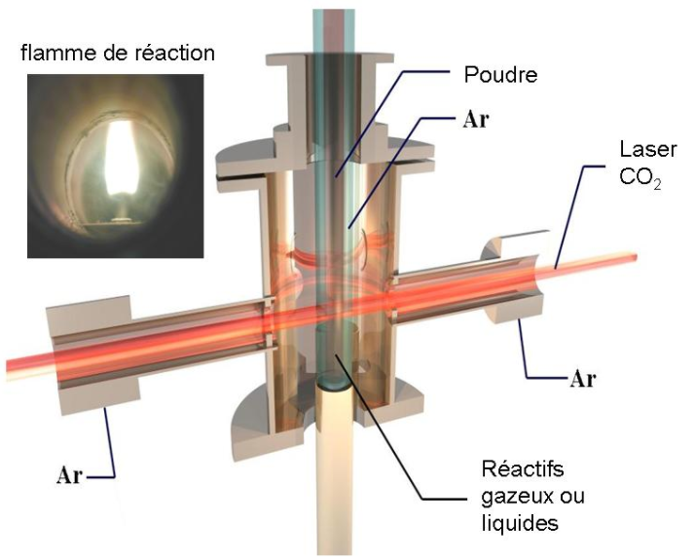
Synthesis method : Laser synthesis
Flame reaction
Nanopowder
Parameters
- Choice of precursor : composition
- Laser power
-> temperature
-> cristallinity
Reactant flow
-> time of residence
-> size
Advantage :
« continuous » method
Carrier gas
CO₂ laser
Confinement gas
Gas
Liquid and/or gaseous precursors
Juliette Karpiel

Slide 7
Synthesis method : Laser synthesis
This study
Flame reaction
Nanopowder
Carrier gas
Temperature :
- Laser Power
- addition of a « sensitizer » gaz
C₂H₄ : increases temperature
source of Carbon
NH₃ : increase temperature
reducing effect
incorporation of N
Choice of precursor : composition
aqueous solution of
(NH₄)₆Mo₇O₂₄.4H₂O
CO₂ laser
Confinement gas
Gas
Liquid and/or gaseous precursors
Juliette Karpiel

Slide 8
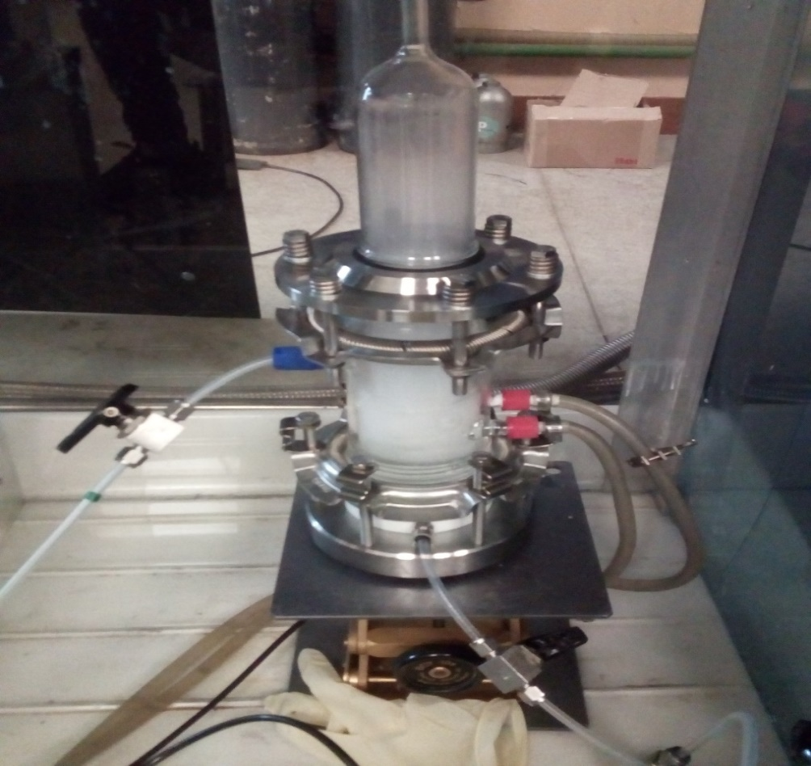
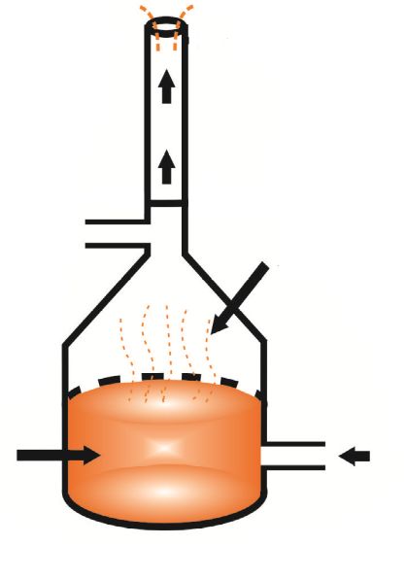
Synthesis method : Laser synthesis
Preparation of precursors (Mo, Ni) suspension
Laser pyrolysis
Annealing
Aerosol
droplets
Precursors
(NH₄)₆Mo₇O₂₄.4H₂O +
Ni(acetate) or Ni(nitrate)
Carrier gas
Aerosol of precursors : Pyrosol device
Juliette Karpiel

Slide 9
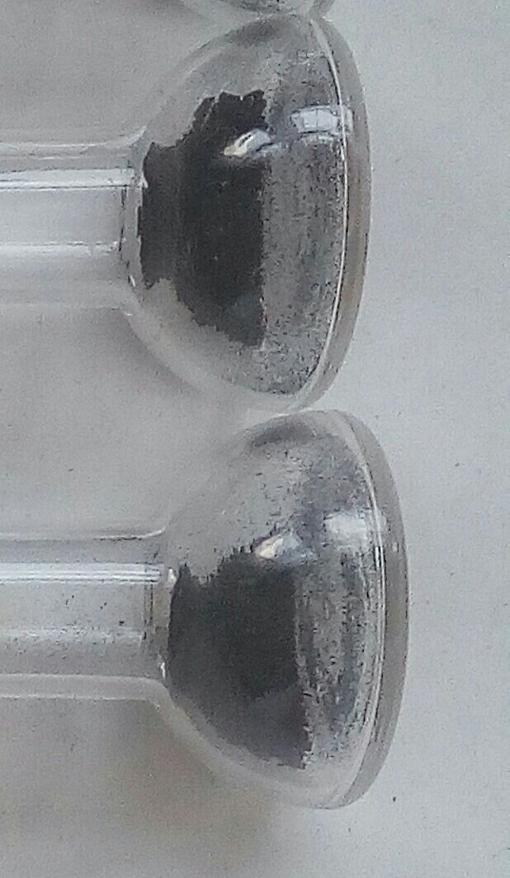
Synthesis of Molybdenum carbide
MOCs | Débit C2H4 (ccm) | Débit NH3(ccm) | Production horaire (mg/h) | % C
15 | 100 | 0 | 397 | 83,52
17 | 100 | 100 | 298 | 70,67
NH3 decreases production rate and C content
Nano poudre de carbure de molybdène

Slide 10
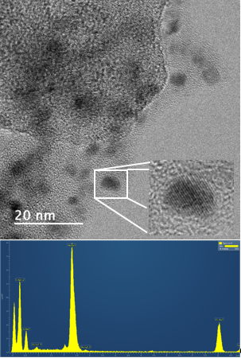
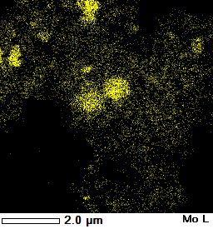
Synthesis of Molybden carbide : STEM and EDX analysis
Yellow = molybden
Particles + dispersed Mo
% massique O | % massique N
5,8% | 0,7%
Crystallized nanoparticles in an amorphous phase

Slide 11
Synthesis of Molybden carbide : DRX
One oxide MoO2 phase +
two MoC et α-Mo2C
carbide phases
MoO2
MoC
Mo2C

Slide 12
What about Ni « doped » samples ?
Echantillons | Dopage | gaz réducteurs | m_{récoltée} (mg/h) | Produit obtenu (DRX) | Teneur en C (%) | % NI
MOC21 | Non | C₂H₄ seul | 357 | Mélange MoO2 (mono) + α-Mo2C (hexa) + η-MoC (cub) | 77,15
MOC22 | Non | C₂H₄ + NH₃ | 200 | Mélange MoO2 (mono) + α-Mo2C (hexa) + η-MoC (cub) | 60,87
MOC25 | Nitrate de Ni | C₂H₄ seul | 275 | Mélange MoO2 (mono) + α-Mo2C (hexa) + η-MoC (cub) | 61,58
MOC26 |  | C₂H₄ + NH₃ | 151,3 | Mélange MoO2 (mono) + α-Mo2C (hexa) + η-MoC (cub) | 45,82
MOC27 | Acétate de Ni | C₂H₄ seul | 350 | Mélange MoO2 (mono) + α-Mo2C (hexa) + η-MoC (cub) | 70,38
MOC28 |  | C₂H₄ + NH₃ | 156,7 | Mélange MoO2 (mono) + α-Mo2C (hexa) + η-MoC (cub) | 43,89 | 0.55 %
Addition of Ni precursor decreases the C content
Ni present in the powder

Slide 13
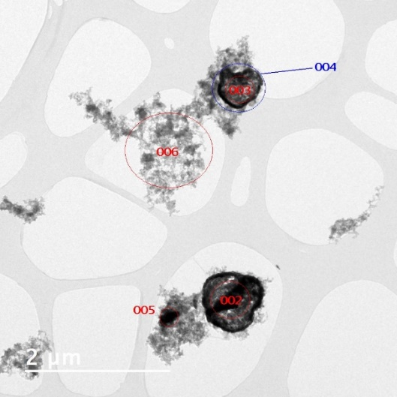
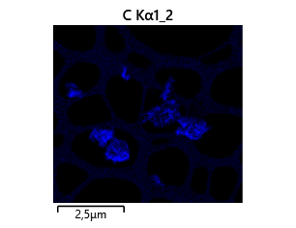
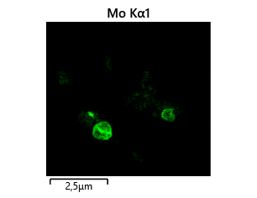
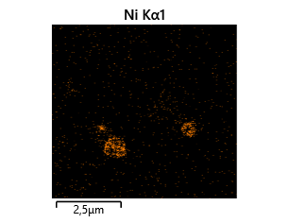
Ni « doped » samples : EDX analysis
Ni and Mo appear
co-localized

Slide 14
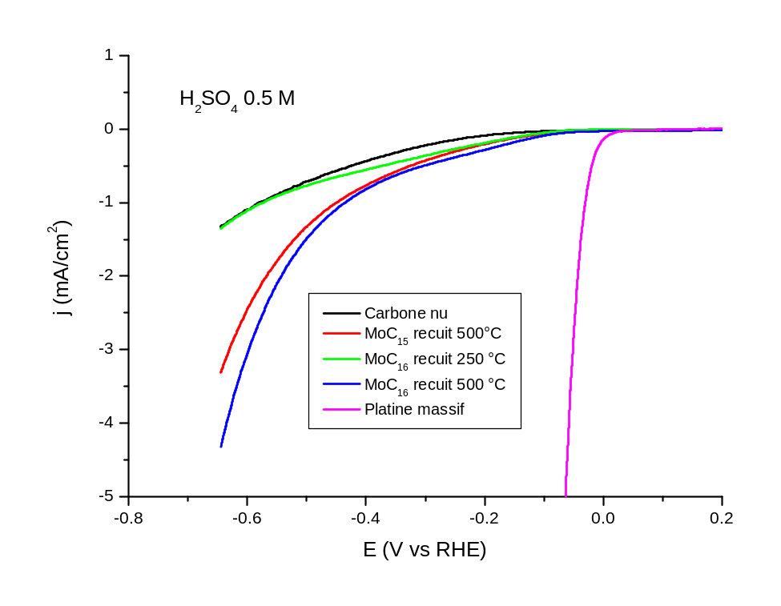
Molybdenum carbide : preliminary HER results
The materials are activ ! However some room for improvement…
Doped materials to be tested

Slide 15


Thank you for attention!

Slide 16
Molybden carbide : electrochemical measurements (literature)

Slide 17
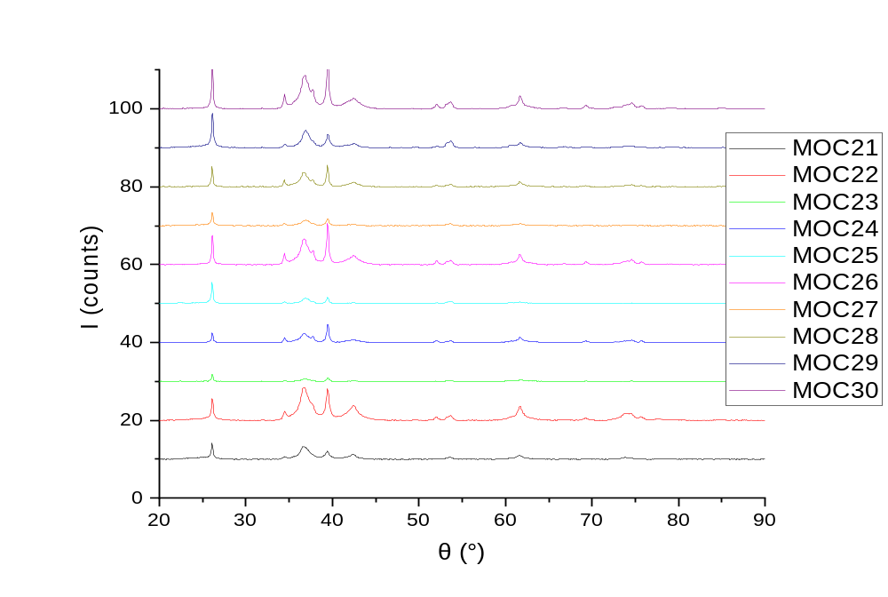
2/ Caractérisation des carbures de molybdène par pyrolyse laser.
DRX MOCs :

Slide 18
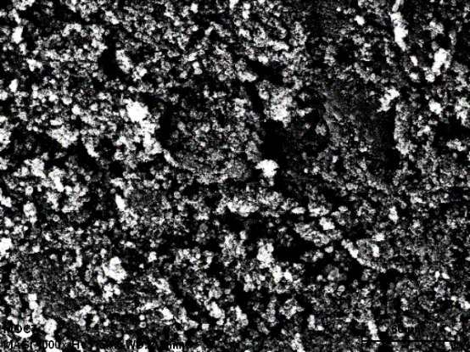
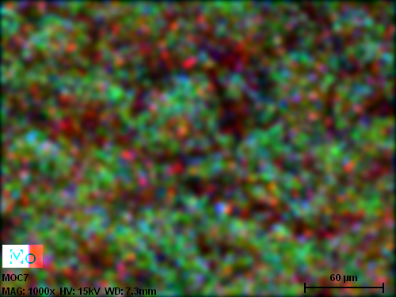
Context : HER
O : bleu
Mo : Rouge
C : vert

Slide 19
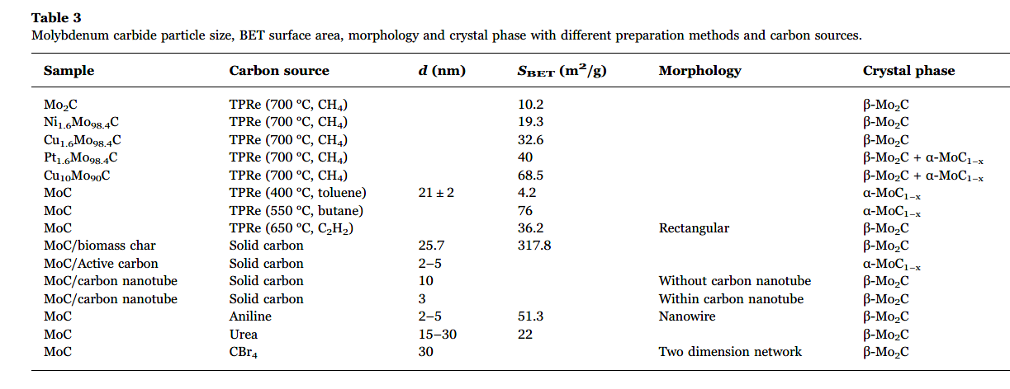
Molybden carbide : synthesis methods
Y. Ma et al., Molybdenum carbide as alternative catalyst for hydrogen production – A review, Renew. Sustain. Energy Rev. 2017, 75, 1101.

Slide 20
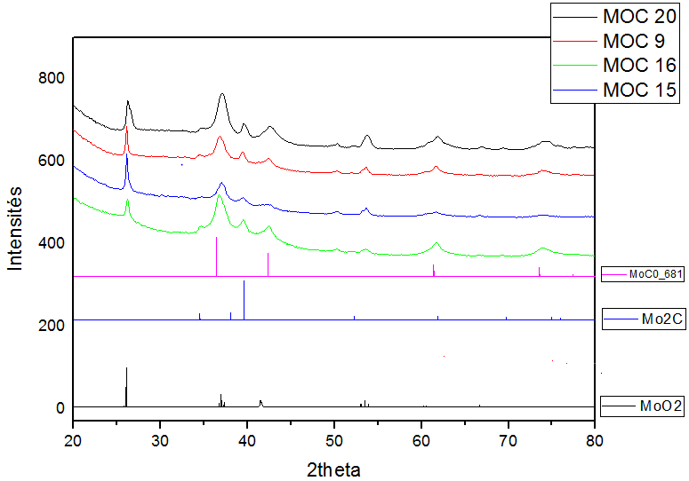
Diffraction des rayon x
Présence de deux phases de carbures identifié à 39° et 43° et une phase d’oxyde
Identifié à 26°.
Le rapport des pics indique que le MOC 15 contient plus de d’oxyde que le MOC16

Slide 21
Echantillons | Réactifs | Dopage | gaz réducteurs | m_{consommée} (g) | m_{récoltée} (mg/h) | Produit obtenu (DRX) | Teneur en C (%) | Masse Mo entrainée (g)
MOC21 | AHM+urée | Non | C₂H₄ seul | 81,0 (mais fuite entre pyrosol et bouteille) | 357 | Mélange MoO2 (mono) + α-Mo2C (hexa) + η-MoC (cub) | 77,15 | 44,0 mais pas possible
MOC22 |  | Non | C₂H₄ + NH₃ |  | 200 | Mélange MoO2 (mono) + α-Mo2C (hexa) + η-MoC (cub) | 60,87
MOC23 |  | Nitrate de Co | C₂H₄ seul | 16,8 | 364 | Mélange MoO2 (mono) + α-Mo2C (hexa) + η-MoC (cub) | 71,34 | 9,13
MOC24 |  |  | C₂H₄ + NH₃ |  | 167,3 | Mélange MoO2 (mono) + α-Mo2C (hexa) + η-MoC (cub) | 51,86
MOC25 |  | Nitrate de Ni | C₂H₄ seul | 17,0 | 275 | Mélange MoO2 (mono) + α-Mo2C (hexa) + η-MoC (cub) | 61,58 | 9,24
MOC26 |  |  | C₂H₄ + NH₃ |  | 151,3 | Mélange MoO2 (mono) + α-Mo2C (hexa) + η-MoC (cub) | 45,82
MOC27 |  | Acétate de Ni | C₂H₄ seul | 14,6 | 350 | Mélange MoO2 (mono) + α-Mo2C (hexa) + η-MoC (cub) | 70,38 | 7,93
MOC28 |  |  | C₂H₄ + NH₃ |  | 156,7 | Mélange MoO2 (mono) + α-Mo2C (hexa) + η-MoC (cub) | 43,89
MOC29 |  | Acétate de Co | C₂H₄ seul | 17,8 | 339 | Mélange MoO2 (mono) + α-Mo2C (hexa) + η-MoC (cub) | 71,42 | 9,67
MOC30 |  |  | C₂H₄ + NH₃ |  | 150,7 | Mélange MoO2 (mono) + α-Mo2C (hexa) + η-MoC (cub) | 44,85

